Slide 1
Year 3 Home learning! English
Week Commencing: 16th November 2020

Slide 2
This week..
Day 1: Grammar- Suffixes
Day 2: Non-Fiction Texts
Day 3: Learning about Iceland
Day 4: Iceland continued…
Day 5: Persuading your audience to visit Iceland

Slide 3
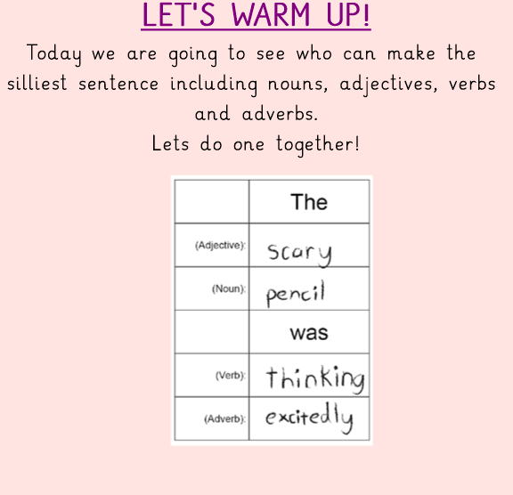
Day 1- Grammar

Slide 4
Day 1- Grammar

Slide 5
Day 1- Grammar

Slide 6
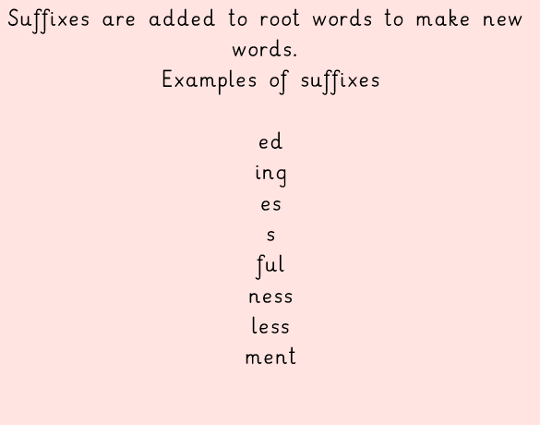
Day 1- Grammar

Slide 7
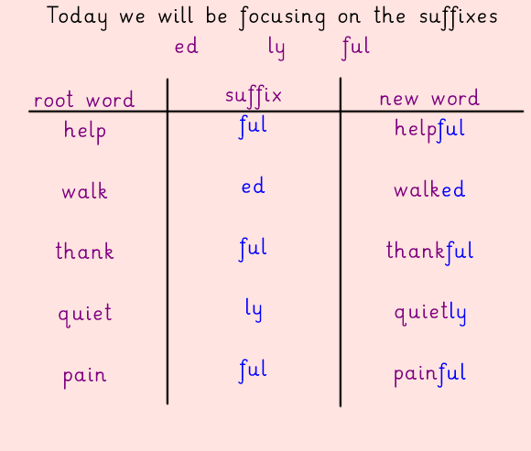

Slide 8
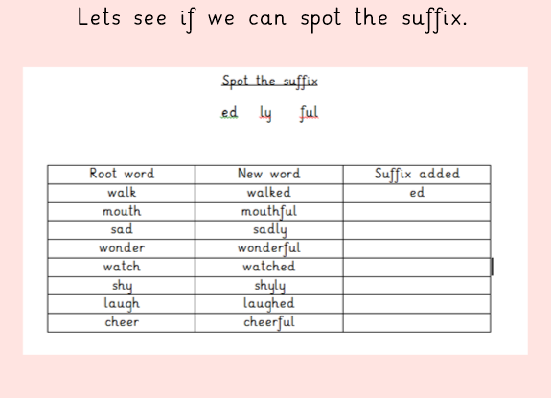
Day 1- Grammar
First Task!

Slide 9
Day 1- Grammar
Lets see if you were right!
ful
ly
ful
ed
ly
ed
ful

Slide 10
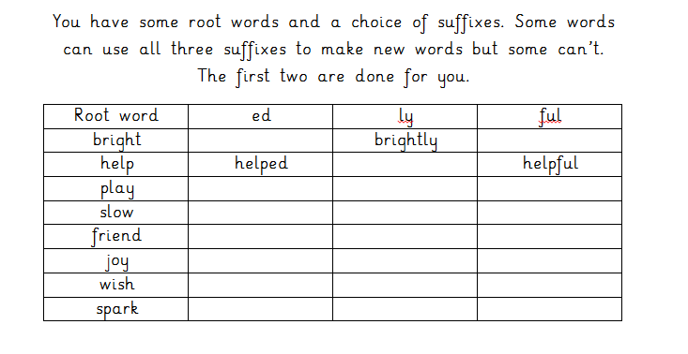
Day 1- Grammar
Second Task

Slide 11
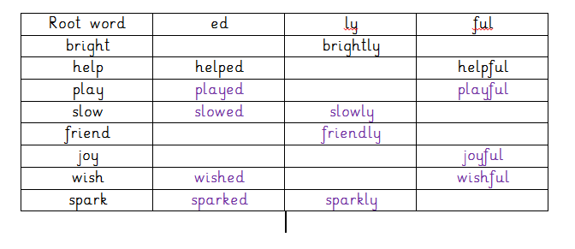
Day 1- Grammar
Lets see if you were correct!

Slide 12
Day 2
Reading Comprehension!
Task 1- Read the book
Task 2- Answer the questions! Today you are going to read a book and answer questions about the text ‘When Animals Attack (Pages 12-25)
You can access the text via bugclub using your login details!
Click the image below to follow the link!

Slide 13
Day 2- Reading Comprehension- Task 1
CLICK ME FOR A REMINDER
I hope you enjoyed finished reading all about ‘Animals that attack’
In your home learning book, answer the questions below.
How does this book inform the readers?
What are two facts that you have learnt?

Slide 14
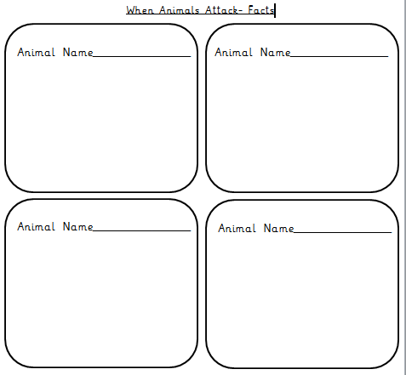
Day 2- Task 2
Today you are going to choose 4 animals of your choice from the book and write at least 3 facts for each of them using the information from the text.

Slide 15
Day 3

Slide 18
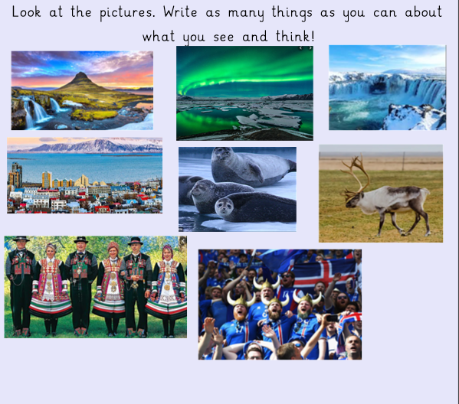

Slide 19
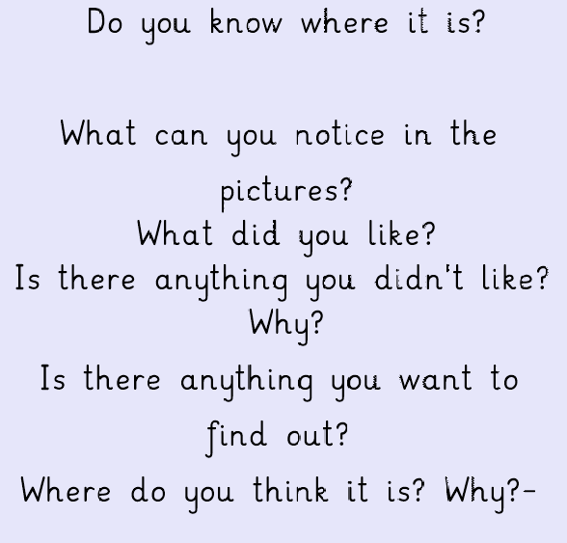

Slide 20
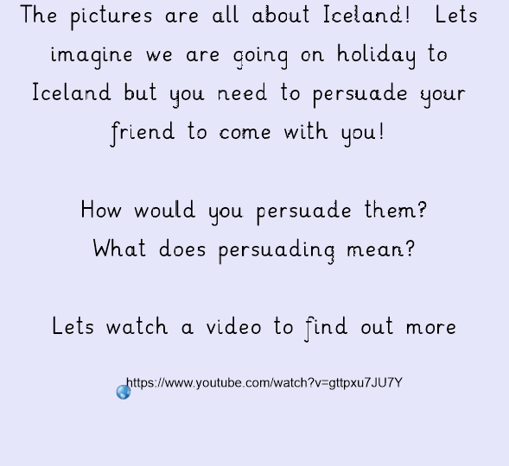

Slide 21
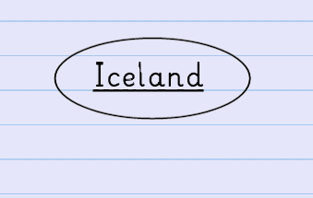
Your task for today is to create a spider diagram including all the facts you have learnt about Iceland

Slide 22
Day 4

Slide 23
Yesterday you learnt all about Iceland and created a spider diagram with all the facts.
Today you are going to be looking at persuasive writing and how to encourage people to visit Iceland.
What do you think persuasive means?

Slide 24
Definition of persuasion…

Slide 26
https://www.youtube.com/watch?v=bR5zVo0BHV8
://www.youtube.com/watch?v=3uY5HbuPSEw

Slide 27
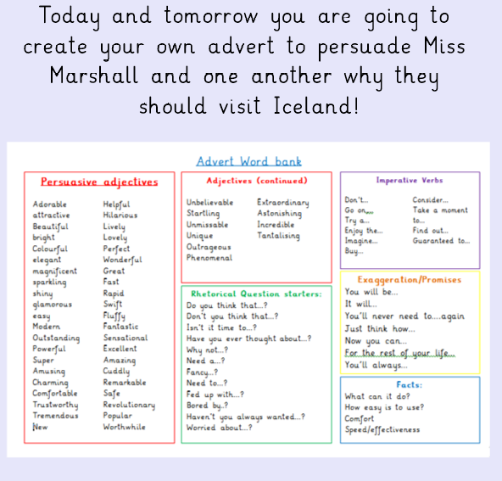

Slide 28
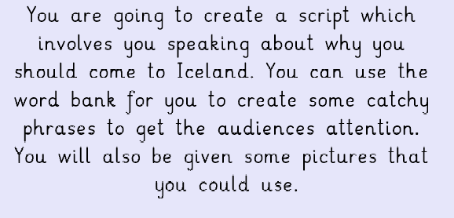

Slide 29
Your task for today is to write 5 catchy phrases you could use to encourage and persuade people to visit Iceland. You can use your notes from earlier on in the week to help you.
Example…..
Come to Iceland because you won’t want to miss out on all the fun!

Slide 30
Day 5

Slide 31
Yesterday you used all the facts you had learnt about Iceland so far to create some persuasive phrases to encourage people to visit Iceland!
Today your task is to create a short script that you can perform to someone at home to try persuade them to come to Iceland!!!

Slide 32
Remember to use expression and actions to really get your audiences attention! Remember to use adjectives to make it interesting!
Example…
Have you been bored recently? Do you want an amazing adventure that will take your breathe away?
Then you need to visit ICELAND!
Iceland is full of AMAZING scenic places to visit including the incredible Blue Lagoon!

