Slide 1
Year 3 Home learning! English
Week Commencing: 2nd November 2020

Slide 2
This week..
Day 1: Grammar- Verbs
Day 2: Non-Fiction Texts
Day 3: What we did in the holidays
Day 4: Introduction to our new book.
Day 5: Description of our new book and characters.

Slide 3
Day 1- Grammar

Slide 4
Day 1- Grammar

Slide 5
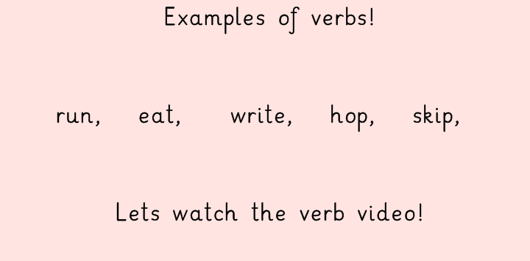
Day 1- Grammar
https://www.bbc.co.uk/bitesize/topics/zrqqtfr/articles/zpxhdxs

Slide 6
Day 1- Grammar
First Task!

Slide 7
Day 1- Grammar

Slide 8
Day 1- Grammar

Slide 9
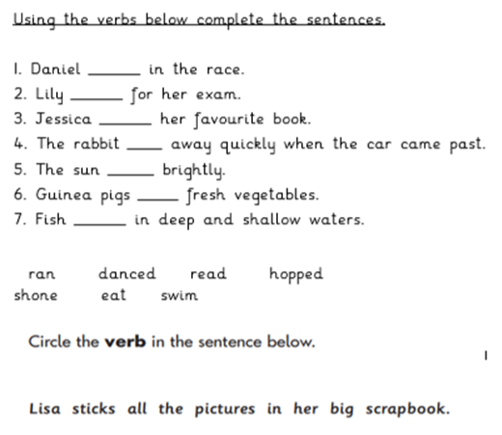
Day 1- Grammar
Second Task!

Slide 10
Day 1- Grammar
Lets see if you were right!
ran
danced
read
hopped
shone
eat
swim

Slide 11
Day 2
Reading Comprehension!
Task 1- Read the book
Task 2- Answer the questions! Today you are going to read a book and answer questions about the text ‘Hot Spots’
You can access the text via bugclub using your login details!
Click the image below to follow the link!

Slide 12
Day 2- Reading Comprehension- Task 1
CLICK ME FOR A REMINDER
I hope you enjoyed reading all about ‘Hot Spots’
In your home learning book, answer the questions below.
Is this book fiction or non-fiction?
What would you see if you looked down on Earth from the sky?

Slide 13
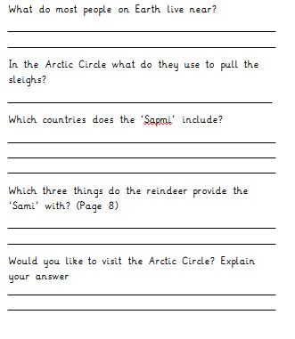
Day 2- Reading Comprehension- Task 2

Slide 14
Day 3

Slide 15
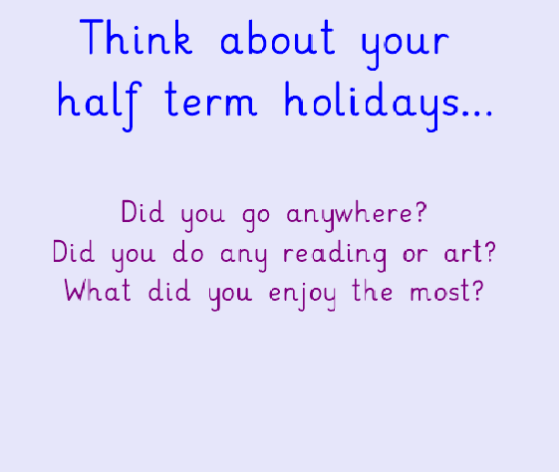
Today you are going to be writing a paragraph about what you did in the holidays!

Slide 16
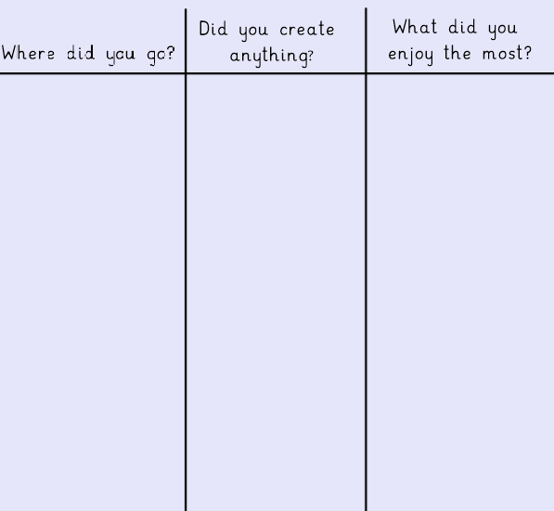
In your work book make a table like this with 3 columns and write a list under each of the columns.

Slide 17
Now you are going to write a paragraph about your holidays. You can illustrate it with a picture afterwards!

Slide 18
Day 4

Slide 19
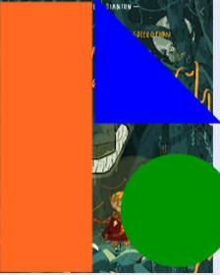
In English we are starting a new topic. Below you will see a picture of our new story with some bits cut out. I want you to write down as many ideas of what you think our new book is about….

Slide 20
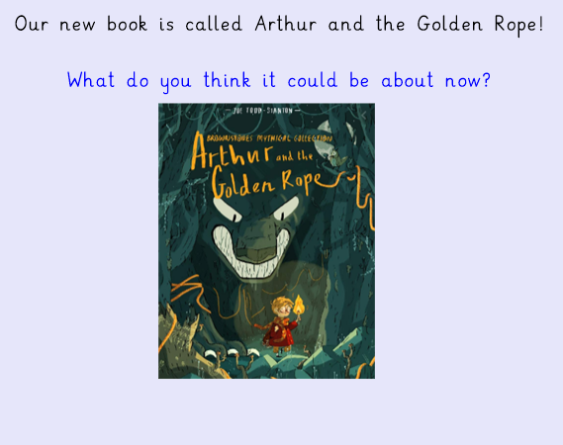
Shall we see if your ideas were right?

Slide 21
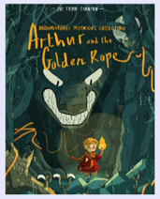
Todays Task!
Your task for today is to describe the cover of our new book using adjectives. After you have done this you need to write sentences including your adjectives and also your writers tools including capital letters, full stops and conjunctions.

Slide 22
dark
gloomy
I can see a gloomy and dark room with lots of frightening features such as a monster with white, piercing eyes.

Slide 23
Day 5

Slide 24
Yesterday you looked at our new story and described the cover of our new book using our writers tools.
Today you are going to be describing our new character Arthur!
What does he look like?
What is he doing?
What do you think he’s like?

Slide 25
Remember to use your writers tools!
Arthur is a tiny boy who is wearing a shiny, long cloak.

