Slide 1
English Home Learning
Week Beginning 30.11.20

Slide 2
This week…
Day 1 – Grammar – Capital letters
Day 2 – Handwriting
Day 3 – Comprehension - Bug Club
Day 4 – Adjectives and Extended Noun Phrases to describe
Day 5 – Setting Description

Slide 3
Day 1 – Recap

Slide 4
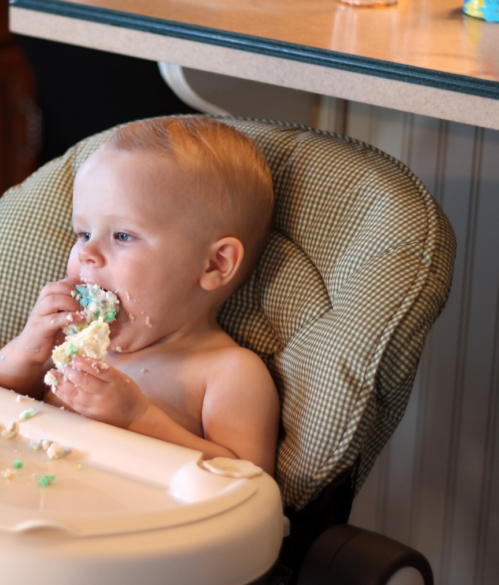
Day 1 – Capital Letters
Where should we use capital letters in our writing?
Capital letters are always used to start sentences
He loves to eat cake!

Slide 5
Day 1 – Capital letters – Proper nouns.
Nouns are naming words.
Proper nouns are naming words for individual people, places, days of the week and months of the year.
Proper nouns all need capital letters.
Common Nouns | Proper Nouns
girl | Helen
country | Australia
city | New South Wales
soccer team | Daintree Rainforest
day/month | Friday/February
Can you think of any sentences for these proper nouns?

Slide 6
Activity - Knowledge check

Slide 7
Activity - Knowledge check Answers

Slide 8
The Personal Pronoun ‘I’
The personal pronoun ‘I’ always needs a capital letter
I can tell the time
Can you think of any more sentences?

Slide 9
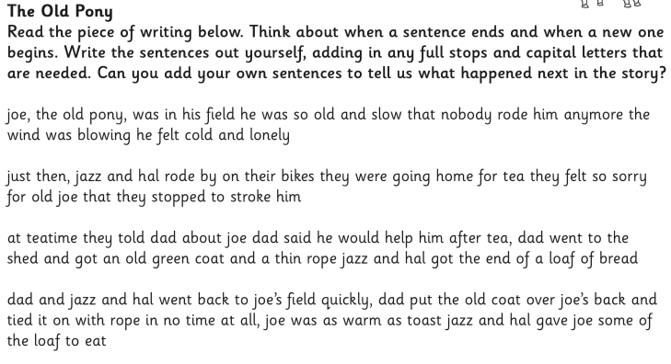
Main Task – Capital Letters
it is always snowing in iceland.
i like going to sydney.
chris and jen went to the shops in melbourne.
when i was a baby i didn’t have any teeth.
my brother zach and i watch football every saturday night.
Challenge

Slide 10
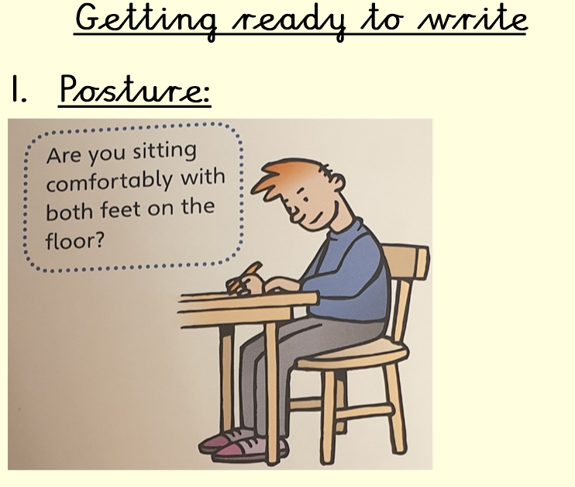
Day 2 – Handwriting ‘ous’
Before we begin, we must do the following:

Slide 11
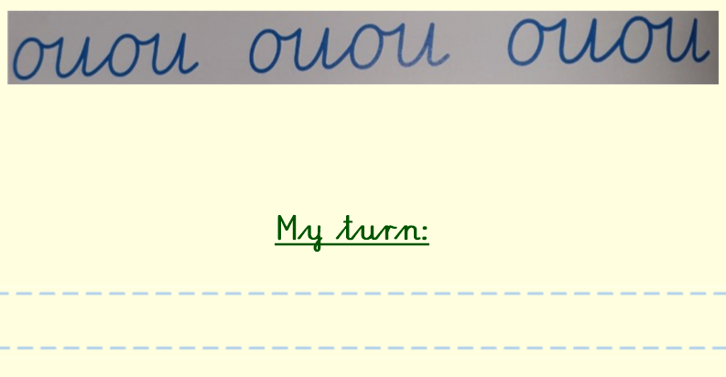
Complete two lines of the following:
Remember to make sure your letters are sat on the line.
Ensure you are finger spacing.
Ensure you are joining.

Slide 12
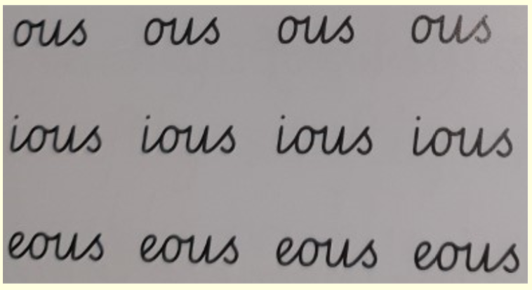
Task 2: Practise other letters
Remember to make sure your letters are sat on the line.
Ensure you are finger spacing.
Ensure you are joining.

Slide 13
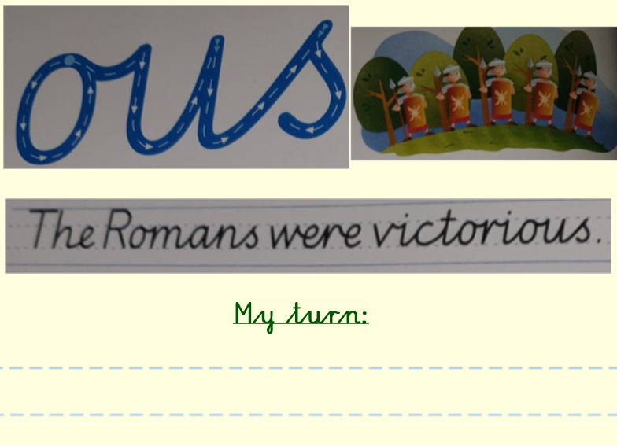
Task 3: Practise the sentence
Remember to make sure your letters are sat on the line.
Ensure you are finger spacing.
Ensure you are joining.

Slide 14
Extension
Can you think of any sentences that include these words?

Slide 15
Day 3 – Reading Comprehension
Read the book Mountain Tales of Norway
What do we think the book is going to be about?
What does the front cover tell us?
What do we know about Norway?
Compare Norway to England. What is similar and what is different?
Who is the author?
Who is the illustrator?
https://www.activelearnprimary.co.uk/resources#bugclub

Slide 16
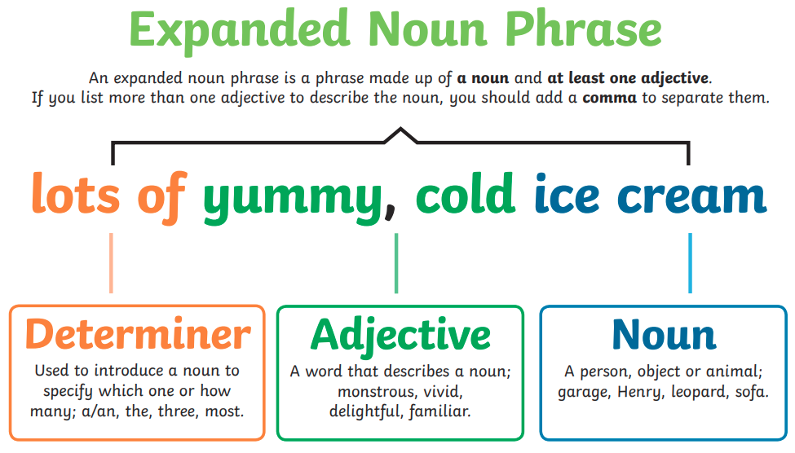
Day 4 – Using extended noun phrases and adjective to describe a setting
What is an extended noun phrase?
Can you think of any more ENPs?

Slide 17
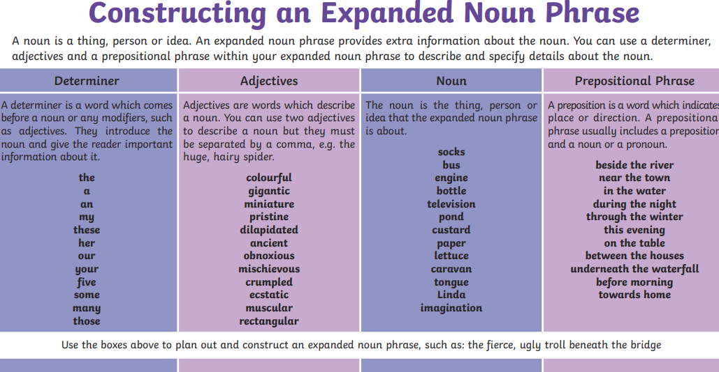

Slide 18
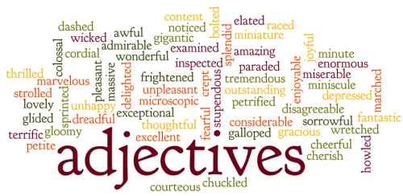
Adjectives – Describing words

Slide 19
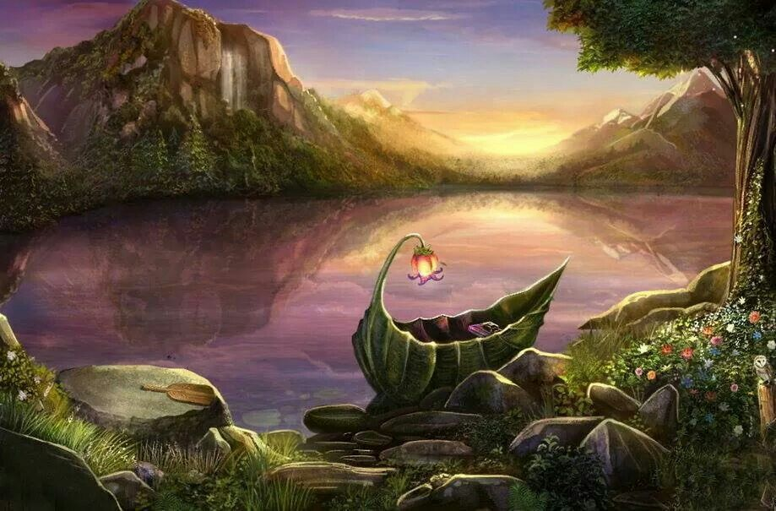
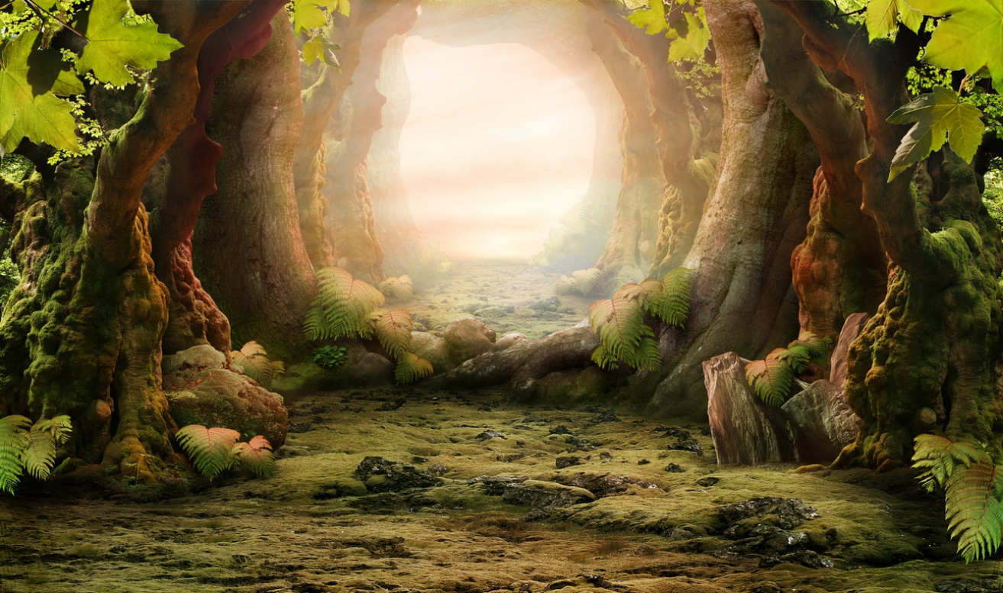
Use the ENP and Adjective mats to help you describe these settings. Remember to write in full sentences.

Slide 20
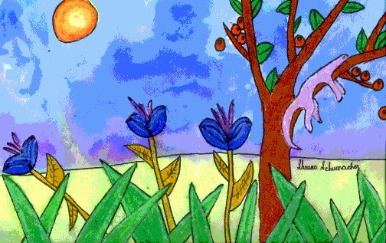
Day 5 – Draw your own fantasy setting and write a paragraph describing it.
First draw a picture of your setting. It could be anything you like! This is your setting. BE CREATIVE? What is your setting going to be made of? Is it a happy setting?
Once you have drawn your picture. Move on to the next slide and start writing your paragraph.

Slide 21
Now write a paragraph describing your setting
What to include in your paragraph?
Senses:
What can you hear?
What can you taste?
What does it smell like?
What does it feel like?
Is it warm or cold?
Use ENPS and adjectives to describe your setting.
Use Similes.
Capital letters and full stops.

