Slide 1
English Home Learning
Week Beginning 30.11.2020

Slide 2
This week…
Day 1 – Reading with t.
Day 2 – Writing with t.
Day 3 – Reading with p.
Day 4 – Writing with p.
Day 5 – Tricky Words.

Slide 3
Day 1- Phonics
Listen to the Jolly Phonics song.
https://www.youtube.com/watch?v=euxN7LGOoLc

Slide 4
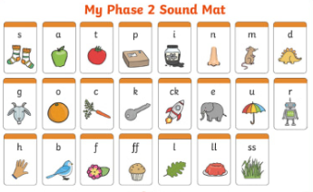
Say all the sounds you can see.

Slide 5
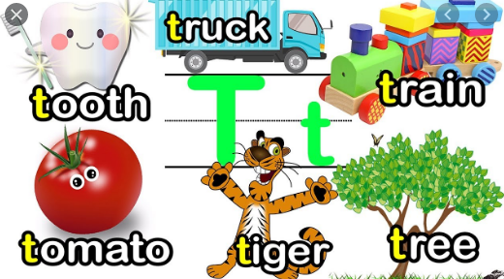

Slide 6
Can you read these words below:
top tag pet hot tin tap

Slide 7
Write these words into your book and put your own sound buttons on them.

Slide 8
Don’t forget to email your work to your teacher!
ra@hortongrangeacademy.co.uk –Miss Bedford
rb@hortongrangeacademy.co.uk – Miss Beaumont
rc@hortongrangeacademy.co.uk – Mrs Wilson

Slide 9
Day 2- Phonics
Listen to the Jolly Phonics song.
https://www.youtube.com/watch?v=euxN7LGOoLc

Slide 10
Say all the sounds you can see.

Slide 12
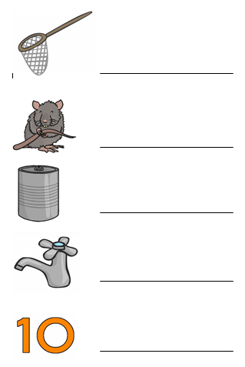
Can you spell these words using your phonics fingers. Write the words in your book and draw the picture at the side.

Slide 13
Do you know any other words that begin with t? Write 3 of your own words that begin with t and draw a picture of it.

Slide 14
Don’t forget to email your work to your teacher!
ra@hortongrangeacademy.co.uk –Miss Bedford
rb@hortongrangeacademy.co.uk – Miss Beaumont
rc@hortongrangeacademy.co.uk – Mrs Wilson

Slide 15
Day 3- Phonics
Listen to the Jolly Phonics song.
https://www.youtube.com/watch?v=euxN7LGOoLc

Slide 16
Say all the sounds you can see.

Slide 17
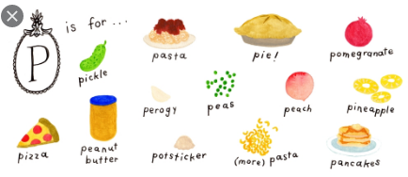

Slide 18
Can you read these words below:
pat pig pin pan pot pen

Slide 19
Write these words into your book and put your own sound buttons on them.

Slide 20
Don’t forget to email your work to your teacher!
ra@hortongrangeacademy.co.uk –Miss Bedford
rb@hortongrangeacademy.co.uk – Miss Beaumont
rc@hortongrangeacademy.co.uk – Mrs Wilson

Slide 21
Day 4- Phonics
Listen to the Jolly Phonics song.
https://www.youtube.com/watch?v=euxN7LGOoLc

Slide 22
Say all the sounds you can see.

Slide 24
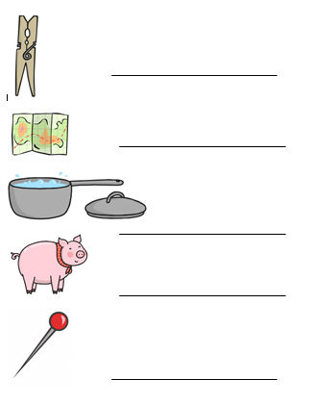
Can you spell these words using your phonics fingers. Write the words in your book and draw the picture at the side.

Slide 25
Do you know any other words that begin with p? Write 3 of your own words that begin with p.
Draw a picture of your word.

Slide 26
Day 5- Tricky Words
Listen to the Tricky Words song.
https://www.youtube.com/watch?v=TvMyssfAUx0

Slide 27
We are learning the tricky words:

Slide 28
Can you find the tricky word in this sentence?

Slide 29
Can you find the tricky word in this sentence?

Slide 30
Can you read these sentences?

Slide 31
Can you copy write these sentences into your book?

Slide 32
Don’t forget to email your work to your teacher!
ra@hortongrangeacademy.co.uk –Miss Bedford
rb@hortongrangeacademy.co.uk – Miss Beaumont
rc@hortongrangeacademy.co.uk – Mrs Wilson

