Slide 1
English Home Learning
Week Beginning 23.11.20

Slide 2
Day 1 - Reading
Sing this rhyme together. Encourage your child to repeat after you.
Wind the bobbin up, wind the bobbin up.
Pull, pull, clap, clap, clap.
Wind it back again, wind it back again.
Pull, pull, clap, clap, clap.
Point the ceiling, point to the floor.
Point to the window, point to the door.
Clap your hands together 1,2,3.
Put your hands upon your knee.
What is a bobbin?

Slide 3
Day 2 Phonics
Use your voice to make sounds like:
A car
A ghost
A dog
Bubbles
A train

Slide 4
Day 3 Communicating
Make some playdough together.
3 cups of plain flour
3 cups of water with added food colouring of your choice
1 ½ cups of salt
6 tablespoons of cooking oil
6 teaspoons of cream of tartar
Put all of the ingredients into a pan over a low heat, and continue to stir until it all comes together. Take out of the pan, let cool and enjoy! If kept in a tupperware tub the playdough should last a while.
Using playdough is really good for your child’s physical skills and encourages communication and imagination.

Slide 5
Day 4 - Reading
This week we will be reading a book in story time called Rumble in the Jungle. There is a link below that will allow you to read this with your child.
https://www.booktrust.org.uk/books-and-reading/have-some-fun/storybooks-and-games/rumble-in-the-jungle/

Slide 6
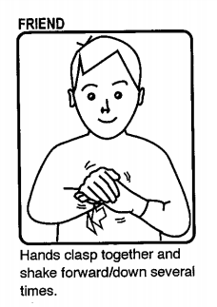
Day 5 Communicating
Teach your child the Makaton sign for ‘friend’.

