Slide 1
English Home Learning
Week Beginning 16th November 2020

Slide 2
This week…
Day 1 – Grammar - past tense
Day 2 – Introduce – reading text and answering questions.
Day 3 – The Snowman
Day 4 – Using our senses
Day 5 – Role on the wall – the snowman

Slide 3
Day 1

Slide 8
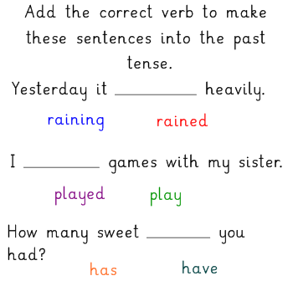

Slide 9
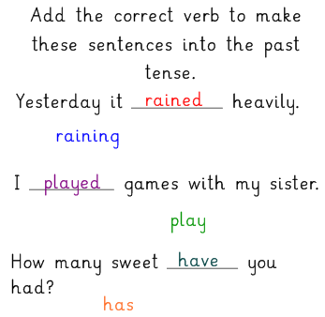

Slide 14
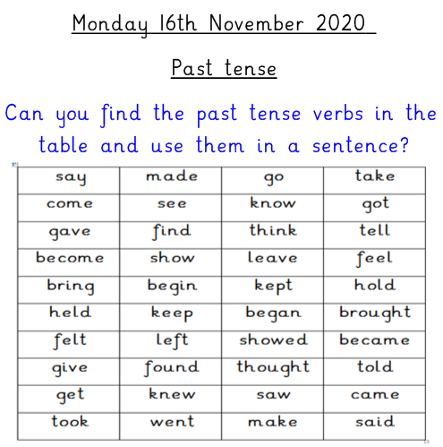
Write these sentences in your home learning books.

Slide 15
Day 2

Slide 16
Day 2 – Reading comprehension
Today we are going to be reading this book on Bug Club.
Strawberries at School by Jill McDougall
Please log in using the details your teacher has given you.
https://www.activelearnprimary.co.uk/login?c=0

Slide 17
Day 2 – Reading comprehension.
Book title: Strawberries in School
Use the link below to login to Bug Club then access through your library.
https://www.activelearnprimary.co.uk/

Slide 18
Day 2 Answer these questions in your Home Learning book
What little strawberry plants called?
What was the weather like on Friday?
Apart from compost and sunshine, what else helps a plant to grow?
Name 4 types of berries.
What colour are the flowers on a strawberry plant?
6. How many strawberries were on the school plant?
7. How many weeks did it take for the strawberries to grow?

Slide 19
Day 3

Slide 21
Click on the following link for the video clip https://www.youtube.com/watch?v=5A3THighARU

Slide 24
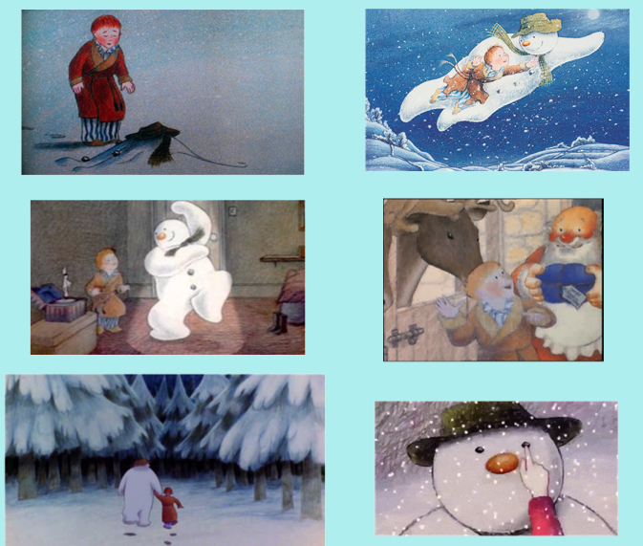
Can you put these pictures into chronological order?

Slide 25
Main task
Now use the pictures to write sentences about the story of the Snowman. Remember they need to be in chronological order!

Slide 26
Day 4

Slide 27
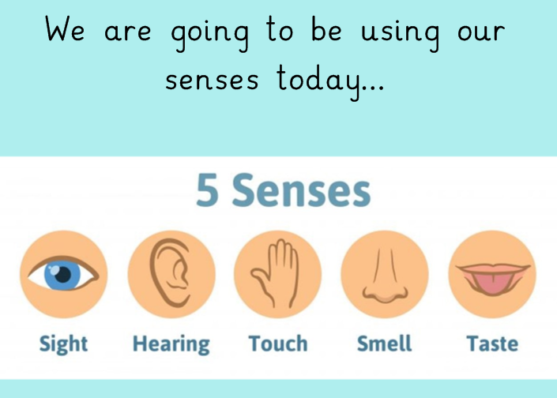

Slide 28
https://www.youtube.com/watch?v=5A3THighARU

Slide 29
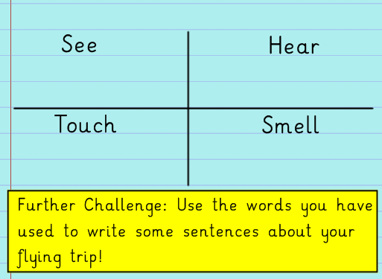
Draw this table in your home learning books.

Slide 30
Day 5

Slide 32
https://www.youtube.com/watch?v=5A3THighARU

Slide 33
Draw the outline of the snowman and write
Do this in your home learning books

