Slide 1
English Home Learning
Week Beginning 02.11.20

Slide 2
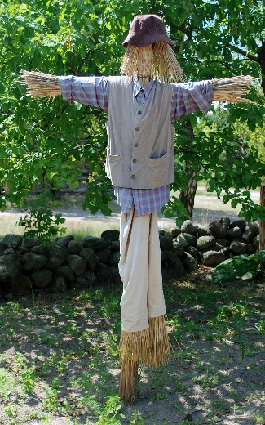
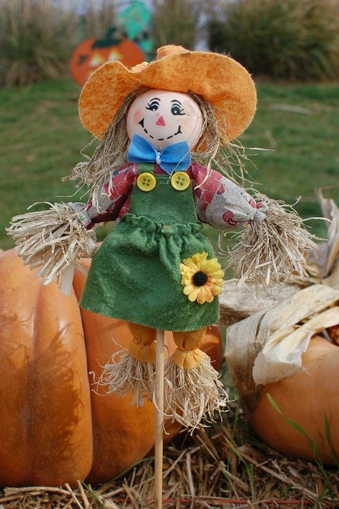
Day 1 - Reading
Sing this rhyme together. Encourage your child to repeat after you.
I'm a dingle dangle scarecrow, with a flippy floppy hat.
I shake my arms like this, and I shake my legs like that.
When all the cows are sleeping, and the sun has gone to bed.
Up jumps the scarecrow, and this is what he says.
I'm a dingle dangle scarecrow, with a flippy floppy hat.
I shake my arms like this, and I shake my legs like that.
Does your child know what a scarecrow is and what it is used for?

Slide 3
Day 2 Communicating
Show the picture on the next slide to your child and ask them:
Where do you think this is?
What can you see?
Who do you think might live in the house?
Encourage your child to speak in full sentences. You could even make up your own story to tell together.

Slide 4
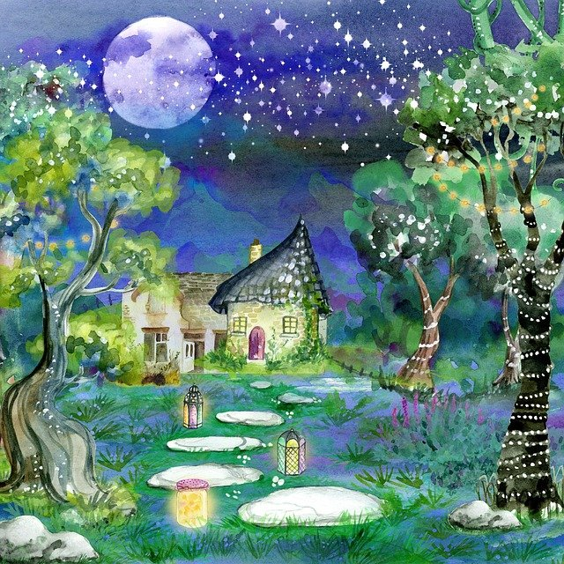
Day 2

Slide 5
Day 3 Communicating
Make some playdough together.
3 cups of plain flour
3 cups of water with added food colouring of your choice
1 ½ cups of salt
6 tablespoons of cooking oil
6 teaspoons of cream of tartar
Put all of the ingredients into a pan over a low heat, and continue to stir until it all comes together. Take out of the pan, let cool and enjoy! If kept in a tupperware tub the playdough should last a while.
Using playdough is really good for your child’s physical skills and encourages communication and imagination. If you already have some playdough you could use it to make a scarecrow and act out the rhyme.

Slide 6
Day 4 - Phonics
Play a listening game.
Hide a toy or a teddy somewhere in the house and invite your child to find it. Give clues that means the child needs to listen carefully. Clap quickly if they are close by the toy and slowly if they are further away.

Slide 7
Day 5 Communicating
Teach your child the Makaton sign for ‘Help’.

