Slide 1
Curriculum Home Learning
Week Beginning W/C 30.11.2020

Slide 2
This week…
Day 1 – Music – Musical vocabulary
Day 2 – Art – Flower design.
Day 3 – RE – The Islamic Creation Story
Day 4 – Spanish - Numbers
Day 5 – PE – PE with Joe and Cosmic Yoga

Slide 3
Day 1 Music

Slide 4
Musical Notation
Today we are going to learn some special Music words.
What are pulse and rhythm?
https://www.bbc.co.uk/bitesize/topics/zcbkcj6/articles/z2mqw6f

Slide 5
What are duration and tempo?
https://www.bbc.co.uk/bitesize/topics/zcbkcj6/articles/z3yfng8

Slide 6
What are pitch and melody?
https://www.bbc.co.uk/bitesize/topics/zcbkcj6/articles/zp99cj6

Slide 7
What is harmony?
https://www.bbc.co.uk/bitesize/topics/zcbkcj6/articles/zgxx2nb

Slide 8
What is texture?
https://www.bbc.co.uk/bitesize/topics/zcbkcj6/articles/z9ffng8

Slide 9
Now you have watched all the videos, try to answer as many questions as you can in this quiz.
https://www.bbc.co.uk/bitesize/articles/z7ryy4j

Slide 10
Day 2 Art

Slide 11
In Art you are going to look at some flower drawings and create your own in your home learning book.

Slide 12
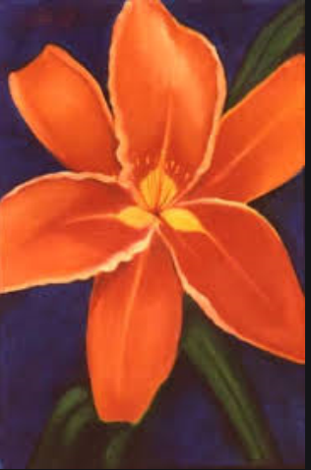
All the pictures on the next few pages were created by a very famous artist called Georgia O’Keefe.

Slide 13
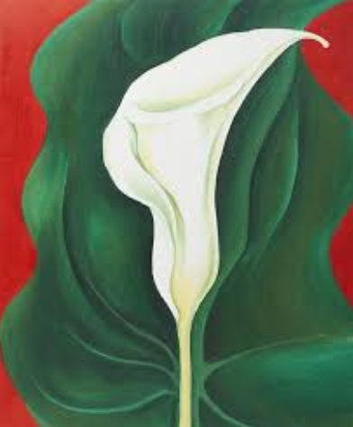
Notice the colours she has used.

Slide 14
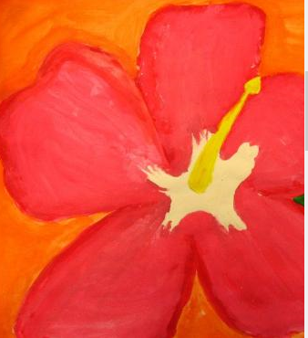
Which is your favourite?
Why did you choose that one?

Slide 15
Choose one of the pictures and create your own version in your sketch book. Remember to sketch it very lightly first with your pencil and when you are happy with it you can use crayons to colour it in. If you don’t have any crayons use your pencil and the different types of shading you have learnt to add detail.

Slide 16
If you have any playdough you can create these flowers. Don’t worry if you haven’t any, just enjoy watching the video.
https://www.youtube.com/watch?v=almqR0KCCw0

Slide 17
Day 3 RE

Slide 18
Ground rules - very important!
This is a safe space so we do not judge anyone else especially if their beliefs are different from our own.
We do not laugh or make fun or criticise each other and we certainly do not tell anyone else they are wrong because we are all allowed to believe what we choose.
You can keep your beliefs private or share them with others.

Slide 20
Islamic Creation Story The sun came and by mid morning Bashir and his mother were settled in the garden. She sat in a garden chair, he roamed about the garden looking at the plants. There was a young tree near the pond. Its glossy leaves fascinate him. Wanting a closer look he began to pull at a spray of leaves, intending to break it off. ‘Don’t do that Bashir,’ his mother called out. ‘Why not?’ he asked. ‘Come here and I will tell you,’ his mother said. Bashir sat by his mothers chair and listened. ‘You see,’ she began ‘We are Muslims - and you are a Muslim, remember - try to look after all living things. And that includes plants.’ ‘But why?’

Slide 21
Islamic Creation Story His mother wondered how she could best convince her son. ‘Go and get the magnifying glass from the drawer. I will show you why we try to look after plants.’ They knelt by the tree and studied one of the leaves under the magnifying glass. Bashir could see the veins running through the leaf, making a wonderful, delicate pattern, and the sunlight shone through, making the green seem to glow. ‘It’s beautiful,’ he said. They sat by the tree. ‘Do you know why this leaf is so beautiful?’ Bashirs mother asked. The boy shook his head. ‘It is a sign that God made it.’

Slide 22
Islamic Creation Story Bashir said ‘Did He make everything in the garden?’ ‘He did. In fact he made the whole world. Shall I tell you about it?’ Bashir settled down to listen. ‘The Qu’ran says,’ his mother began, ‘that God had a throne in heaven. He spread out the earth below Him and shaped tall mountains. Then he made rivers and plants and the fruits on the trees. He made sure that the rain fell so that all His plants might continue to grow and bear fruit. He also made the sun so that the day was flooded with light. And He made the night with its moon and stars.’

Slide 23
Islamic Creation Story ‘How did He do all these things?’ Bashir wanted to know. ‘He just said “Be” and it happened,’ his mother answered. ‘Did God make us too?’ Bashir asked, his face suddenly eager. His mother took him on her lap. ‘He did. He made the first human beings out of dust. He made them different colours and gave them different languages.’ ‘Did it take Him a long time?’ It took Him just six days. And when he had finished He told everyone in Heaven, “Bow down to this man and woman that I have made. They have the breath of my spirit within them.” Now everyone bowed down - except one Jinn. He was called Iblis. Do you know what Iblis said to God?’ Bashir shook his head. ‘He said, “I will not bow down to something made of mud. I am made of fire which is better than mud.” And he meant it: he refused to bow, and God became angry with him. Iblis was thrown out of heaven - he could not understand Gods creation.’

Slide 24
Islamic Creation Story ‘How did He do all these things?’ Bashir wanted to know. ‘He just said “Be” and it happened,’ his mother answered. ‘Did God make us too?’ Bashir asked, his face suddenly eager. His mother took him on her lap. ‘He did. He made the first human beings out of dust. He made them different colours and gave them different languages.’ ‘Did it take Him a long time?’ It took Him just six days. And when he had finished He told everyone in Heaven, “Bow down to this man and woman that I have made. They have the breath of my spirit within them.” Now everyone bowed down - except one Jinn. He was called Iblis. Do you know what Iblis said to God?’ Bashir shook his head. ‘He said, “I will not bow down to something made of mud. I am made of fire which is better than mud.” And he meant it: he refused to bow, and God became angry with him. Iblis was thrown out of heaven - he could not understand Gods creation.’

Slide 25
Islamic Creation Story Bashir turned and looked at the leaves of the tree again. ‘I’ll look after everything in the garden from now on,’ he promised. ‘That’s good said his mother. ‘Because God put us here to look after His creation. That’s why I have told you this story. Now, I think I’ll do some gardening. Do you want to help me?’ ‘Yes please,’ said Bashir.

Slide 26
In the Qur’an there are details of the Creation: Surely, your Lord is Allah. Who created the heavens and the earth in six periods; then He settled Himself on the Throne. He makes the night cover the day, pursuing it swiftly. He has created the sun and the moon and the stars, all made subservient by His command…He it is Who sends the winds… Good land brings forth vegetation plentifully by the command of the Lord. Surah 7:55-59 What can you learn from this passage?

Slide 27
I have created men, high and low, that they may worship Me. I desire no support from them, nor do I desire that they should feed Me. Surely, it is Allah who is the Great Sustainer, the Lord of Power, the Strong. Surah 51:56 What can you learn from this passage?

Slide 28
Answer these questions into full sentences into your book: In Islam how many days did God create the world? What did God make first? How did God make all these things? What were the first human beings made out of? What did God say to His angels after He created man? Who refused to bow down to Adam? Why did he refuse? What happened to Iblis? What does this story tell you about looking after Gods creations?

Slide 29
Day 4 Spanish

Slide 30
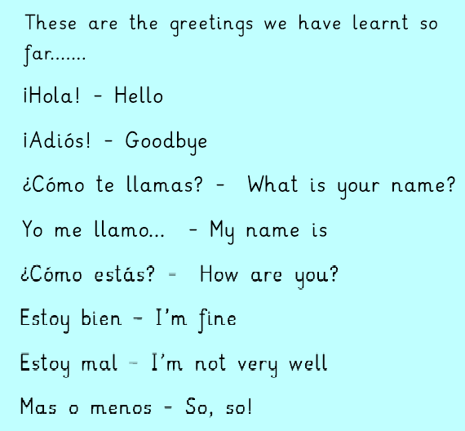

Slide 31
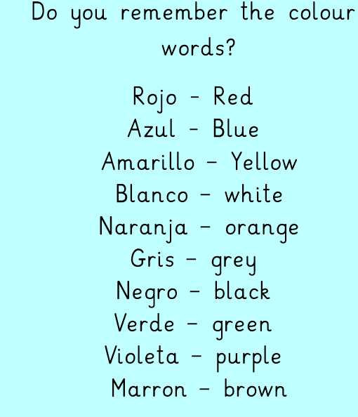

Slide 32
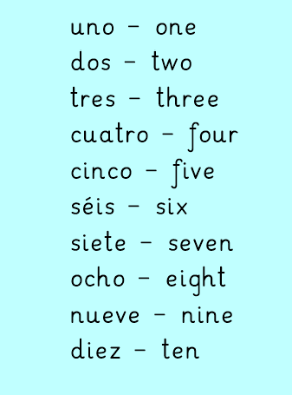
Today we are going to learn the Spanish words for number to ten.

Slide 33
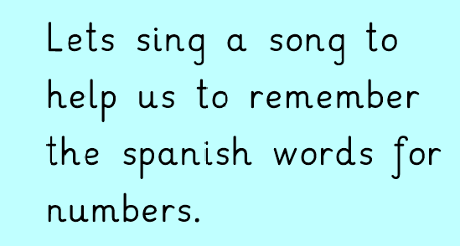

Slide 34
Day 5 PE

Slide 35
It is really important to keep ourselves fit and healthy. One of the way we can do that is by exercising.
You will do the following:
Warm-up
Main activity
Cool down

Slide 36
Warm-up
Make circles with your arms. Repeat 10 times
Run on the spot for 1 minute
Stand with feet hip width apart and touch your toes.

Slide 37
Main activity
https://www.youtube.com/watch?v=v4ShRREe26w

Slide 38
Cool down
Stand as tall as you can then reach for the stars with both arms. Count to 30
Bend to one side and hold for a count of 10
Now repeat on the other side.

