Slide 1
Curriculum Home Learning
Week Beginning 23.11.2020

Slide 2
This week…
Day 1 – Don’t Hog the Hedge!
Day 2 – Autumn Leaves
Day 3 – Little Acorns
Day 4 – Woodland Crafts
Day 5 – Fairy Tales

Slide 3
Day 1 –Don’t Hog the Hedge!
Read the Story – Don’t Hog the Hedge!

Slide 27
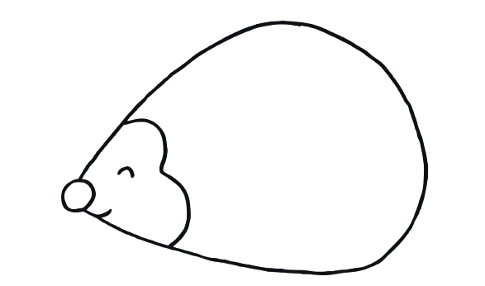
Task: Print or draw an outline of a hedgehog. Using sticks or leaves decorate it to make it look spiky!

Slide 28
Don’t forget to email your work to your teacher!
ra@hortongrangeacademy.co.uk –Miss Bedford
rb@hortongrangeacademy.co.uk – Miss Beaumont
rc@hortongrangeacademy.co.uk – Mrs Wilson

Slide 29
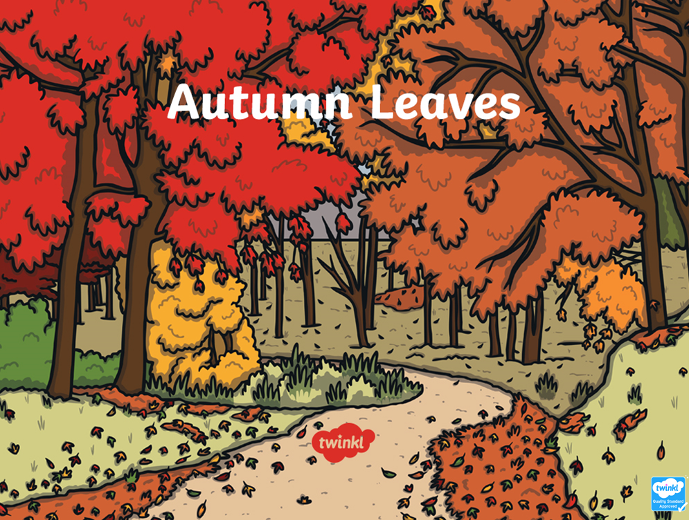
Day 2 – Autumn Leaves

Slide 37
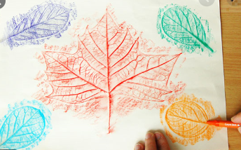
Task: Collect some leaves of different shapes and sizes. Place a sheet of paper over the leaves and rub over the top using chalk or wax crayon and see the beautiful detail in the leaves.

Slide 38
Don’t forget to email your work to your teacher!
ra@hortongrangeacademy.co.uk –Miss Bedford
rb@hortongrangeacademy.co.uk – Miss Beaumont
rc@hortongrangeacademy.co.uk – Mrs Wilson

Slide 39
Day 3 – Little Acorns

Slide 54
Task: Draw what the weather is like in the 4 seasons mentioned in the story.
Summer
Autumn
Winter

Slide 55
Don’t forget to email your work to your teacher!
ra@hortongrangeacademy.co.uk –Miss Bedford
rb@hortongrangeacademy.co.uk – Miss Beaumont
rc@hortongrangeacademy.co.uk – Mrs Wilson

Slide 56
Day 4 – Woodland Crafts

Slide 57
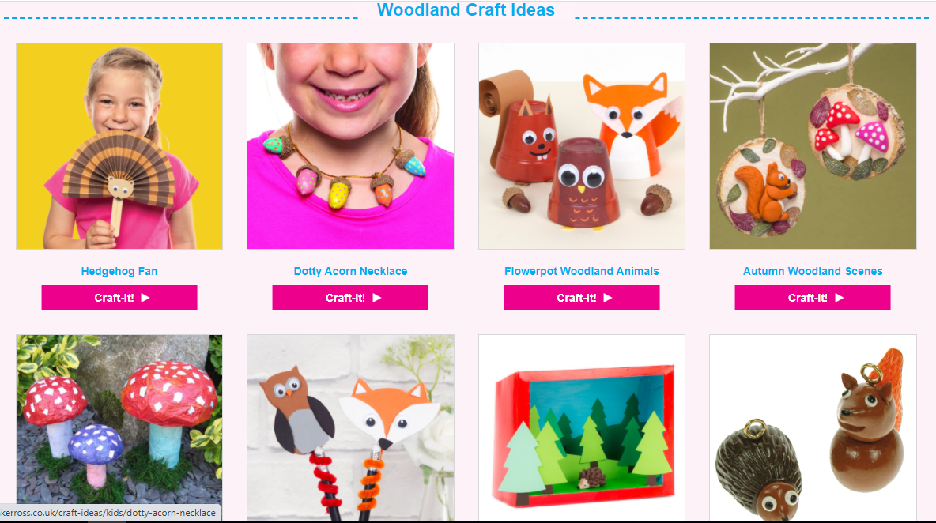
Visit this craft website and have a go at making something!
https://www.bakerross.co.uk/craft-ideas/category/kids/themes/woodland/

Slide 58
Don’t forget to email your work to your teacher!
ra@hortongrangeacademy.co.uk –Miss Bedford
rb@hortongrangeacademy.co.uk – Miss Beaumont
rc@hortongrangeacademy.co.uk – Mrs Wilson

Slide 59
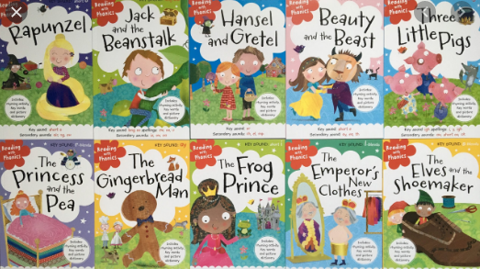
Day 5 – Fairy Tales

Slide 60
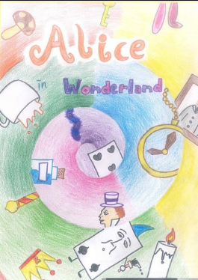
Task: Make a book cover for your favourite fairy tale. It will need:
A picture
The title of the book
The author’s name
This is mine ->

Slide 61
Don’t forget to email your work to your teacher!
ra@hortongrangeacademy.co.uk –Miss Bedford
rb@hortongrangeacademy.co.uk – Miss Beaumont
rc@hortongrangeacademy.co.uk – Mrs Wilson

