Slide 1
Curriculum
Week Commencing: 23.11.2020

Slide 2
This Week
Day 1: Science- Water Cycle
Day 2: Ancient Egyptians – Introduction
Day 3: Ancient Egyptians – Importance of the River Nile
Day 4: Spanish – La Familia
Day 5: Music- Mamma Mia – Verse 3 and chorus variation

Slide 3
Day 1 – The Water Cycle
Starter questions….
What do you think the water cycle is?
What processes have we learned recently that might be present in the process?
Does the water cycle involve solids, liquids or gases?

Slide 4
Day 1 – The Water Cycle
How did you do?
The process involves gases and liquids, gas turns into a liquid but also uses solid ground to evaporate into.

Slide 5
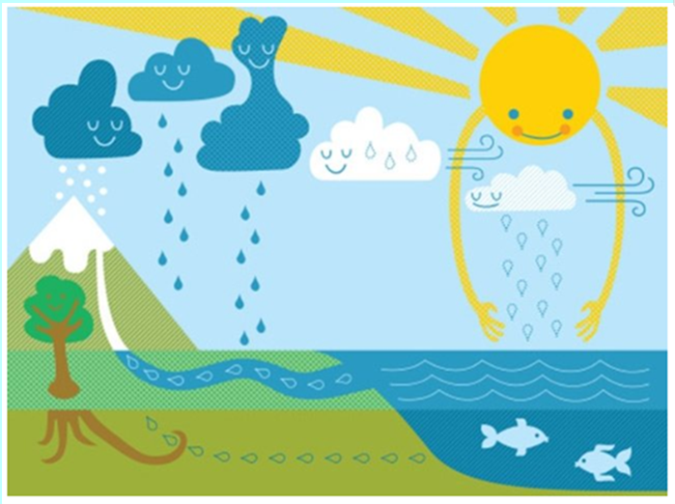
Day 1 – The Water Cycle
Look at the following videos for a further explanation, what are the important features?
https://www.bbc.co.uk/bitesize/clips/zh4rkqt
https://www.bbc.co.uk/bitesize/clips/z8qtfg8

Slide 6
Day 1 – The Water Cycle

Slide 7
Stages of the Water Cycle

Slide 8
Day 1 -Task

Slide 9
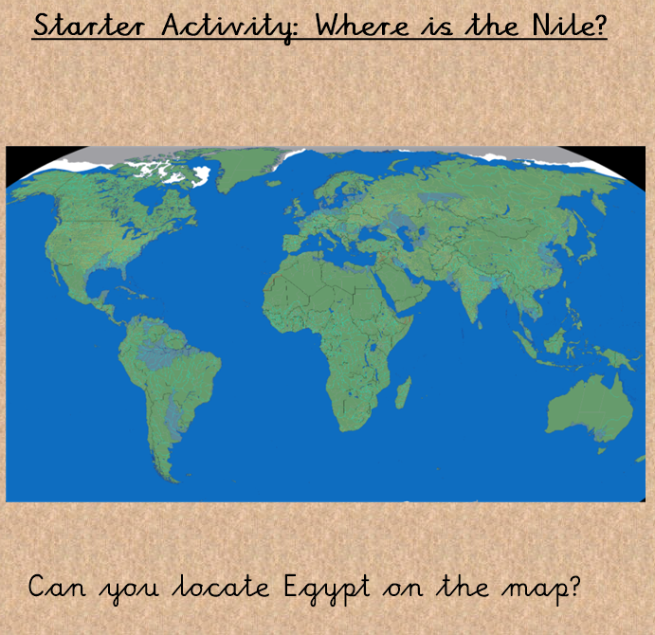
Day 2 – Ancient Egyptians - Introduction
Think about…
What continent might it be on?
What country is it near?
Have you ever visited?

Slide 10
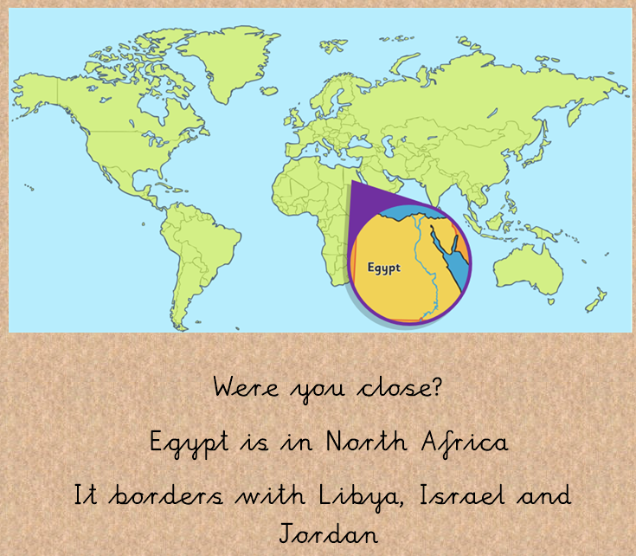
Day 2 – Ancient Egyptians - Introduction

Slide 11
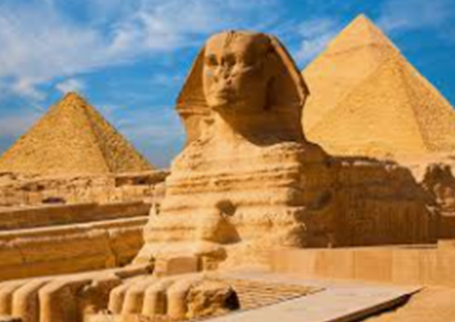
Day 2 – Ancient Egyptians - Introduction
Watch the video link below for facts about Egypt…
https://www.youtube.com/watch?v=_V3C6szgcIY
Can you add any of your own?

Slide 12
Day 2 – Task – Facts about Egypt
Use your knowledge of Egypt from the video and the location of the country to create a fact sheet about Ancient Egypt
Think about
Adding a small map to locate Egypt
5 facts about the country
Add your own opinions about the country, why should people visit?

Slide 13
Day 3 – The Importance of the River Nile
Today we will focus on the River Nile in Egypt.
Can you think of a reason why this may be important?
Why might people settle near a river?
Answers on the next slide…

Slide 14
Day 3 – The Importance of the River Nile

Slide 15
Day 3 – The Importance of the River Nile
Can you think of another country or city in the UK that has a river or canal?
Why might this be here?
What might it have been used for?

Slide 16
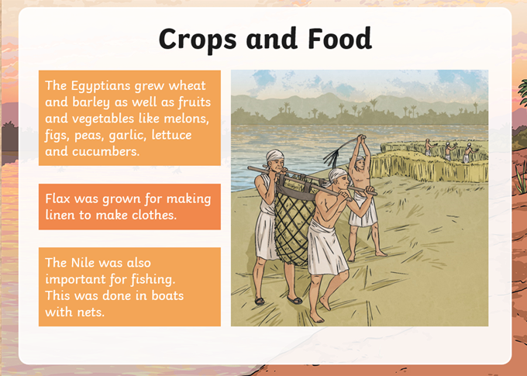
Day 3 – The Importance of the River Nile

Slide 17
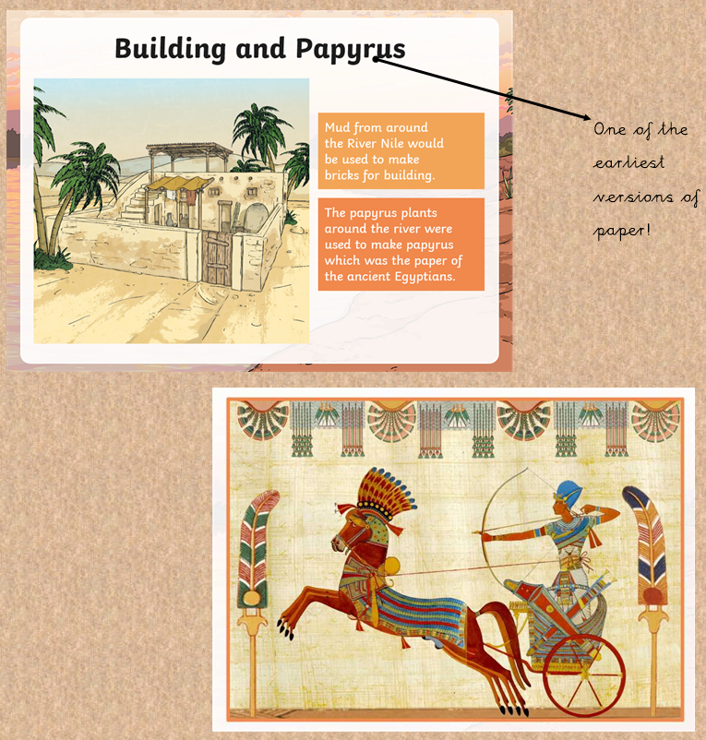
Day 3 – The Importance of the River Nile

Slide 18
Day 3 – Task
Draw the diagram in your home learning book.
Take care to use a ruler to draw your arrows.
Label your diagram with reasons why the Nile was so important.
Challenge: Can you write three sentences describing how you think this may have changed today? Where will you find this out?

Slide 19
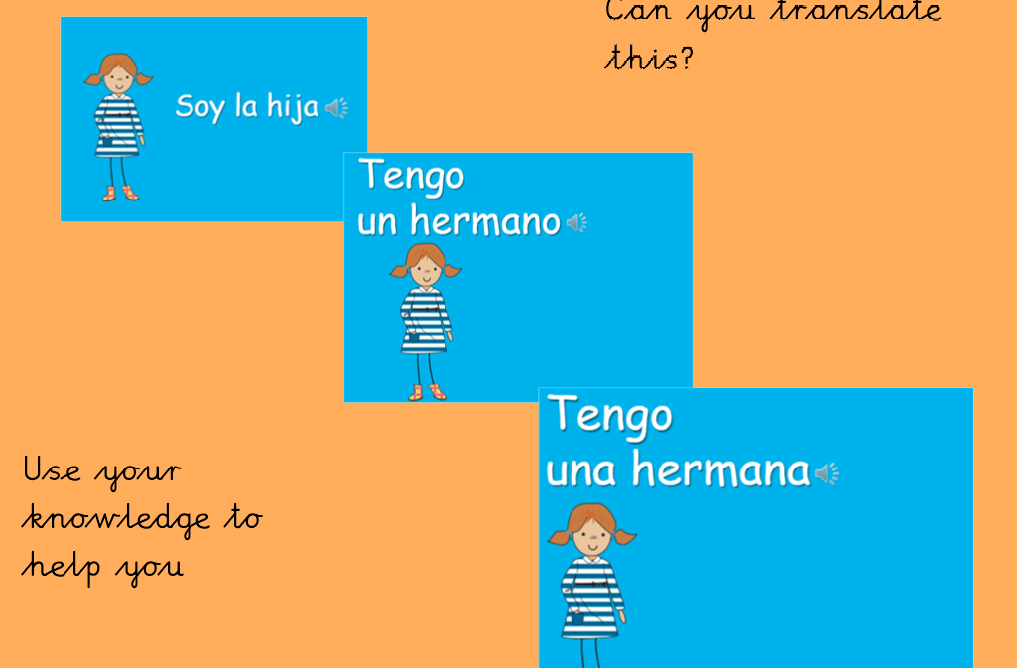
Day 4- Spanish
Can you remember how to count from 1-20?
Can you remember what the phrases say? Use the pictures to help you.
Tienes – Do you have?
Tengo – I have
Soy – I am

Slide 20
Day 4- Spanish Recap

Slide 22
Si! Bravo!

Slide 24
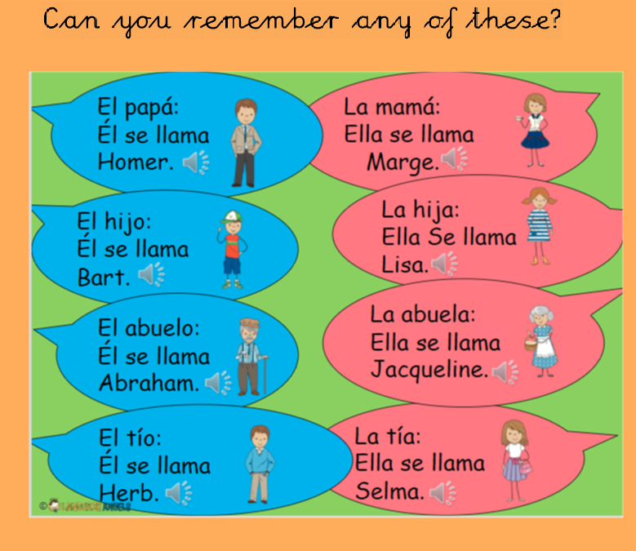

Slide 25
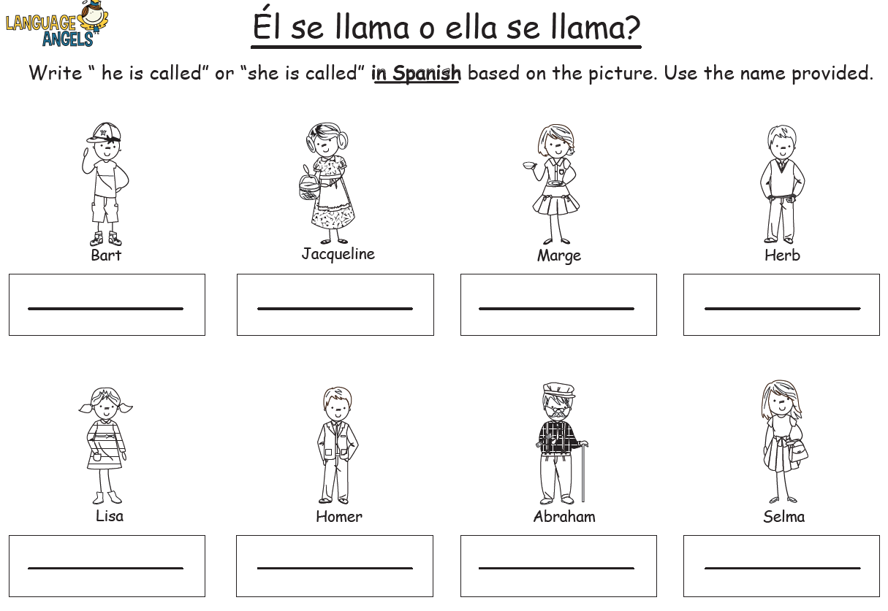
Main Task
BP and Hulks:
Using the vocabulary learned today, write the Spanish translations using the names.

Slide 26
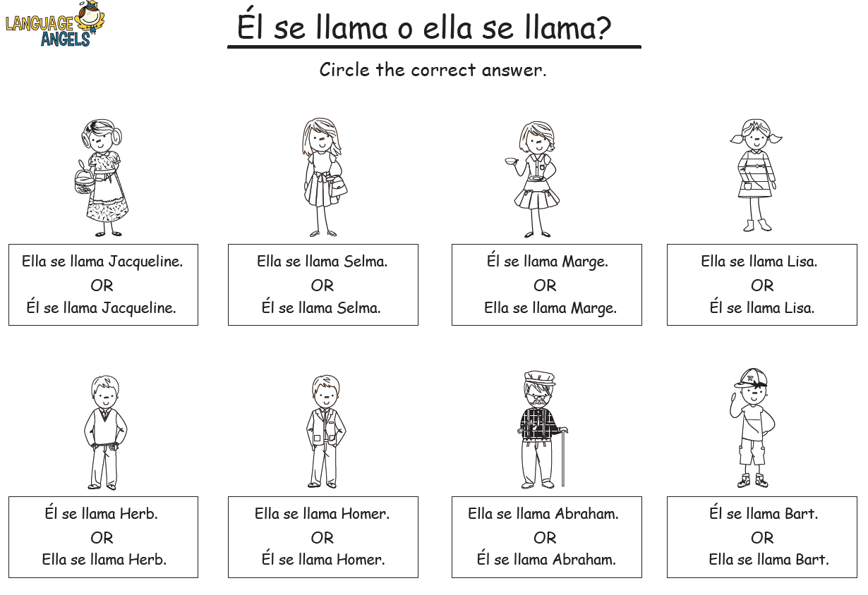
Main Task
Storms:
Circle the answer – identify whether the picture is a boy or girl first!

Slide 27
Day 5 – Music
Can you remember …
What is pulse?
What is tempo?
What is rhythm?

Slide 28
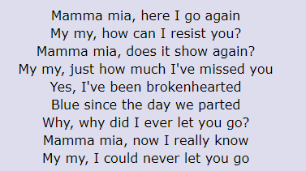
Day 5 – Music
Listen to the song!
Can you remember the second verse?
https://www.youtube.com/watch?v=BogW-2X_X6k

Slide 29
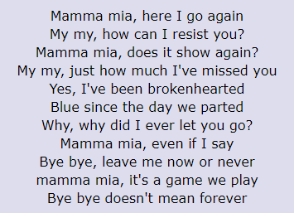
Day 5 – Music
Learn verse 3.
Can you sing it faster or slower? (change the tempo).
Can you add the chorus?
What do you notice? Is it the same? Why?

