Slide 1
Curriculum
Week Commencing: 16.11.2020

Slide 2
This Week
Day 1: Science- Condensation
Day 2: P.E – Gymnastics
Day 3: PSHE – Ant-Bullying week
Day 4: Spanish – La Familia
Day 5: Music- Mamma Mia

Slide 3
Day 1 - Condensation
What is that coming from the woman’s mouth?
Find out on the next slide

Slide 4
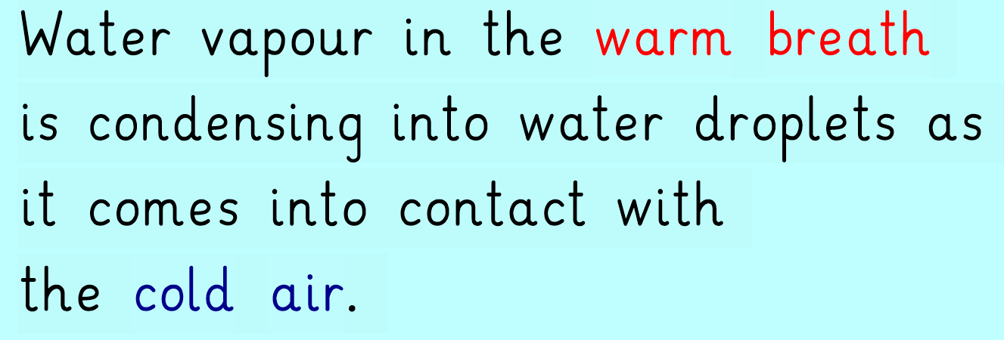
Condensation

Slide 5
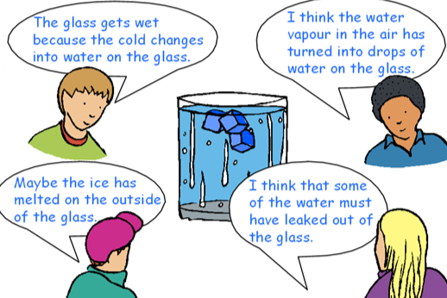
Who do you agree with? Why do you agree with them?

Slide 6
Condensation

Slide 7
Main Task
Further Challenge – can you think of any more examples of condensation?

Slide 8
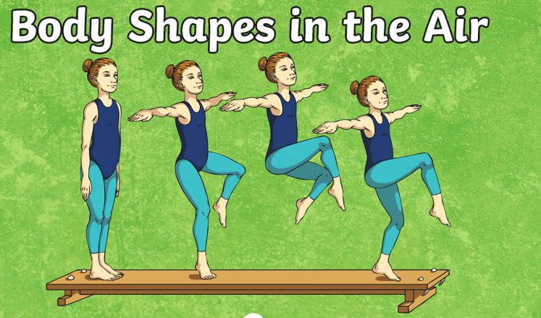
Day 2 – PE Gymnastics
Can you describe each of the movements?
For this lesson you will need to be very careful as it involves jumping.
Firstly, find a space in your house.

Slide 9
1 – Jog
2 – Sprint on the spot.
3 – Hop on the spot
4 – Balance on the spot
Warm up

Slide 10
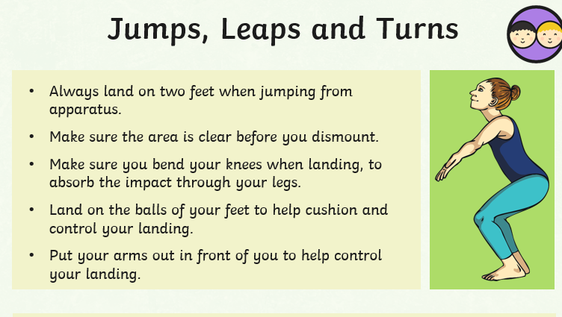
You will need something to jump from for this activity – Preferably a bed. Make sure that there is nothing surrounding the bed. Place a blanket on to the floor to ensure safe landing.

Slide 11
Main - Types of jumps and leaps

Slide 12
Day 3- PSHE - Anti-Bullying

Slide 13
What is bullying and who can you tell?

Slide 14
Day 3- Create an anti-bullying poster
Include why we need to stamp out bullying.
Who we should tell?
Make it colourful.

Slide 15
Day 4- Spanish
Can you remember how to count from 1-20?
Can you remember any of these people from last week?

Slide 16
Day 4- Spanish Recap

Slide 17
Get someone to test you.
How many did you get correct?

Slide 18
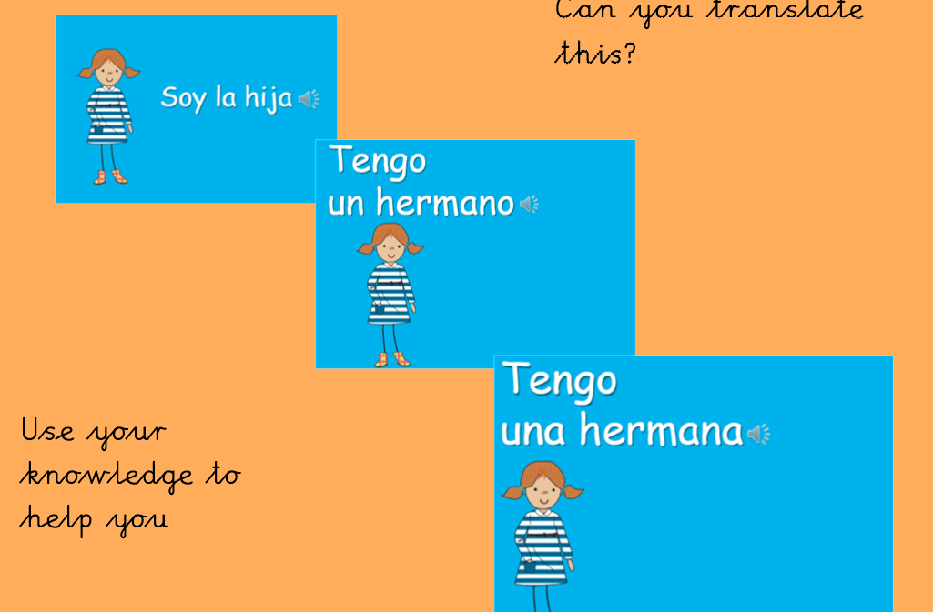

Slide 21
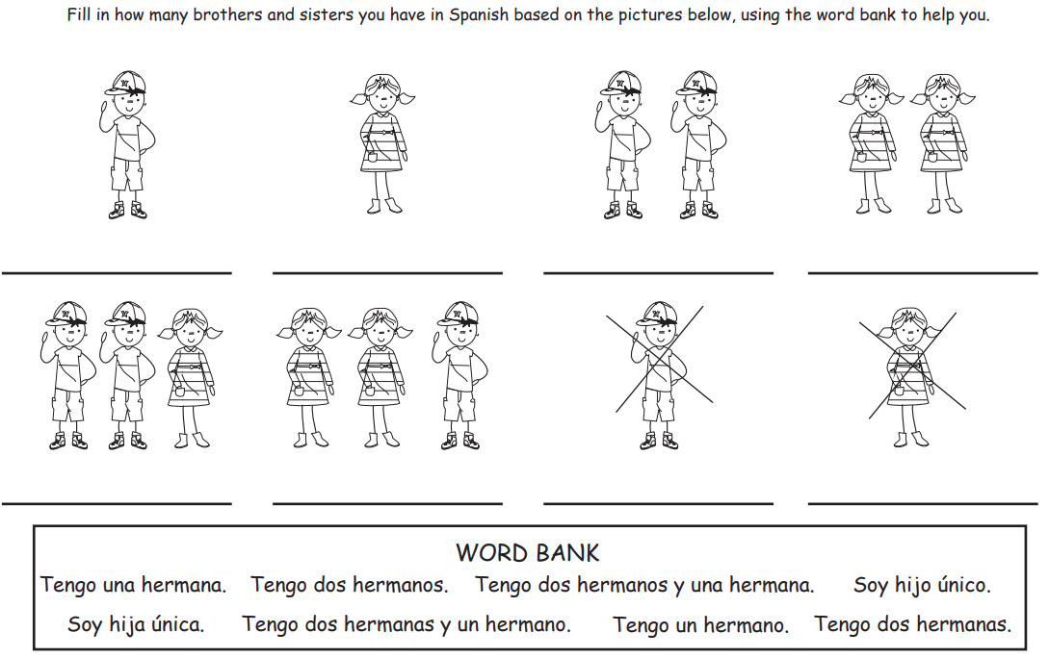
Main Task

Slide 22
Day 5 – Music
Can you remember …
What is pulse?
What is tempo?
What is rhythm?

Slide 23
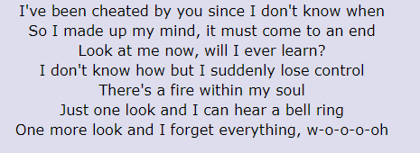
Day 5 – Music
Listen to the song!
Can you remember the first verse?
https://www.youtube.com/watch?v=BogW-2X_X6k

Slide 24
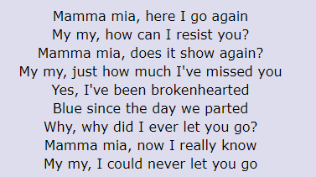
Day 5 – Music
Learn verse 2.
Can you sing it faster or slower? (change the tempo).

