Slide 1
Curriculum
Week Commencing:
30/11/2020

Slide 2
This Week
Day 1: Science- 2 Seasons
Day 2: Art – Season picture
Day 3: Science - Day and Night
Day 4: PSHCE- Choices and how they affect others
Day 5: PE – An autumn dance

Slide 3
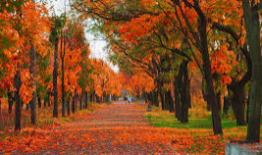
Day 1 – Science - Seasons
Watch this video about the 4 seasons:
https://www.bbc.co.uk/bitesize/topics/zkvv4wx/articles/zcx3gk7
What season is this?
What do you know about Autumn?

Slide 4
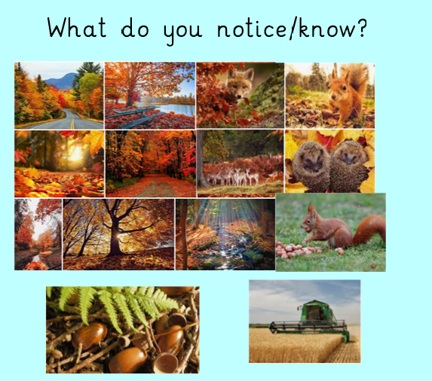
Watch this video and see what you notice:
https://www.bbc.co.uk/teach/class-clips-video/how-autumn-weather-affects-the-behaviour-of-british-animals-and-plants/z6h6nrd
Discussion points for parents during video clip:
This clip shows all the exciting things that happen during this season. Mice and squirrels can be seen gathering and storing nuts.
Deciduous trees lose their leaves which provide food for worms, fungi and slime molds.
Visiting birds such as swallows gather to migrate abroad, while geese arrive from cold countries to overwinter here.
As the days shorten, humans enjoy Halloween and Bonfire Night.
The weather begins to get worse and heavy rains swell rivers and cause flooding.
Frost covers the countryside and as much of the wild food runs out, some mammals begin hibernation.

Slide 5
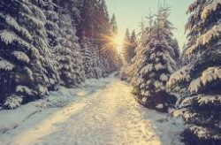
What season is this?
What do you know about Winter?

Slide 6
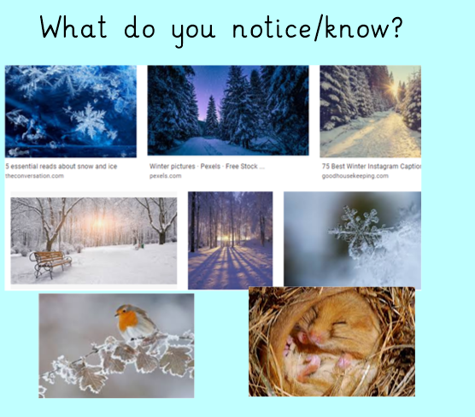
Watch this video and see what you notice:
https://www.bbc.co.uk/teach/class-clips-video/science-ks1-ks2-winter-weather-behaviour-british-animals-plants/zbcg92p
Discussion points for parents while clip is showing:
Winter for animals is not so much fun, and this clip looks at the work animals put in with their continuing quest for food.
Sometimes humans provide food for animals during the winter.
Garden birds are given nuts and sheep are given straw.
Ploughing the soil turns up worms and grubs for seagulls to eat.
Many animals find food without the help of humans so must be ready for any opportunity.
Barn owls watch for mice, a robin keeps an eye on a mole hill and a squirrel searches for a nut it has stored away.
Huge flocks of seabirds dig under the sand and mud for food hidden beneath the beaches.

Slide 7
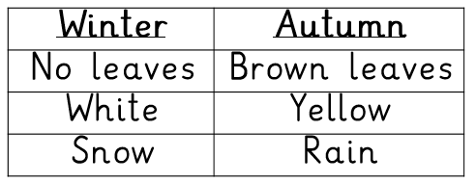
Task – Draw a picture like this and write vocabulary words underneath the picture
Add some of your own ideas too!
Brown leaves
Snow

Slide 8
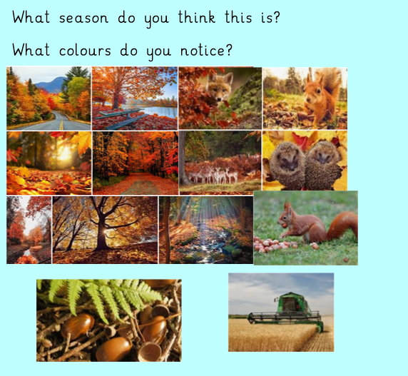
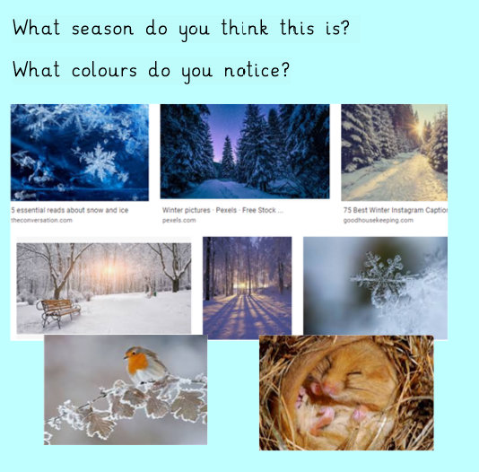
Day 2 – Art –Making a seasonal picture

Slide 9
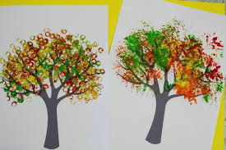
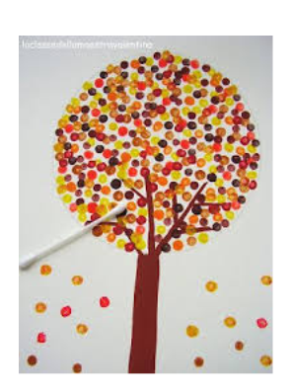
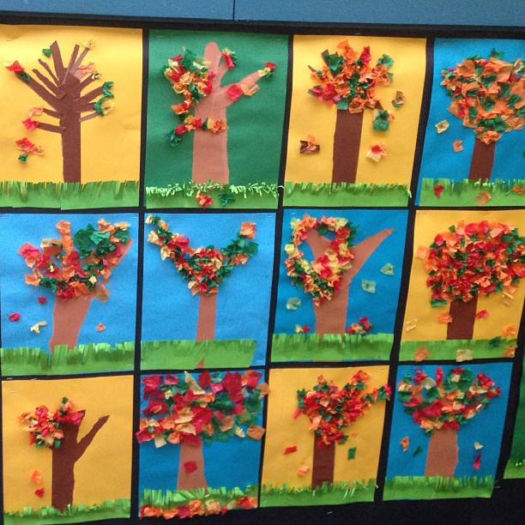
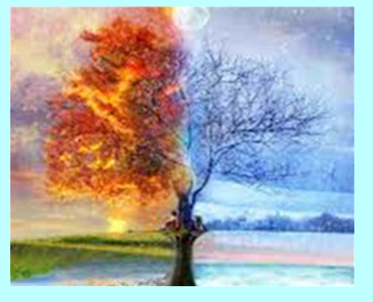
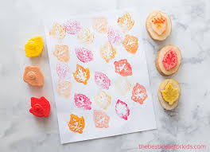
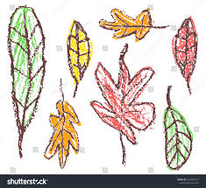
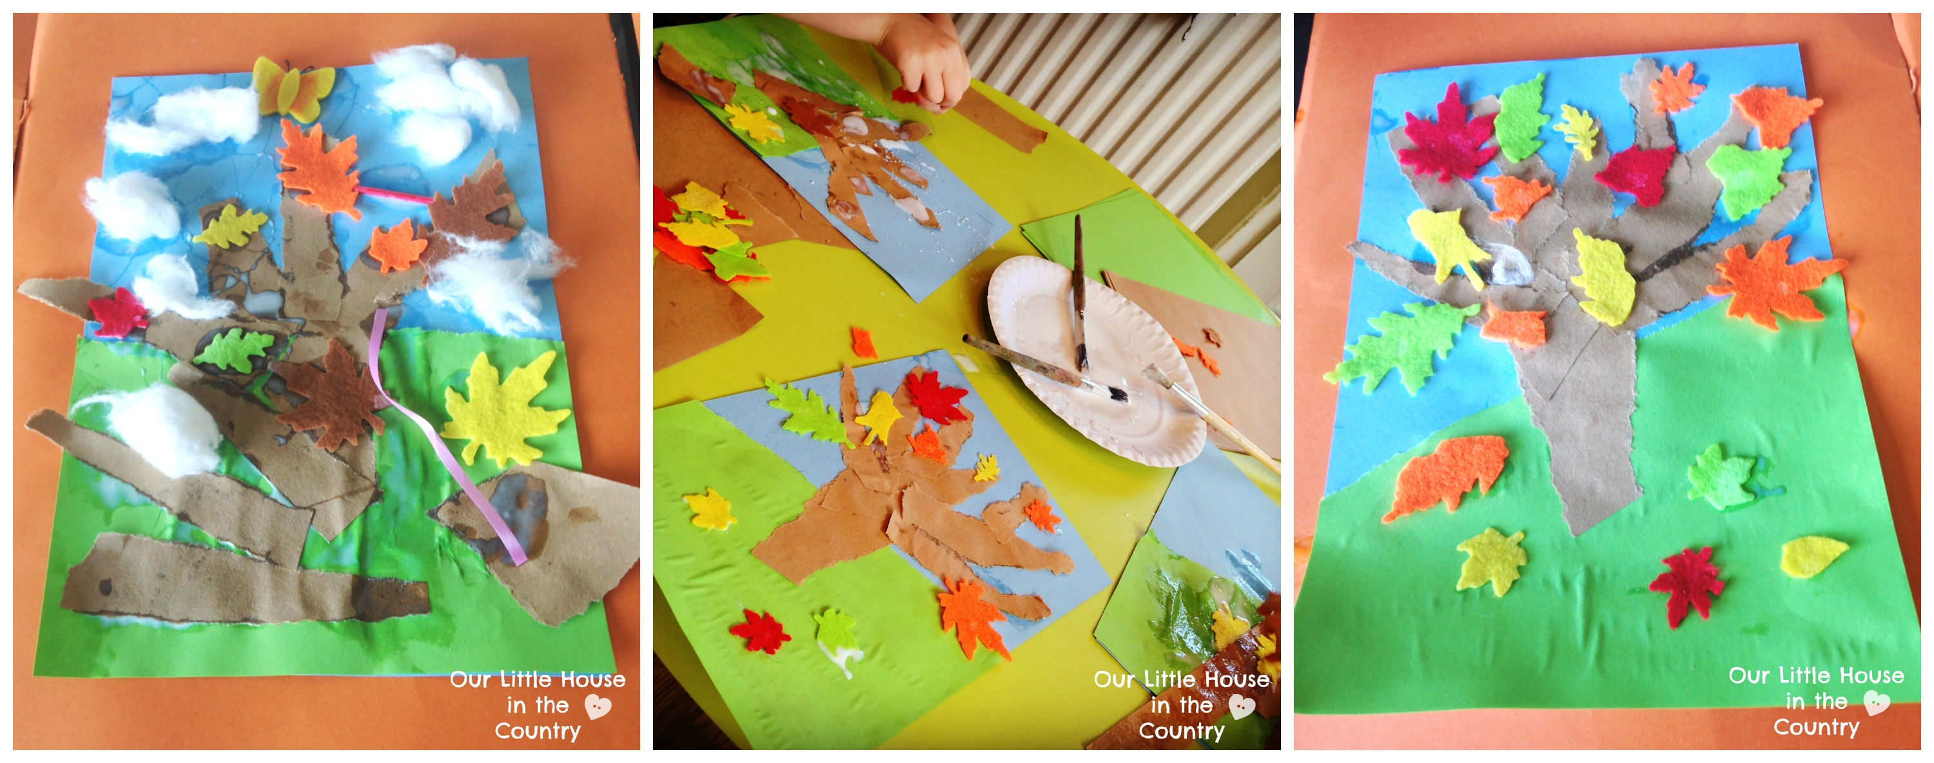
Task – Use what you have…
See what you have around the house and see if you can make a split tree picture. Here are some ideas…

Slide 10
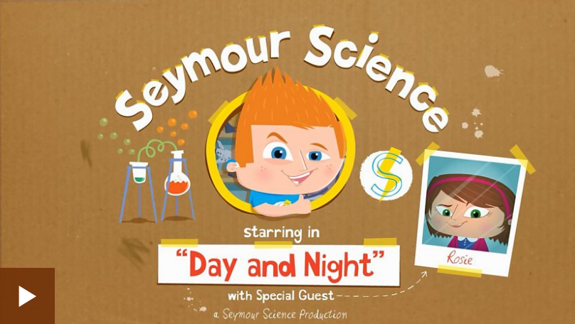
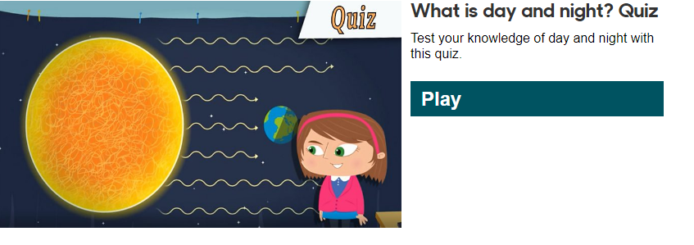
Day 3 – Night and Day
Watch this video: https://www.bbc.co.uk/bitesize/articles/zvfbgwx and then try the quiz

Slide 11
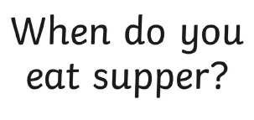
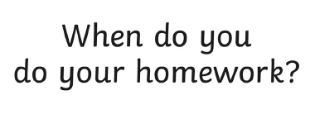
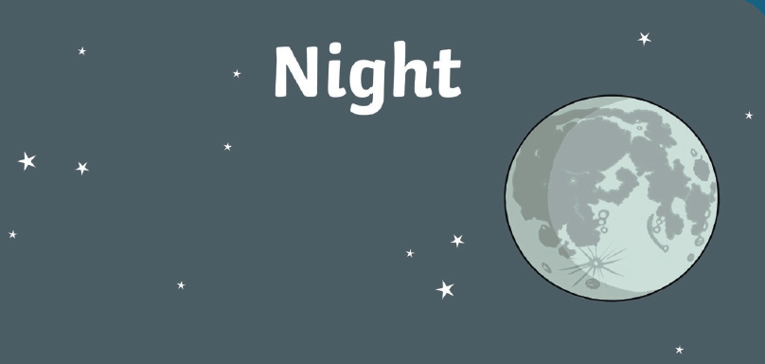
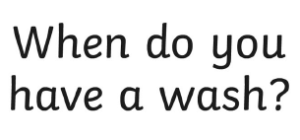
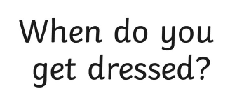
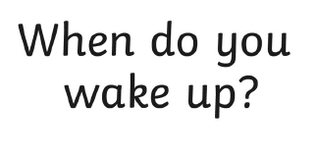
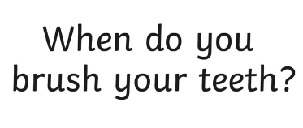
Task – Discuss and answer

Slide 12
Day 4 – PSHCE – How do my choices affect others

Slide 13
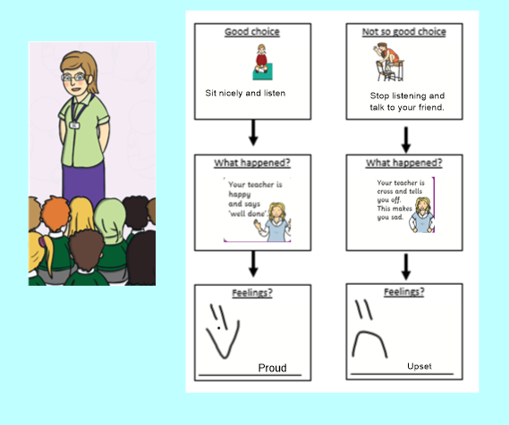
Choices and consequences

Slide 14
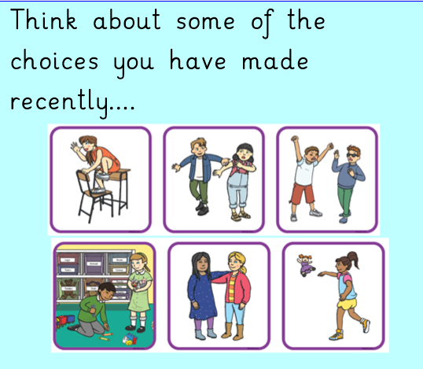
What happened? How did you feel?

Slide 15
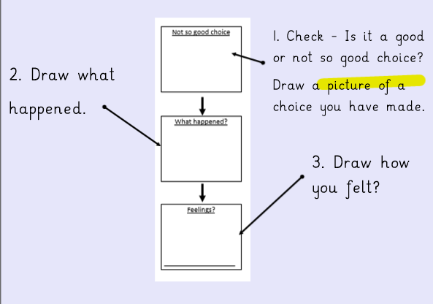
Task – Draw a choice you have made recently and the consequences

Slide 16
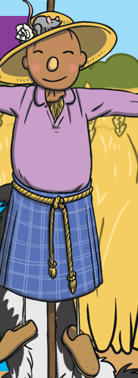
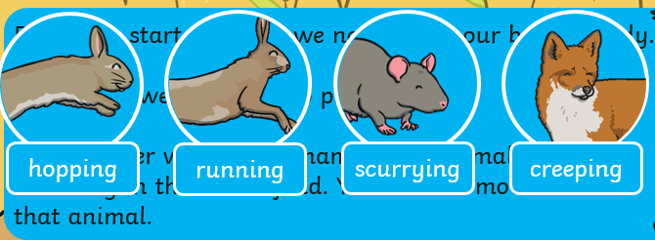
Day 5 – PE – Warm up!
Pretend to be these animals and move around your house
Rabbit: hopping
Hare: running
Field mouse: scurrying
Fox: creeping
Scarecrow: freeze in a scarecrow position

Slide 17
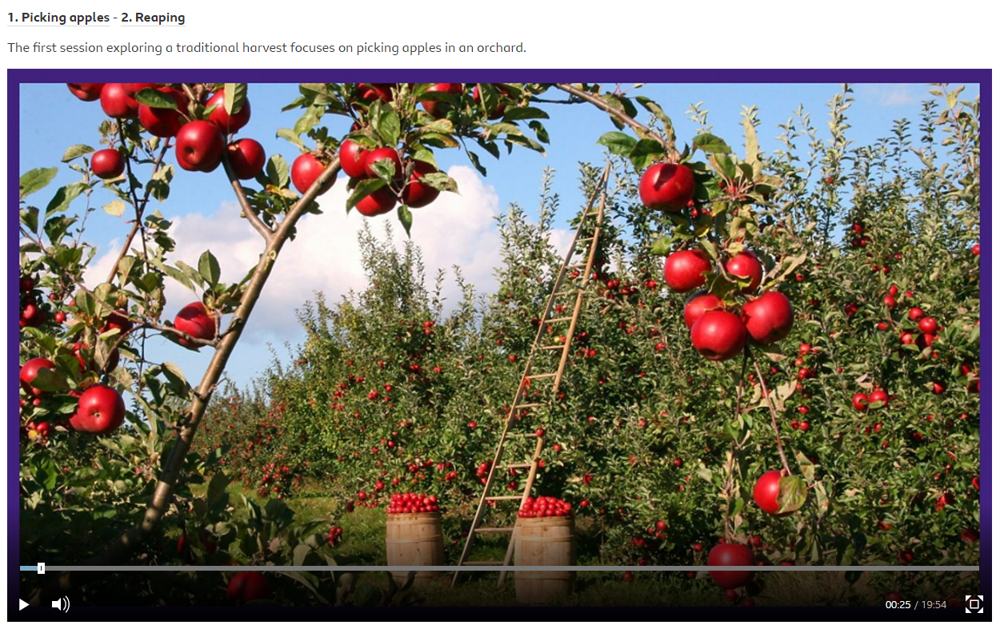
Task - A traditional harvest dance
Go to here and follow the instructions for the harvest dance:
https://www.bbc.co.uk/teach/school-radio/dance-ks1-time-to-move-traditional-harvest-1-picking-apples/zc7bn9q

Slide 18
Lesson summary
Warm up: bending knees and rolling arms over each other to create the shape of rolling barrels. Repeating and getting faster.
Barrel rolling: the barrel rolling sequence is repeated with the addition of a jump and quick travelling steps.
Pairs - picking apples: working in twos in unison, picking apples and passing them down to the barrel.
Pairs - picking apples from lower branches: this time the pairs jump to pick apples from lower branches, then spin together in a circle.
Circle - apple picking dance: each pair is numbered as ‘ones’ and ‘twos’; then one member jumps and picks while the other waits; then swap over; spin at the end.
Circle - rolling barrels together: the barrel rolling is repeated, this time everyone moving together in a circle.
Circle - barrel rolling and apple picking: finally, remaining the circle, pairs combine the movements for barrel rolling and picking apples.

