Slide 1
Curriculum Home Learning
Week Beginning 30.11.20

Slide 2
Weather
In Nursery we are learning about different types of weather. Use the following pictures to discuss different types of weather with your child.

Slide 4
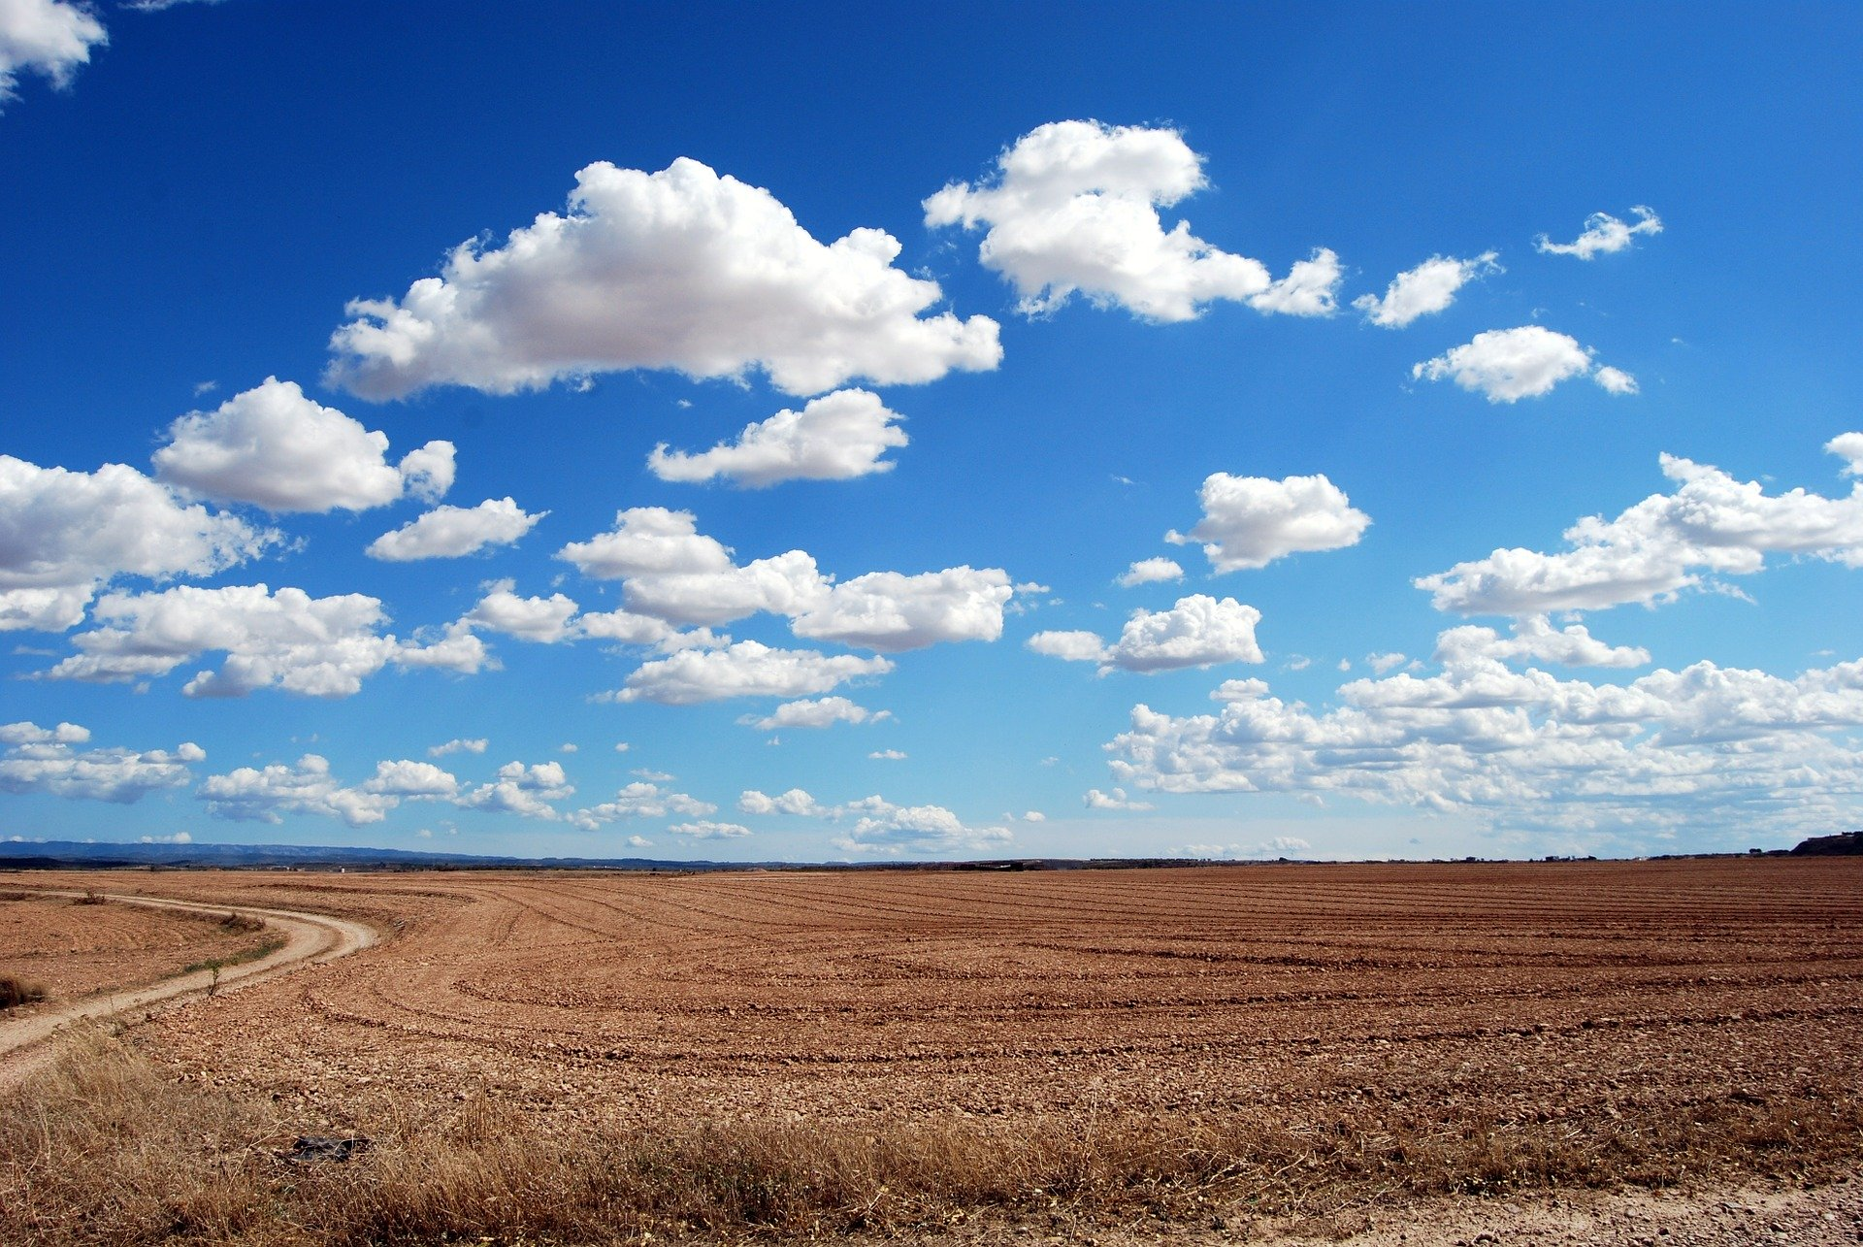
cloudy

Slide 5
overcast

Slide 6
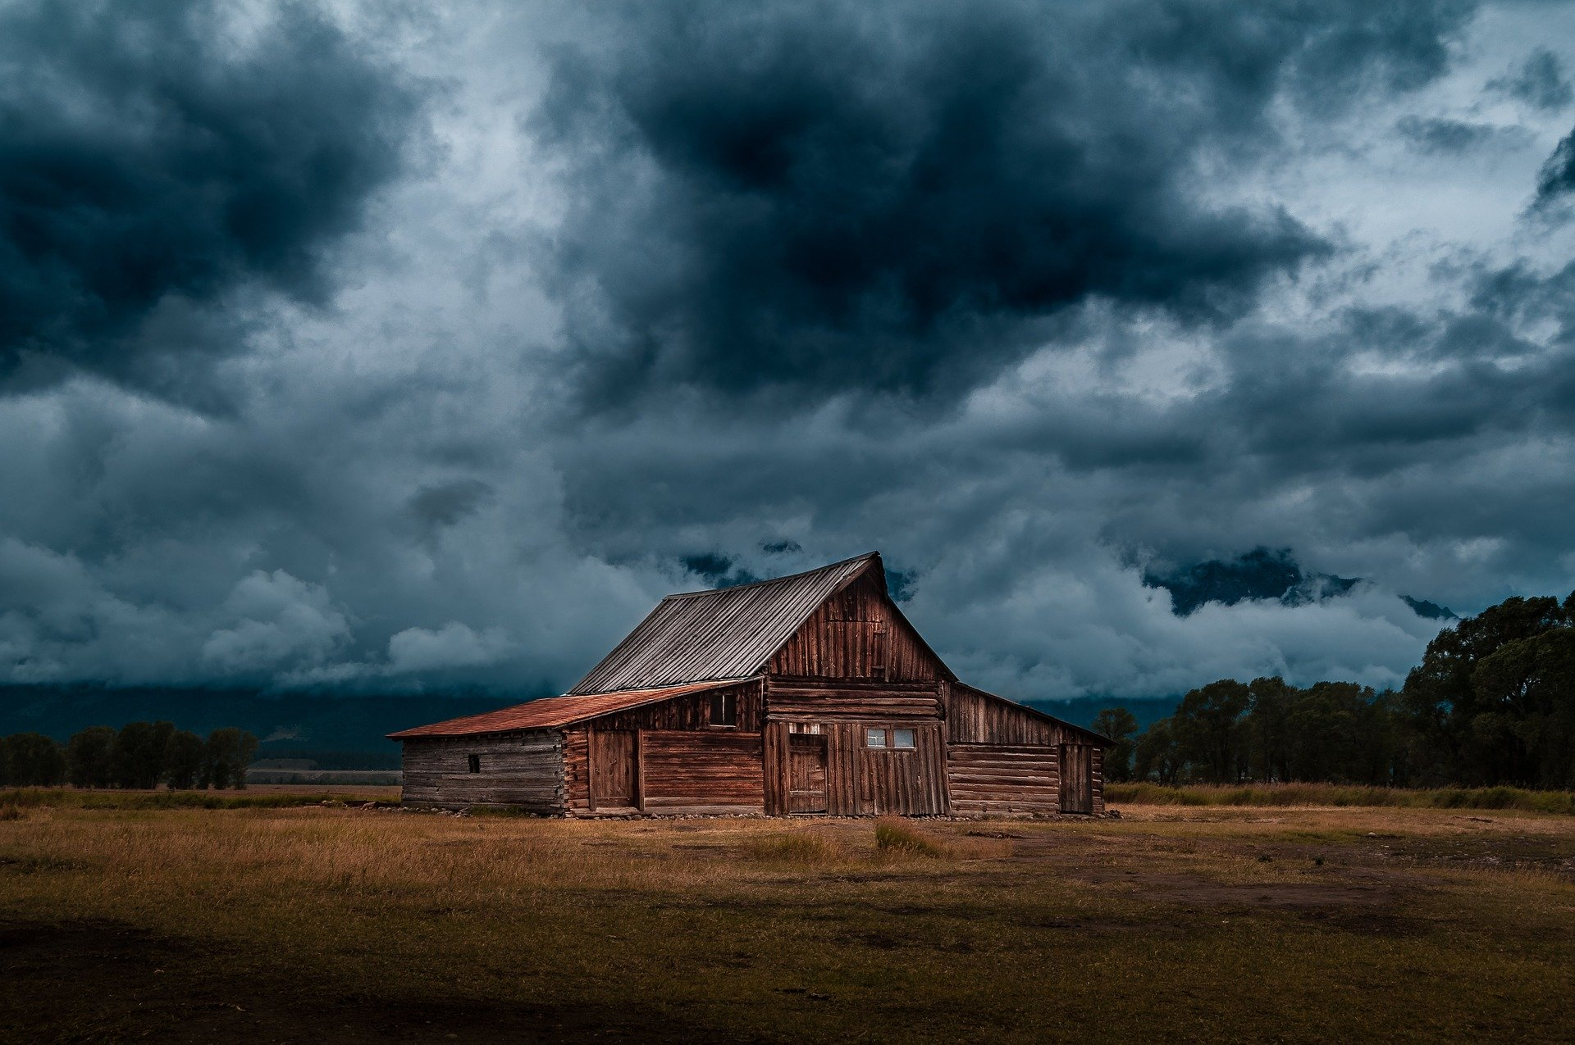
stormy

Slide 7
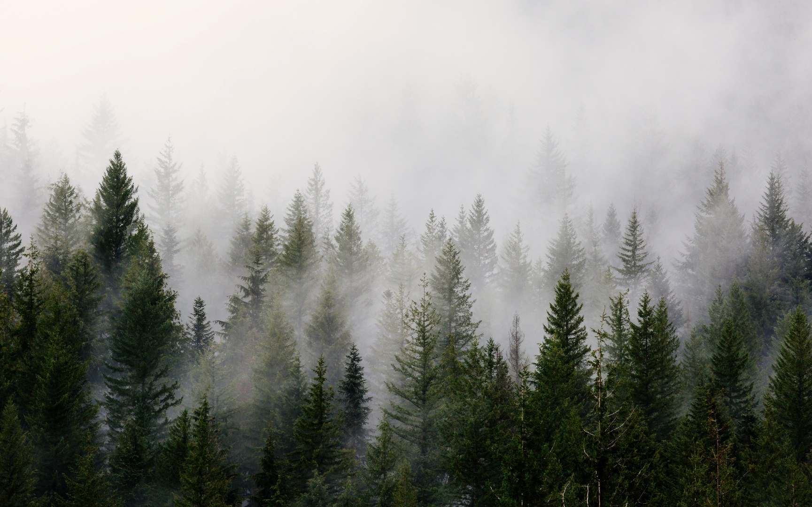
fog

Slide 8
mist

Slide 9
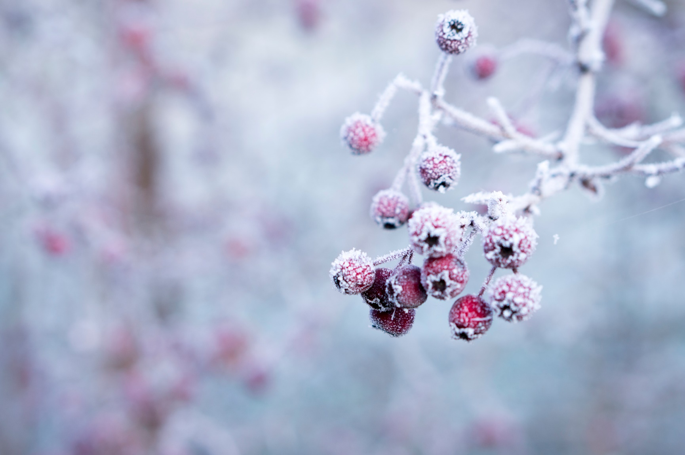
frost

Slide 10
ice

Slide 11
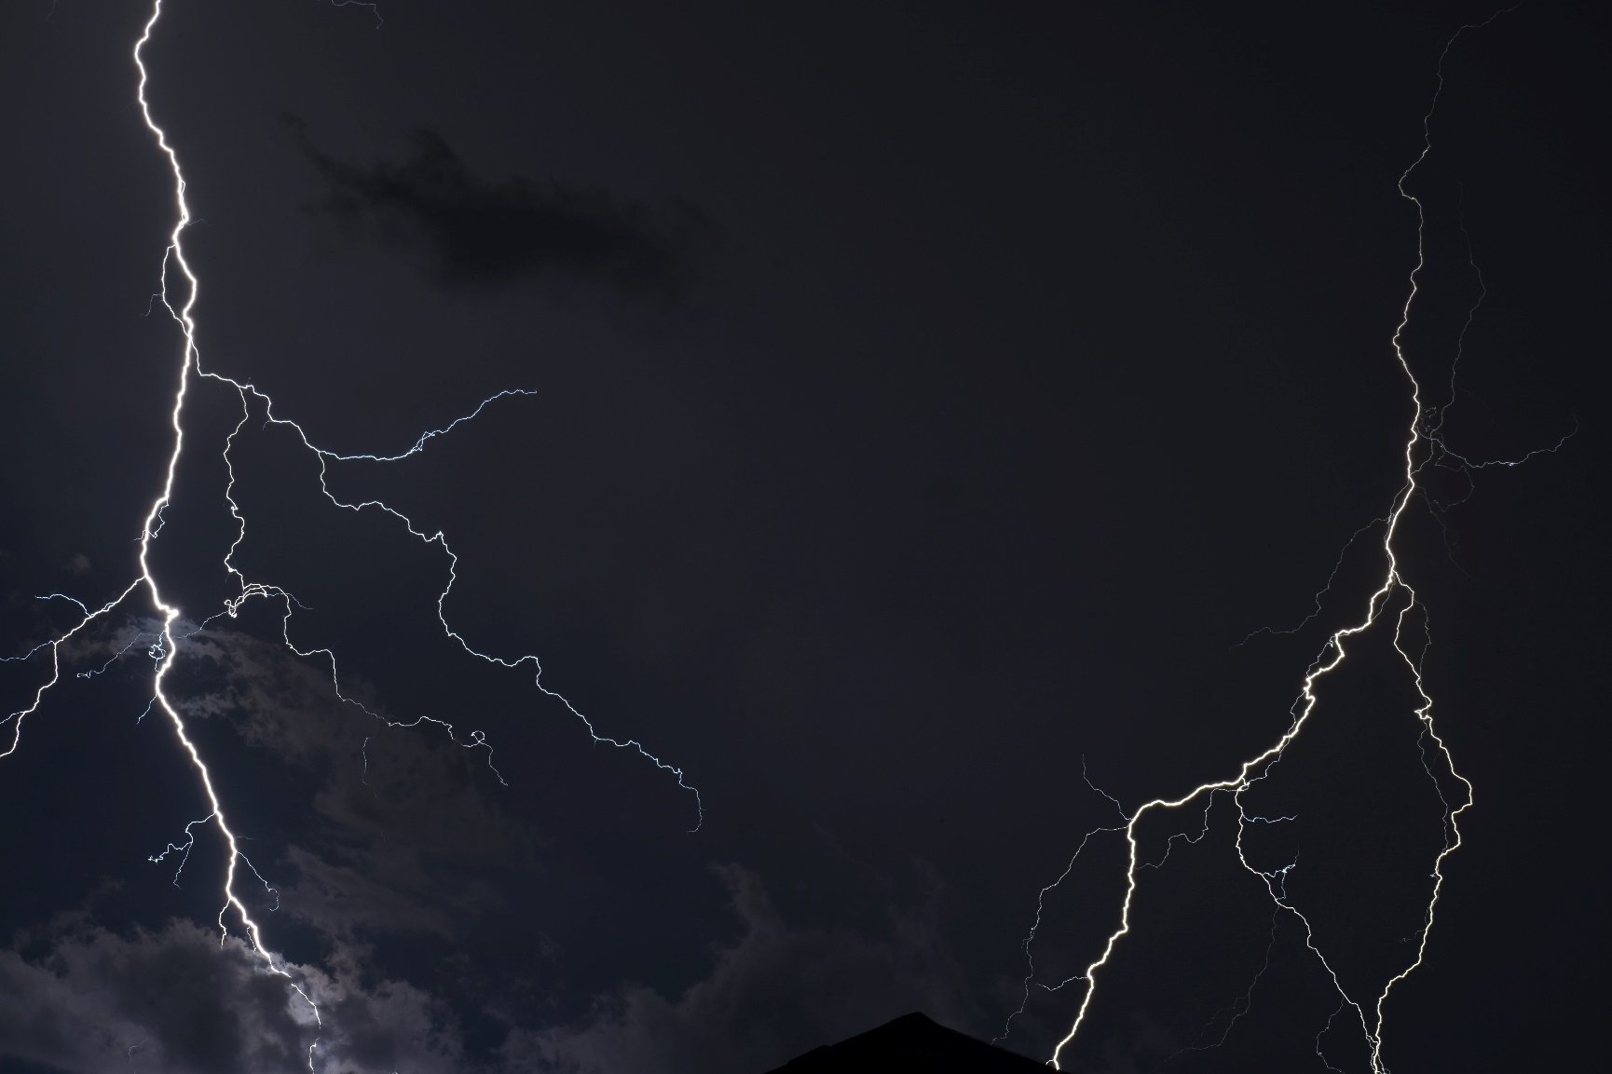
lightning

Slide 12
rain

Slide 13
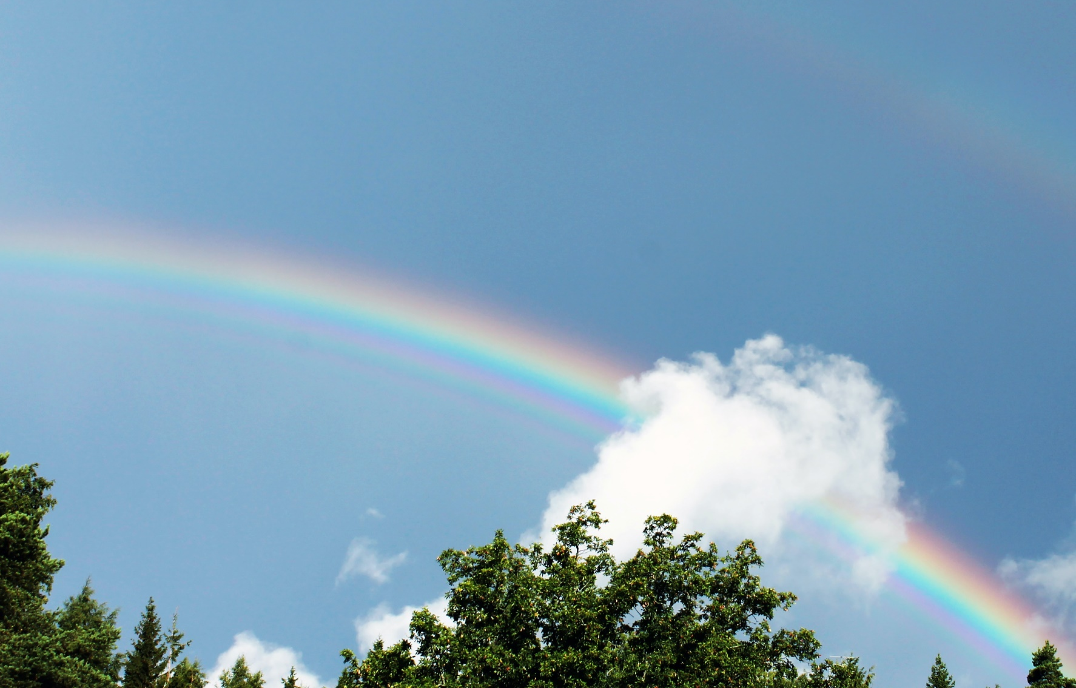
rainbow

Slide 14
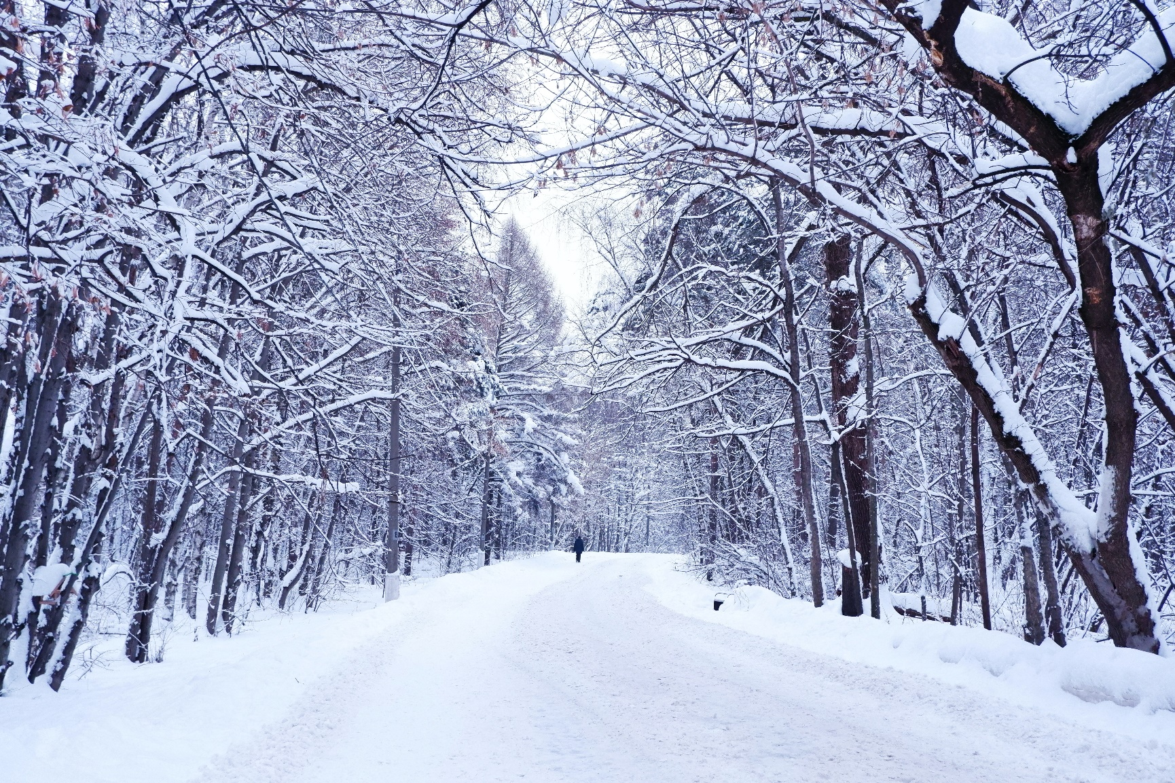
snow

Slide 15
sun

Slide 16
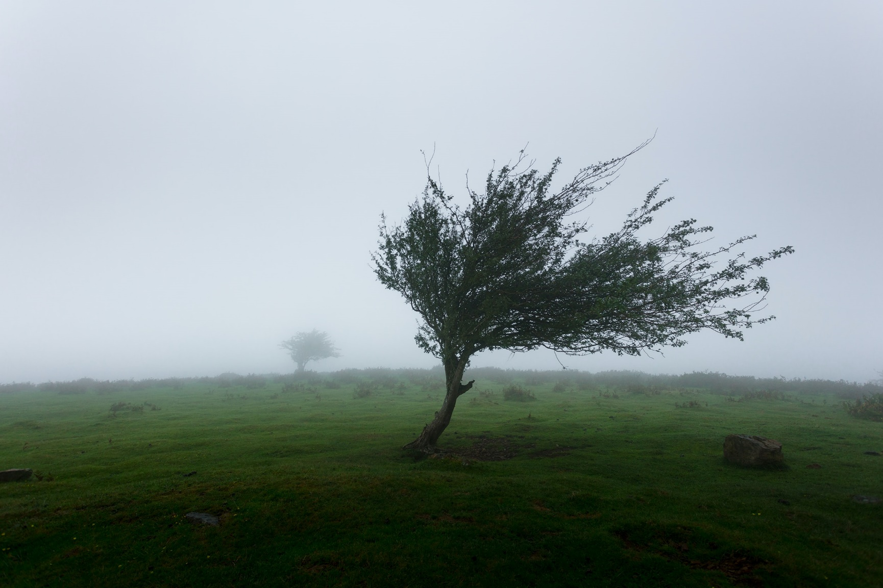
wind

