Slide 1
Curriculum Home Learning
Week Beginning 02.11.20

Slide 2
Fireworks
This week we are learning about fireworks in Nursery.
Use the following slides to encourage your child to talk about fireworks.
Encourage them to speak in full sentences such as…
I can see red sparkles.
Fireworks are loud and make big bangs.

Slide 7
Fireworks
Please use the following slides to discuss firework safety with your child.

Slide 9
Never throw fireworks.

Slide 10
Keep pets indoors.

Slide 11
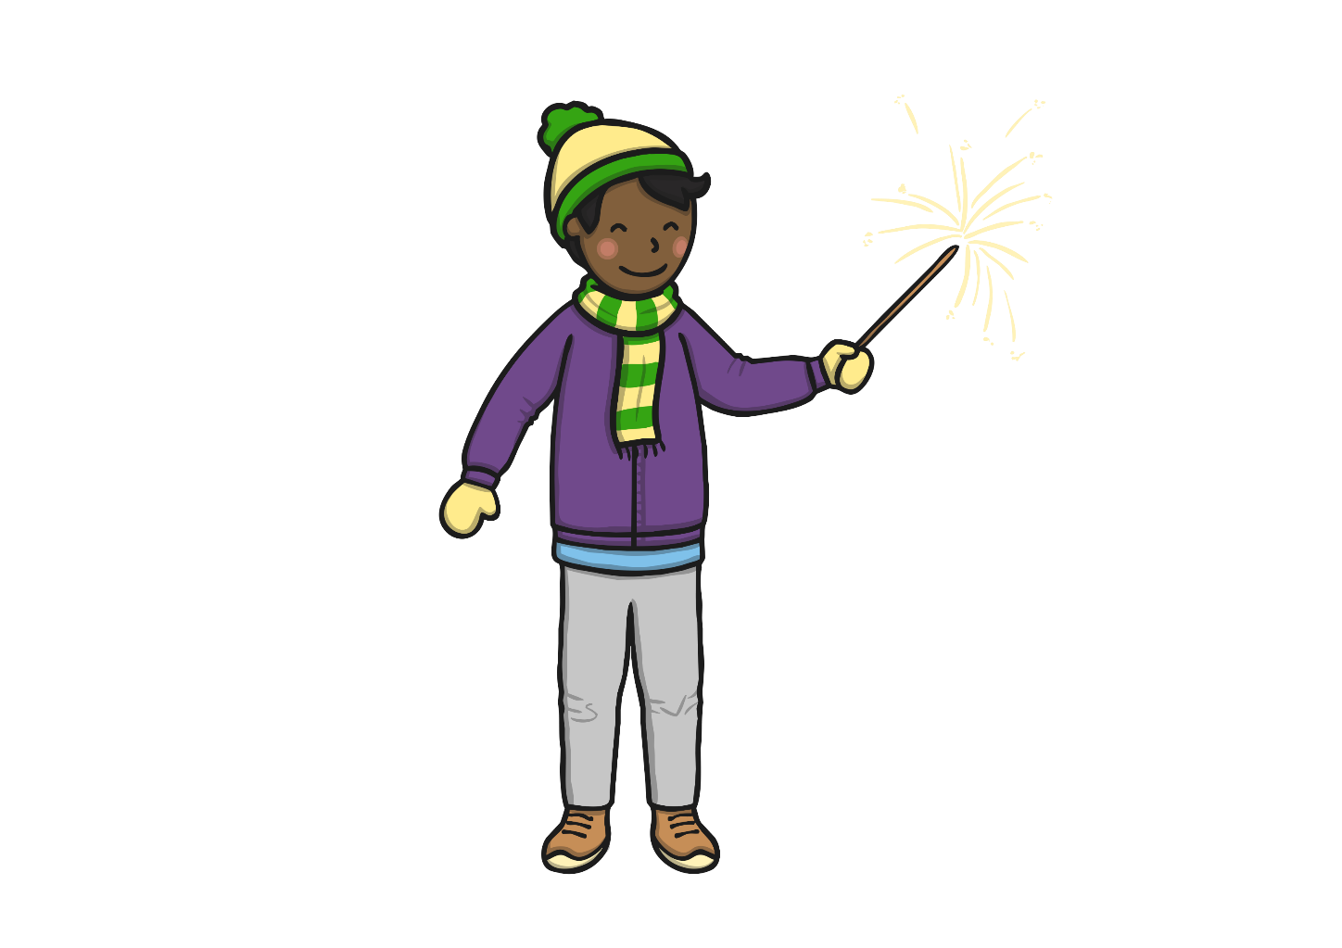
Always wear gloves with sparklers. Never use without help from a grown up.

Slide 12
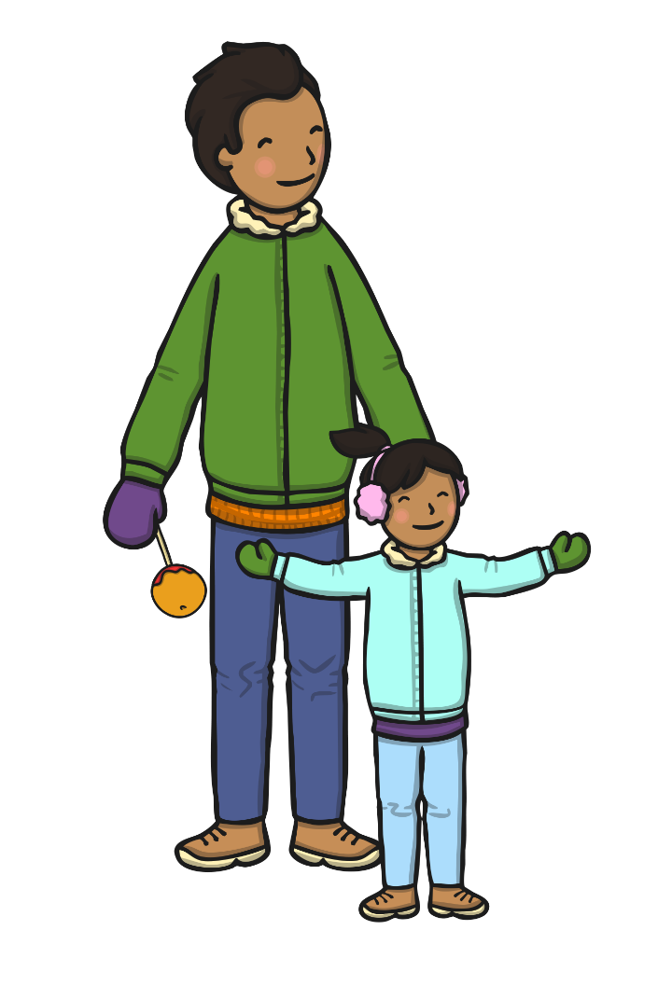
Stand well back.

Slide 13
Never go back to a lit firework.

Slide 14
Fireworks
Why not have a go at some firework crafts. There are lots of great ideas on the website below…
https://www.activityvillage.co.uk/fireworks-crafts
…or you could make a simple picture with coloured crayons.

