Slide 1
Maths – Week 8
Day 1 – Arithmetic: Division
Day 2 – Measurement: Appropriate measures
Day 3 – Measurement: Reading scales
Day 4 – Measurement: Converting units of time
Day 5 – Measurement: Converting units of time

Slide 2
This week we will be practising our 9 time tables
Listen to the video, practise chanting and play the games to practise. What score can you reach?
https://www.timestables.co.uk/9-times-table.html
https://www.topmarks.co.uk/maths-games/hit-the-button

Slide 3
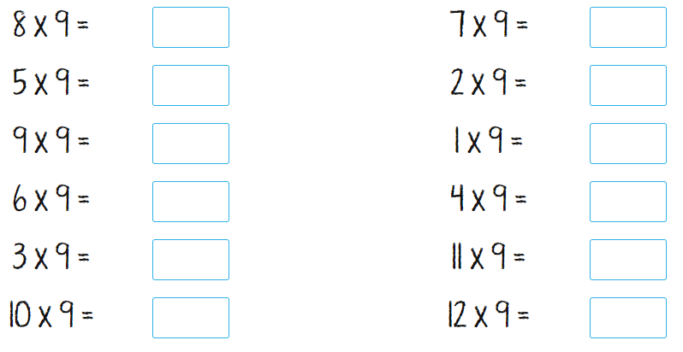
Can you answer these multiplication facts?

Slide 4
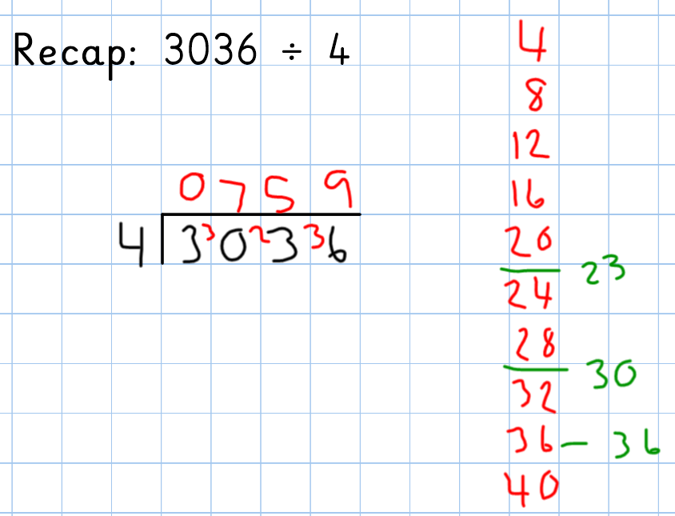
Day 1 - Arithmetic
I begin, with how many groups of 4 are in 3. I know this is 0, so I exchange my 3 to my hundreds column, creating a new number 30.
I then see how many groups of 4 are in 30. I know 4x7=28, so there are 7 groups of 4 in 30 with a remainder of 2. I carry this remainder to the next column.

Slide 5
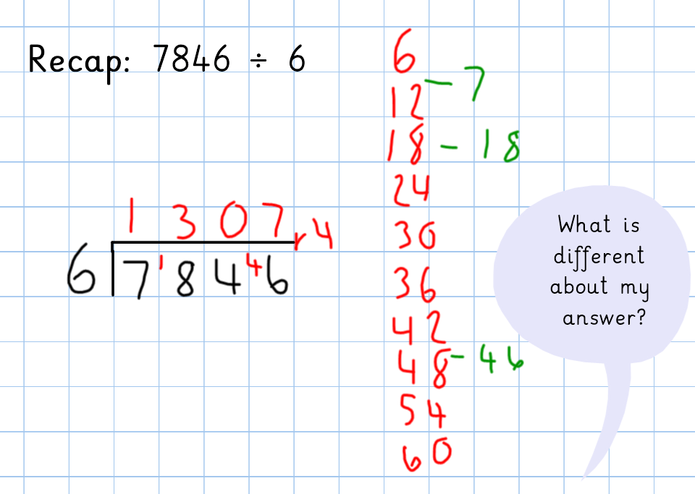

Slide 6
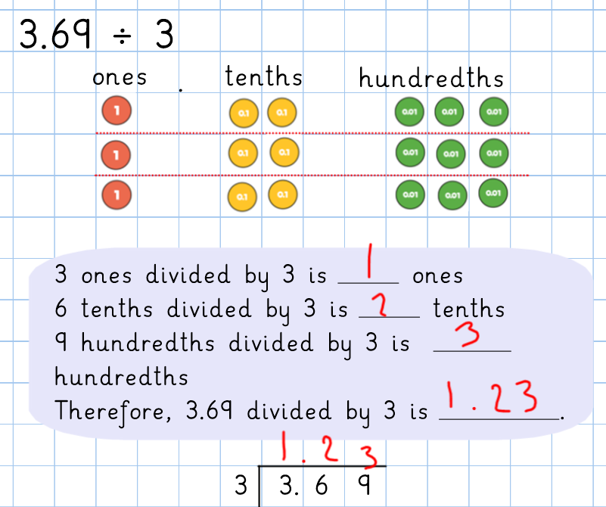
Today we will be looking at dividing using decimals. The method is the same except we need to remember to use our decimal places.

Slide 7
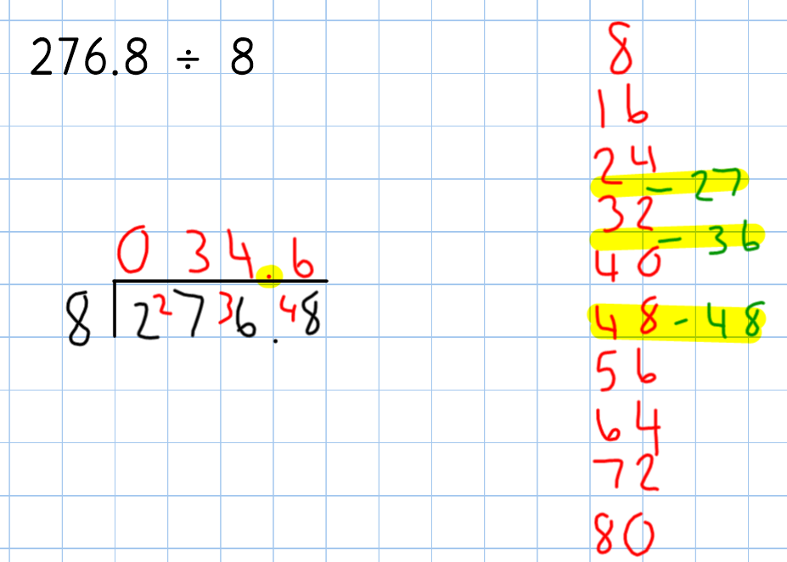

Slide 8
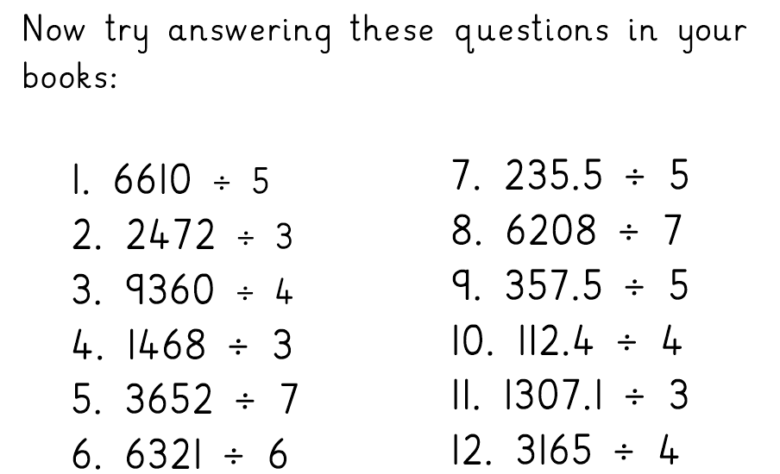

Slide 9
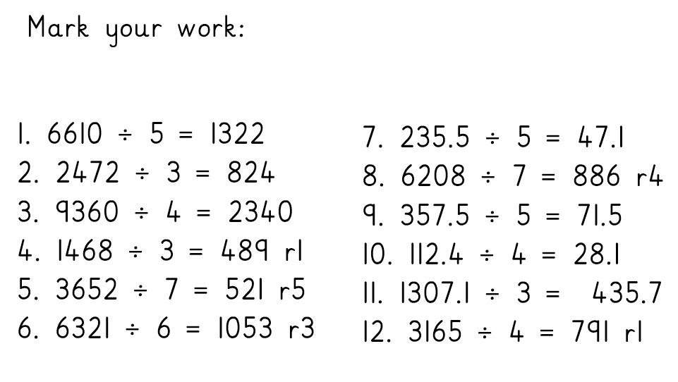

Slide 10
Day 2 – Appropriate measurement

Slide 11
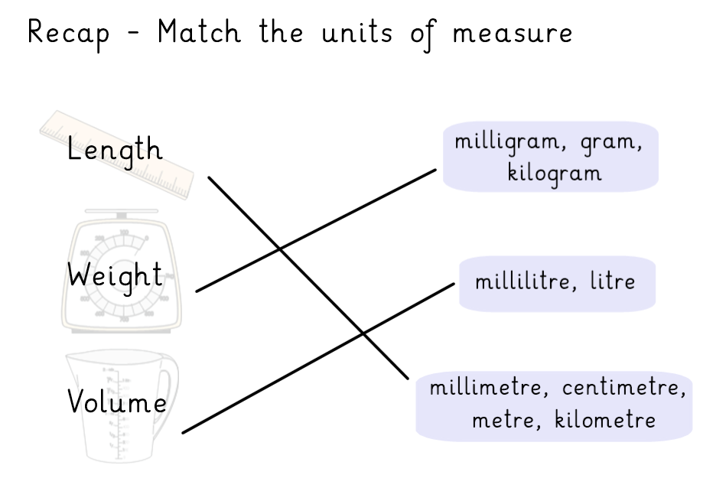

Slide 20
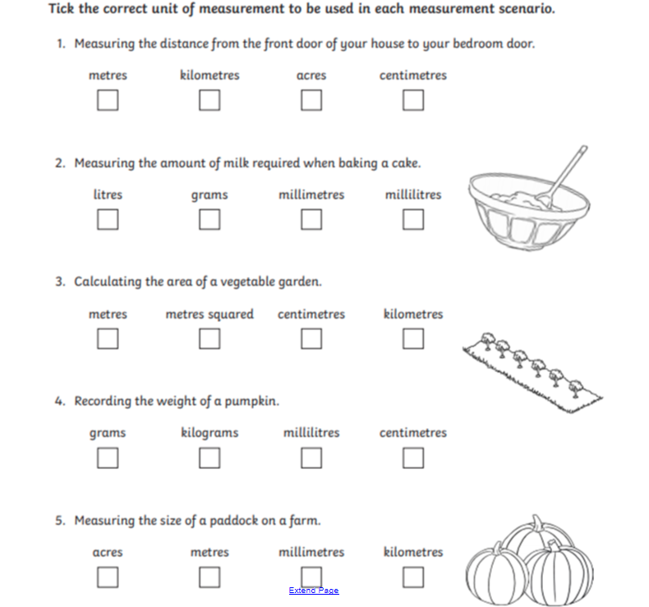

Slide 21
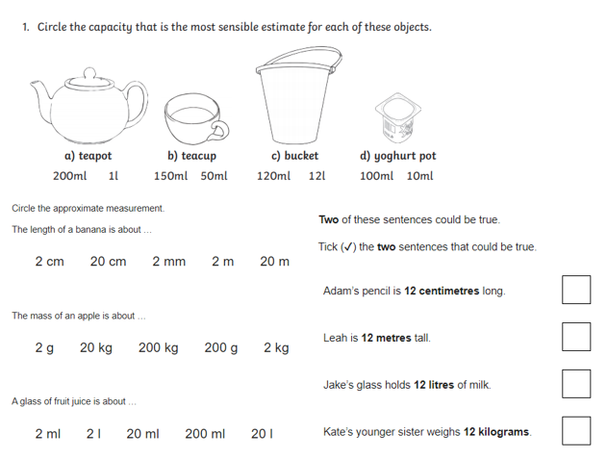

Slide 22
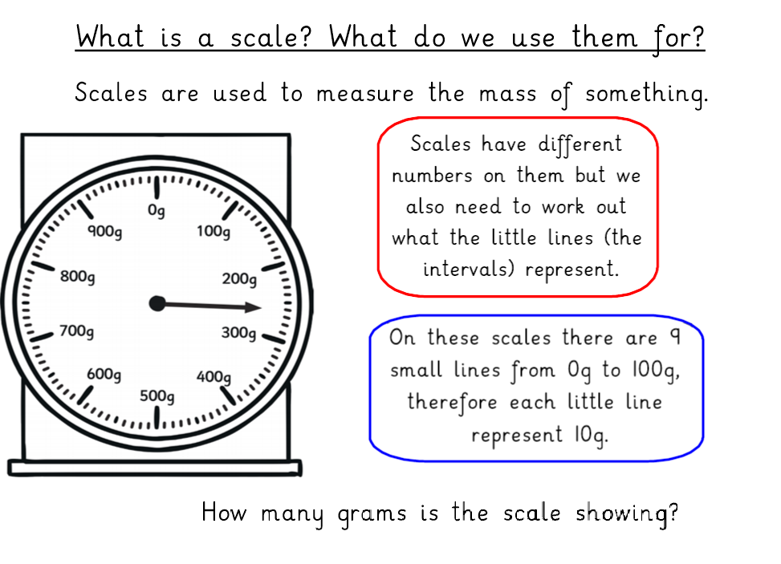
Day 3 – Reading Scales

Slide 23
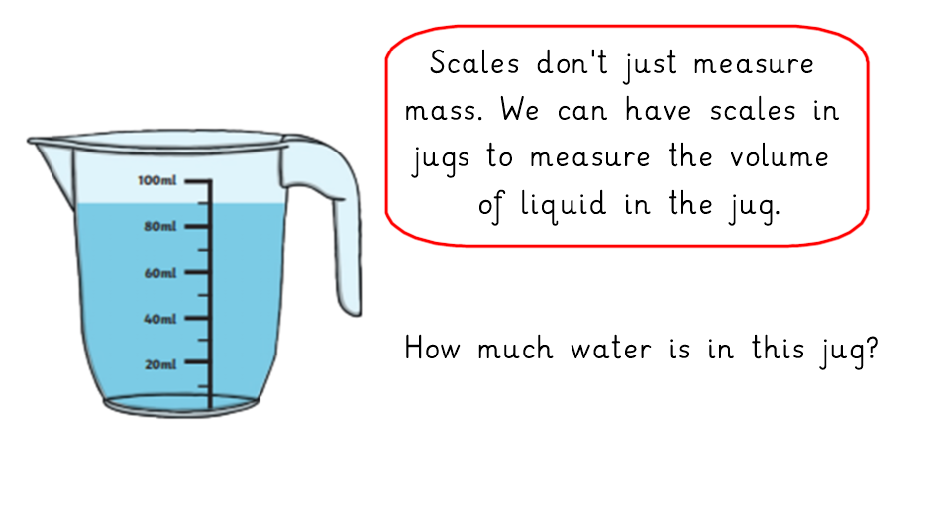

Slide 24
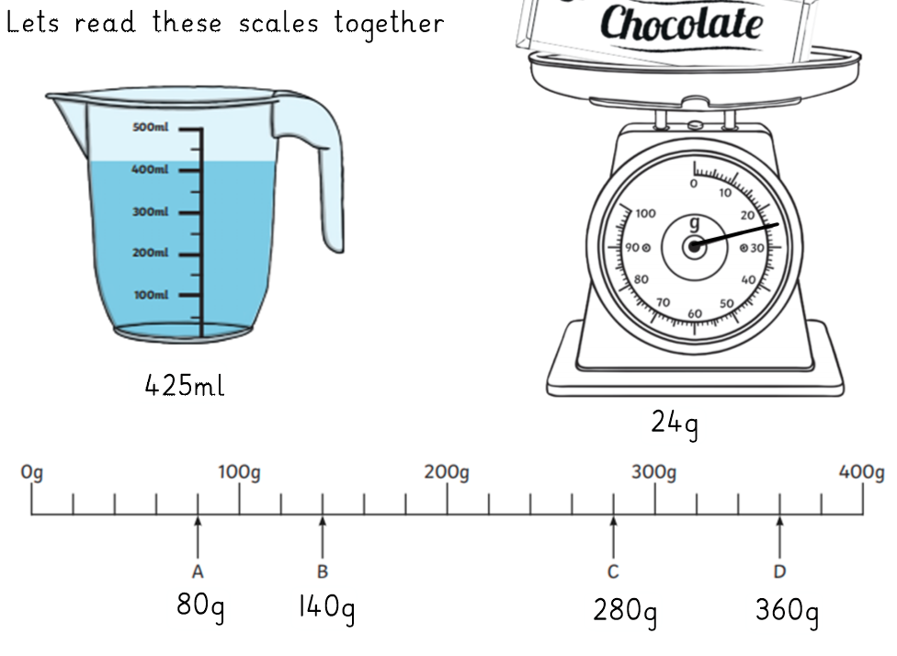

Slide 25
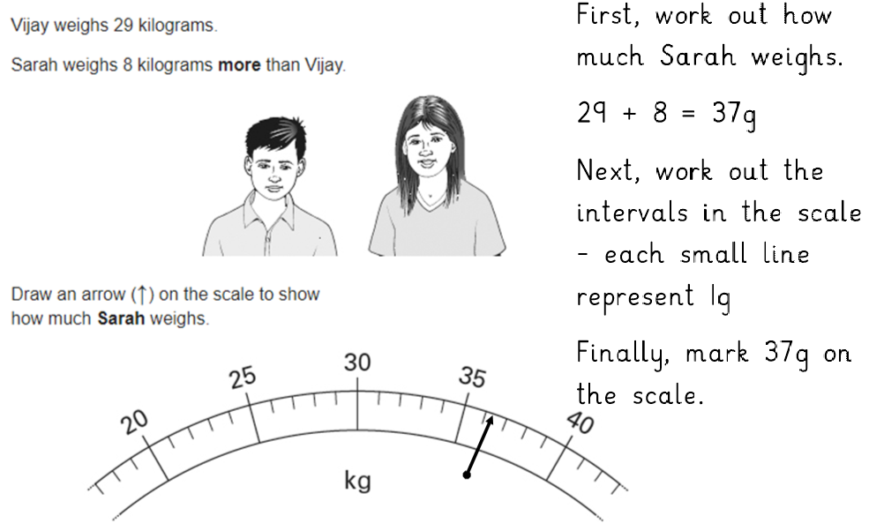

Slide 28
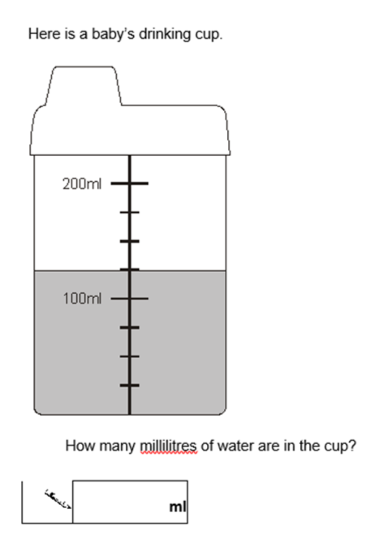

Slide 29
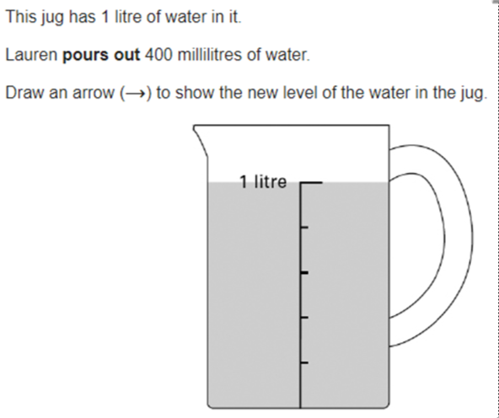

Slide 30
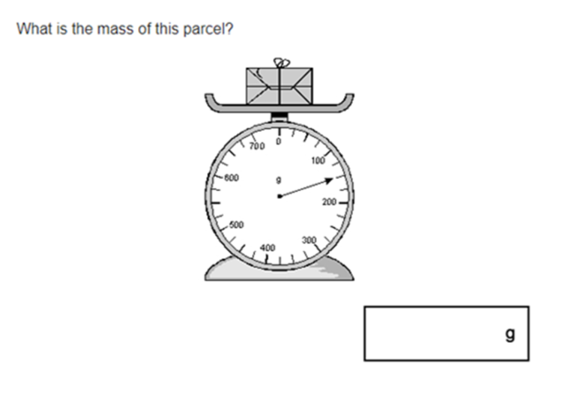

Slide 31
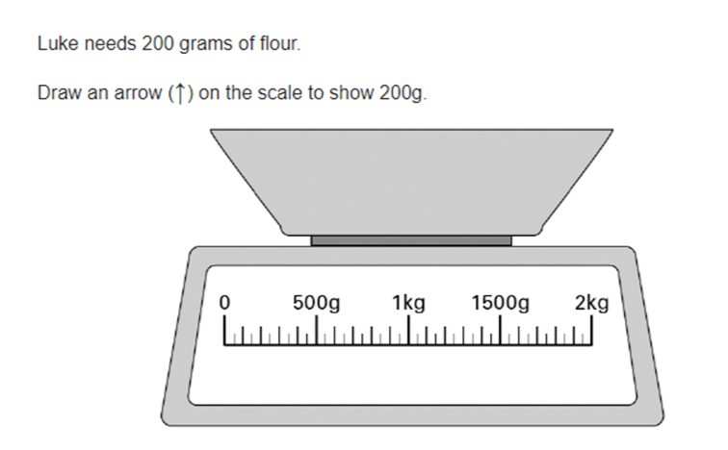

Slide 32
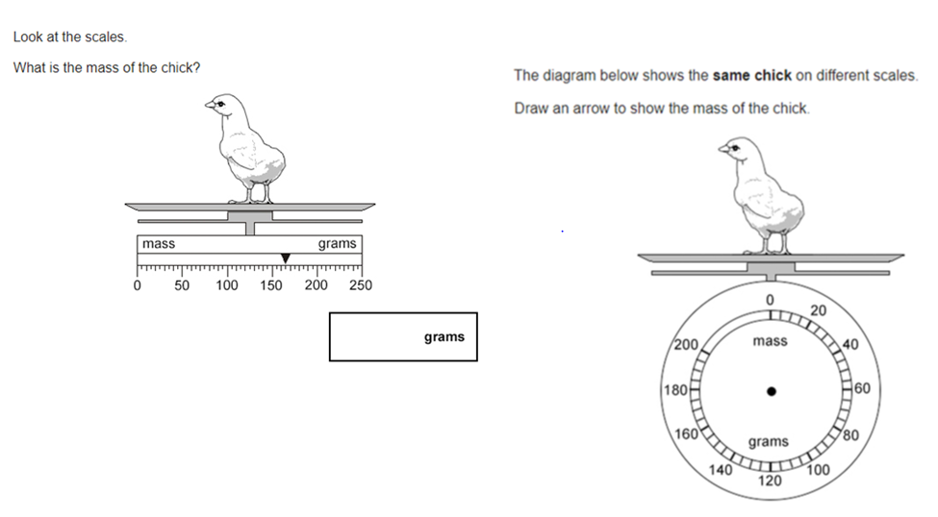

Slide 33
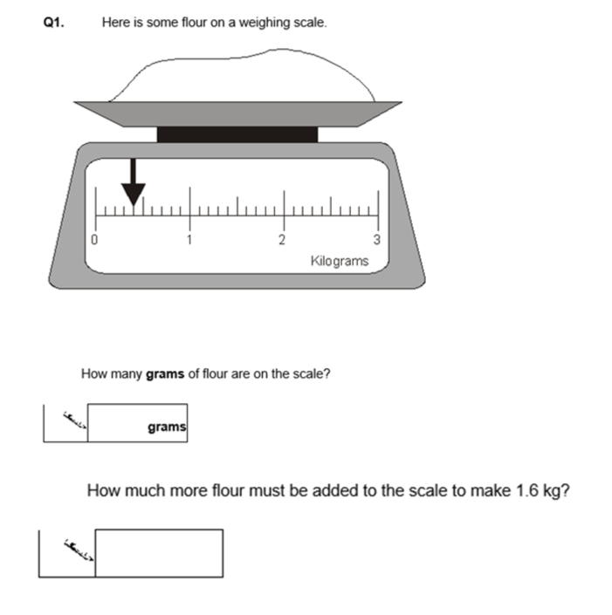

Slide 34
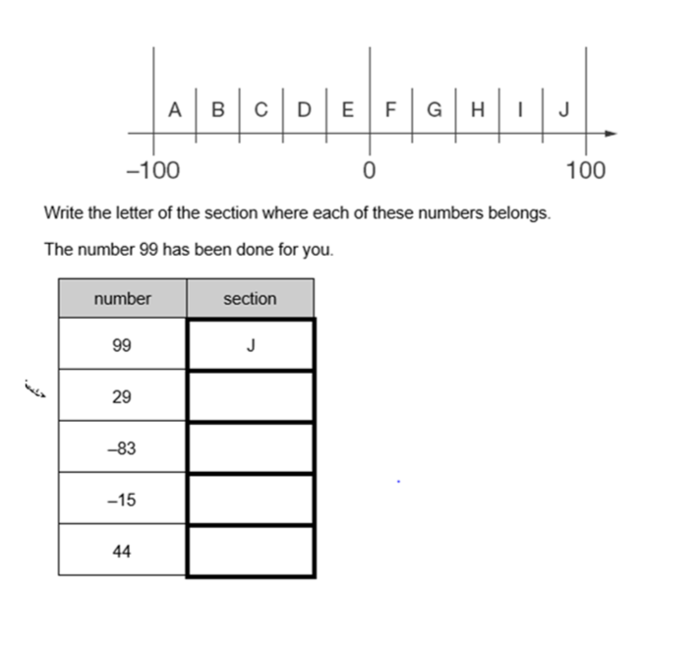

Slide 35
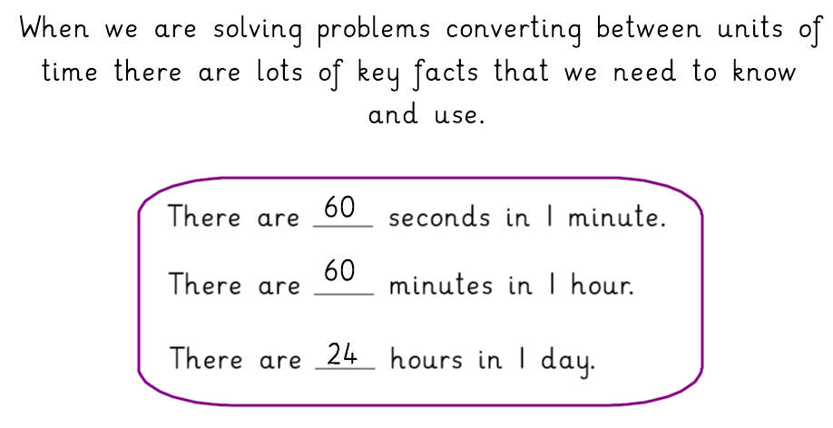
Day 4 and 5 – Converting units of time

Slide 37
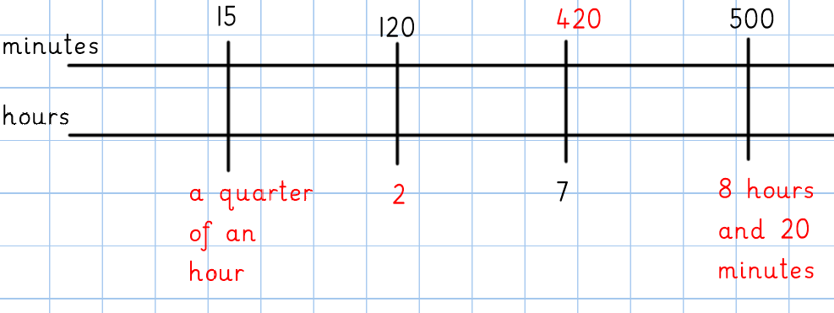

Slide 38
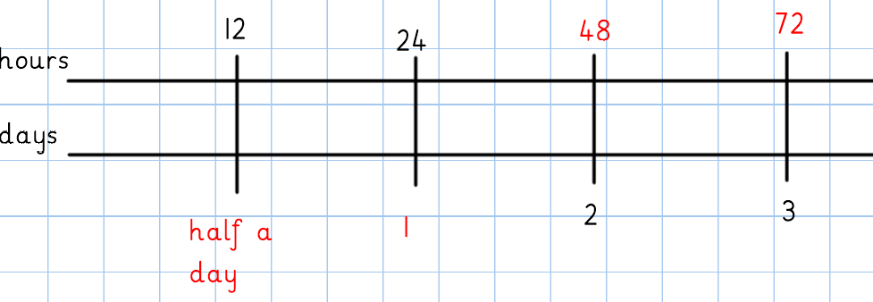

Slide 39
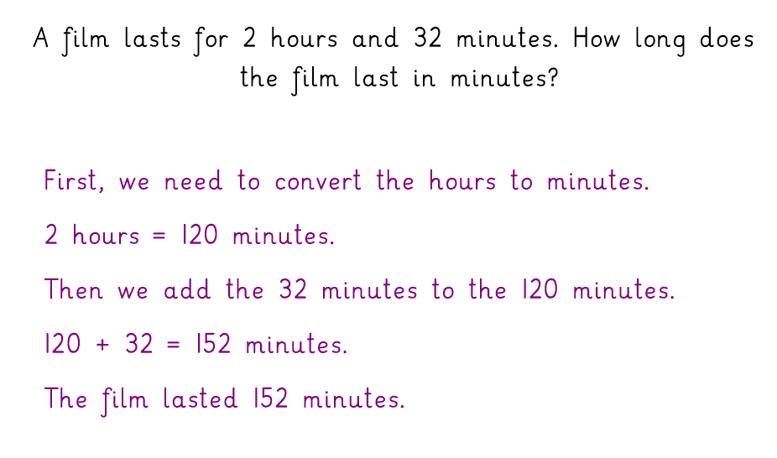

Slide 41
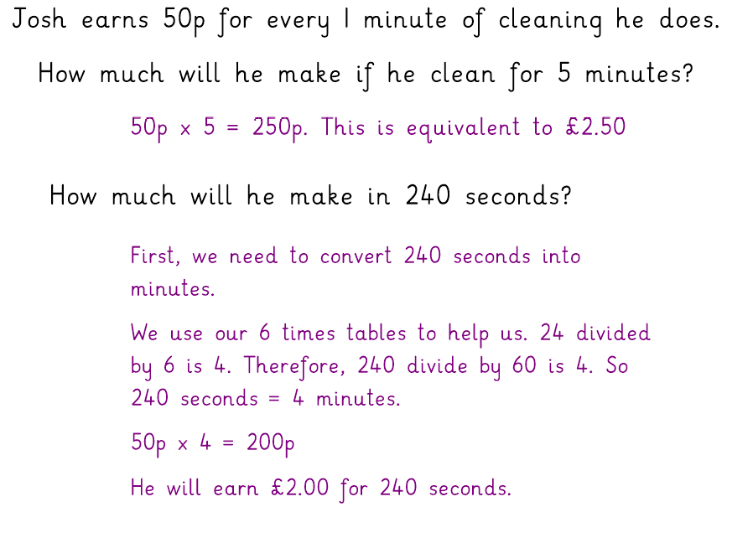

Slide 45
Complete these activities

Slide 46
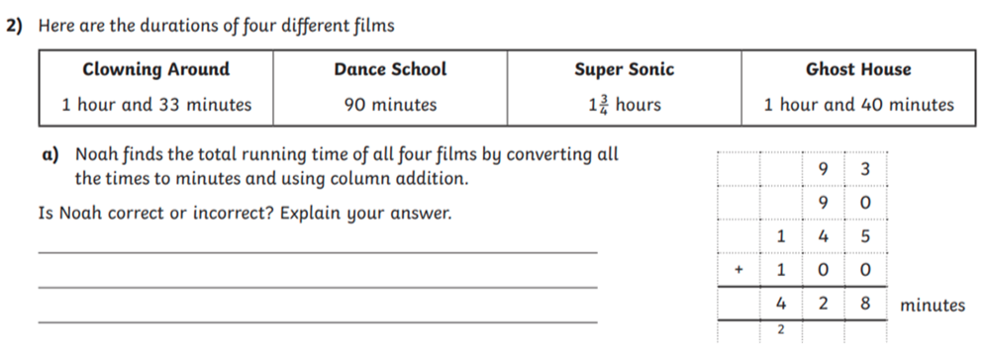

Slide 47
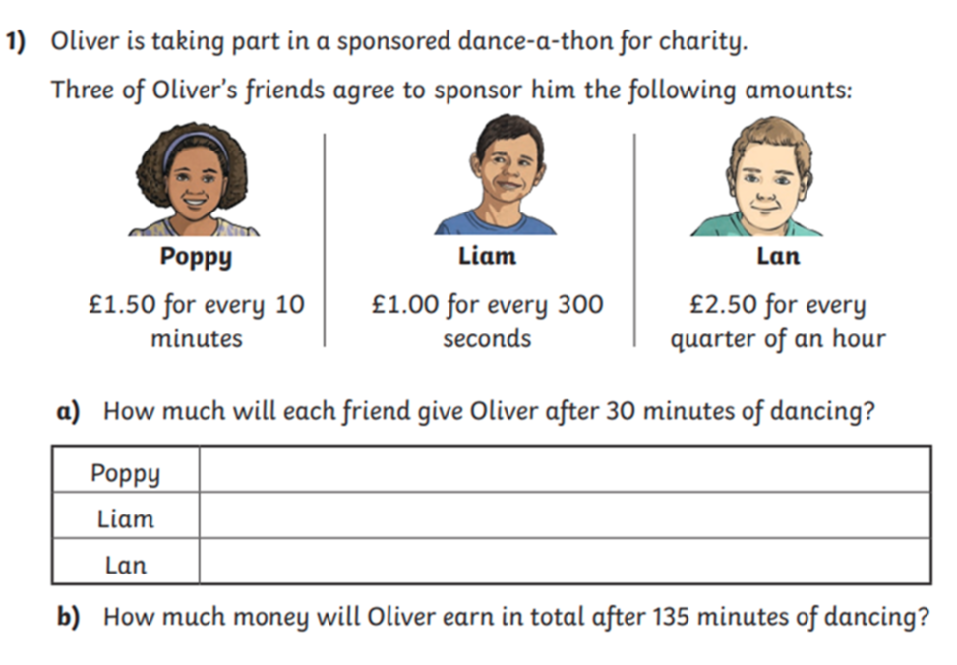

Slide 48
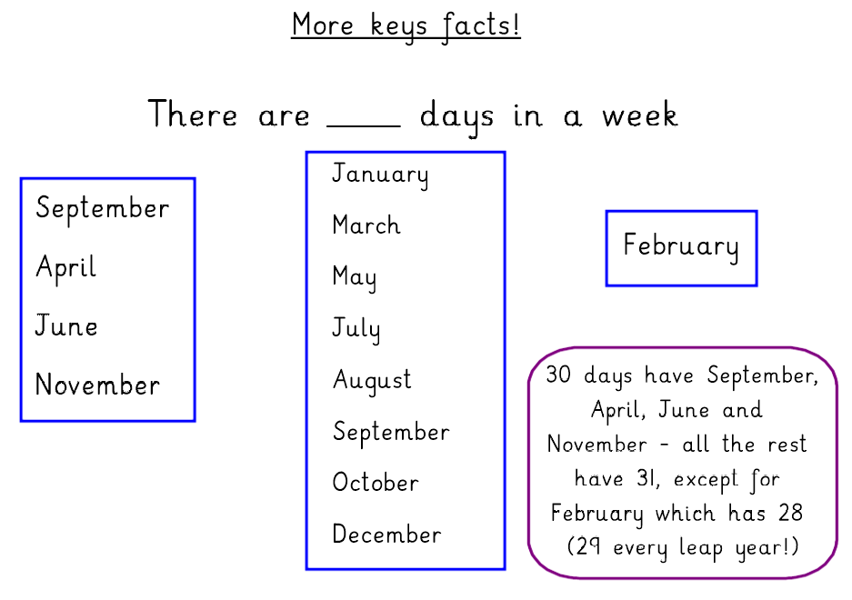

Slide 49
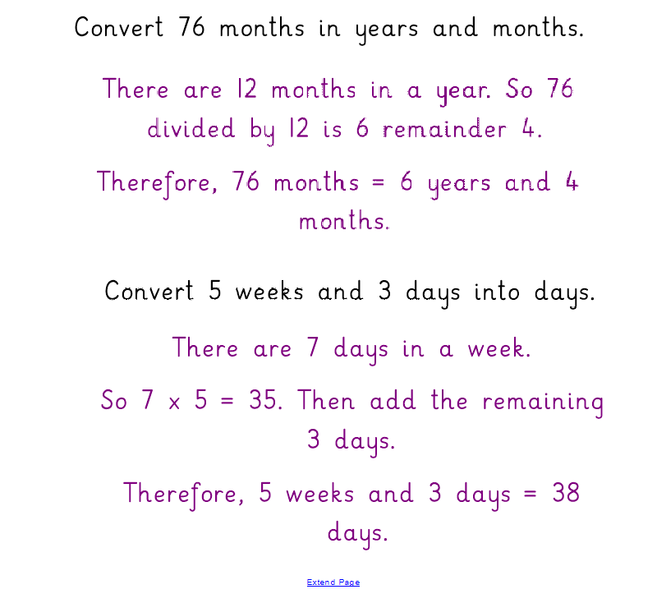

Slide 50
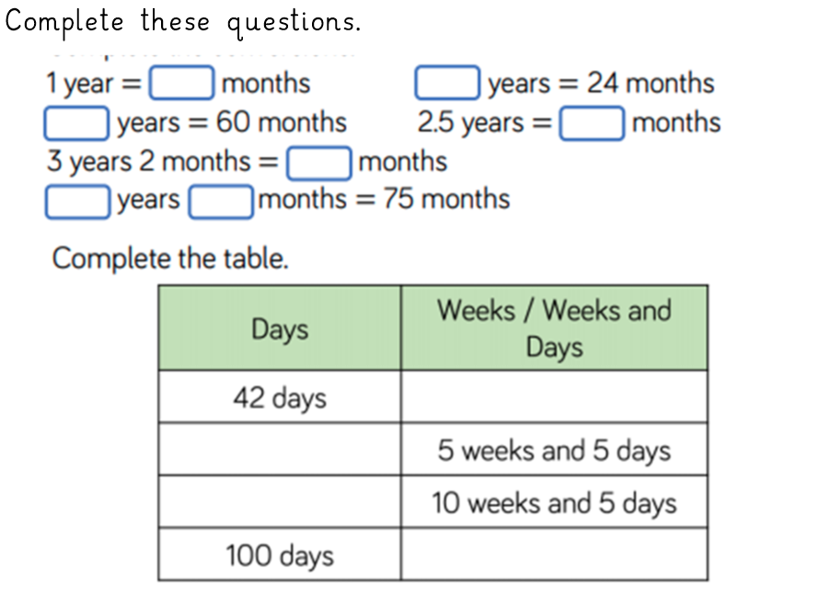

Slide 51
