Slide 1
Maths Home Learning
Week Beginning 05.10.20

Slide 2
This week…
Day 1- Arithmetic test
Day 2 – Translation
Day 3 – Reading and interpreting tables
Day 4 – Reading and interpreting line graphs
Day 5 – Drawing and plotting line graphs

Slide 3
Day 1 – Arithmetic test
Complete the following Arithmetic test, use your homework books or spare paper for working out the methods.
You only have 30 minutes to complete the test – ask an adult to help time you.
Try your best and good luck.

Slide 4
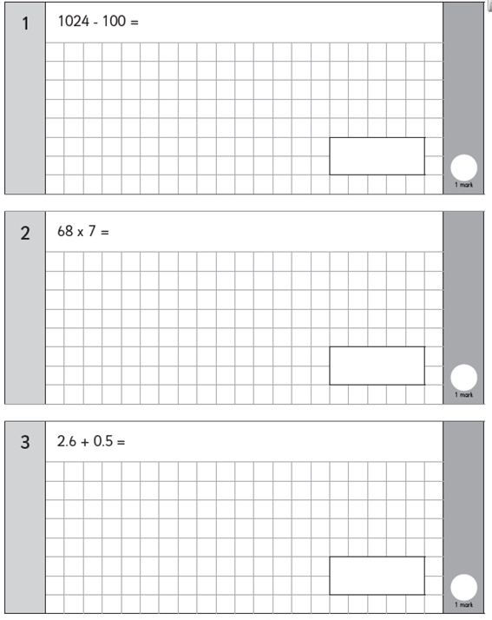
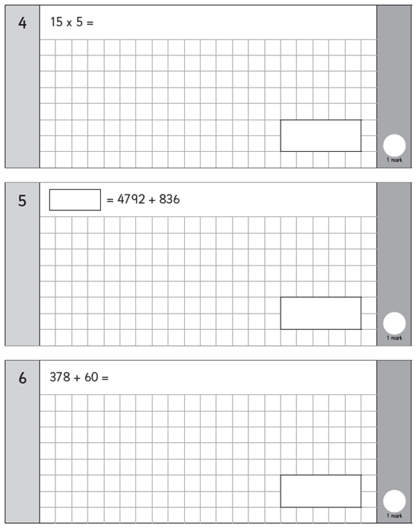

Slide 5
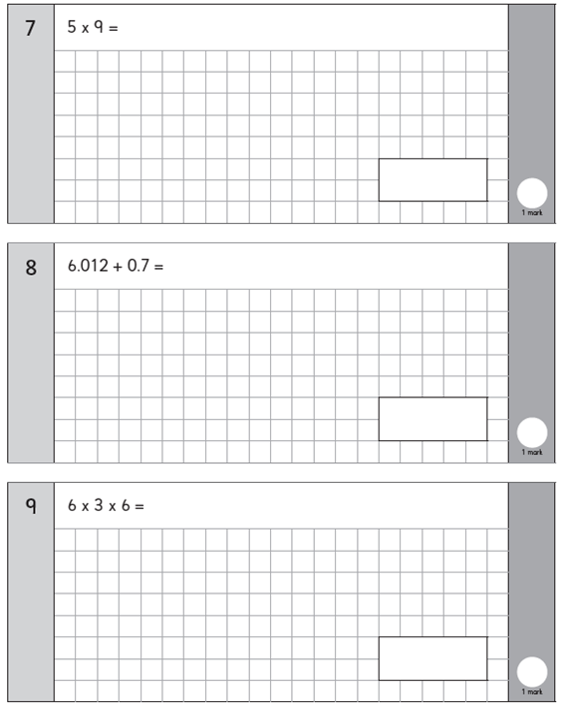
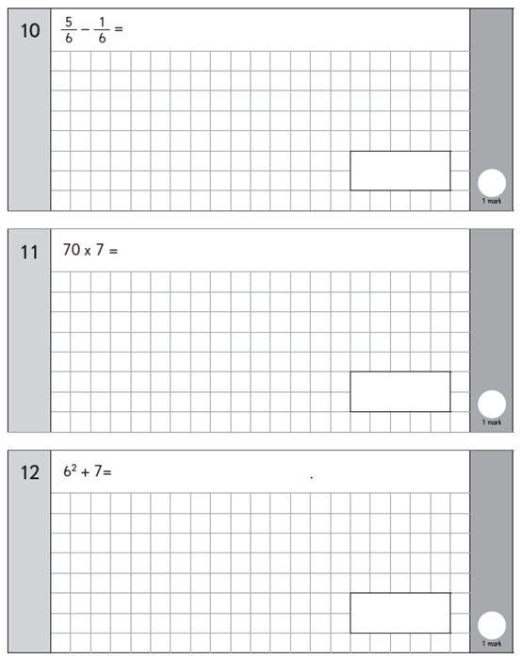

Slide 6
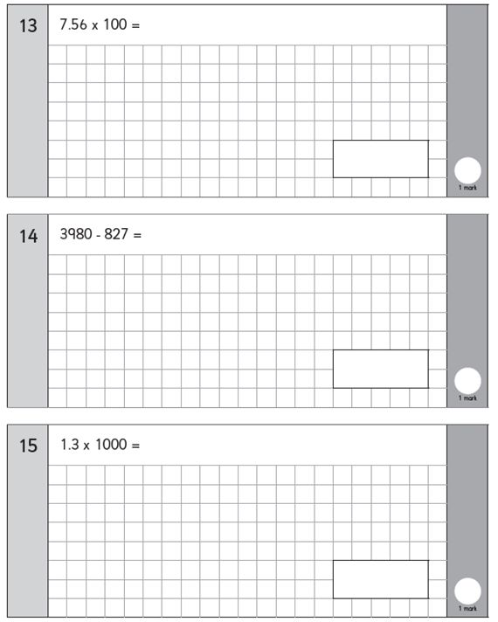
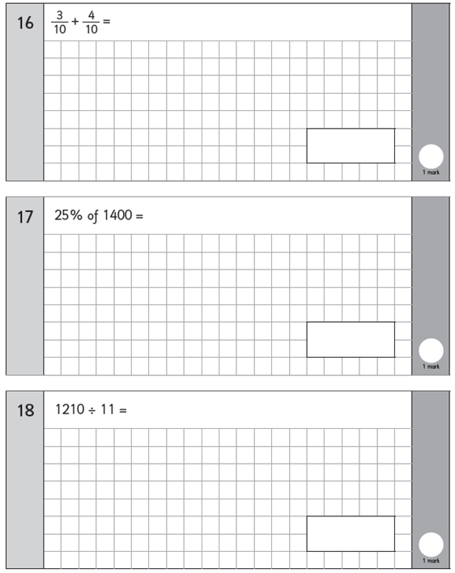

Slide 7
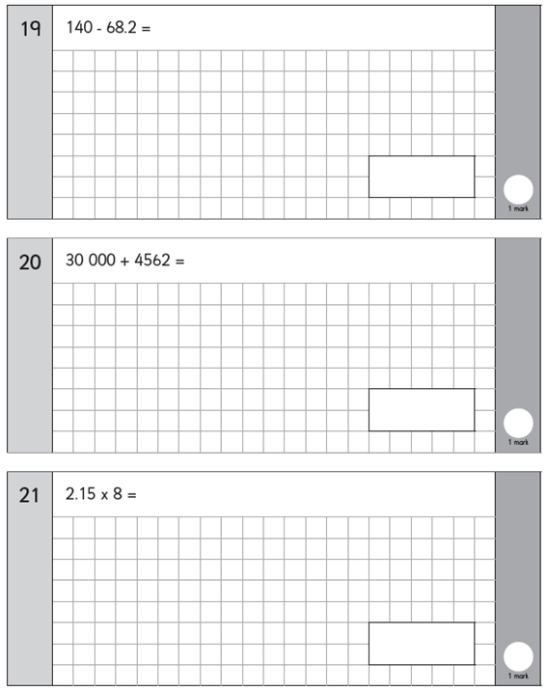
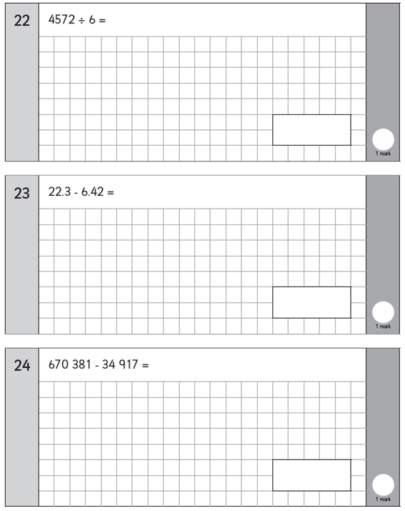

Slide 8
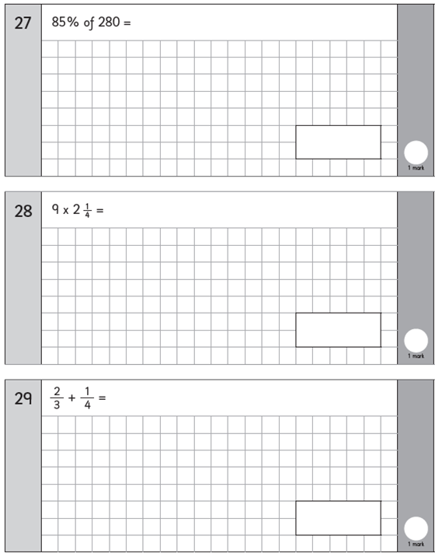
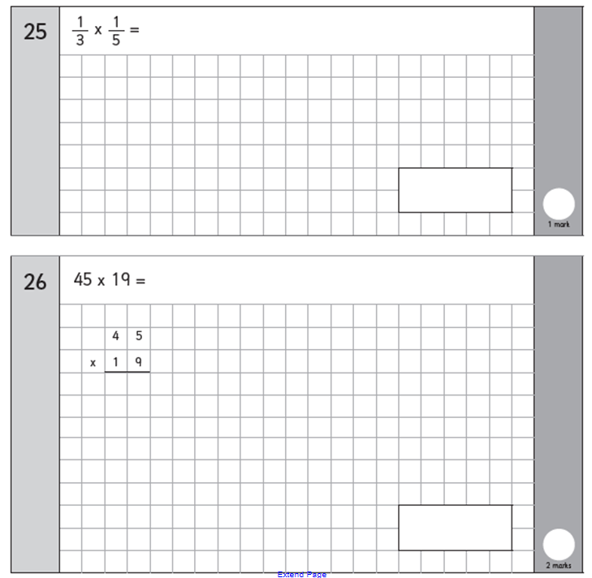

Slide 10
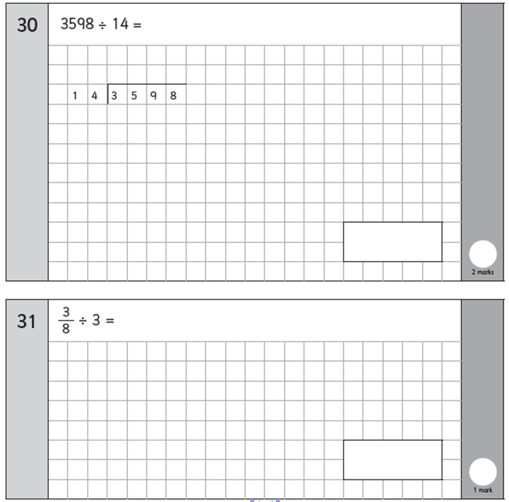
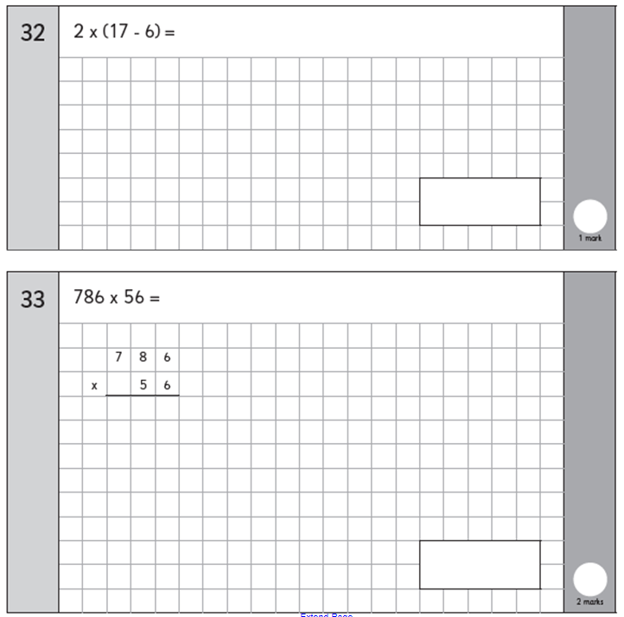

Slide 11
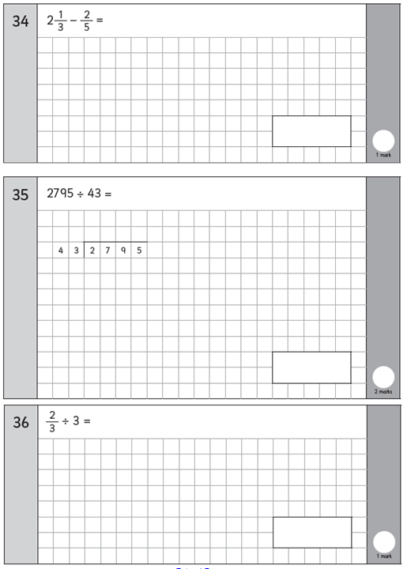

Slide 12
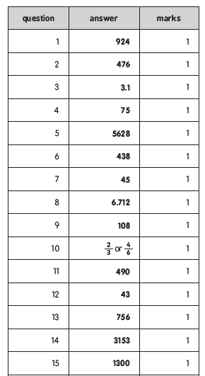
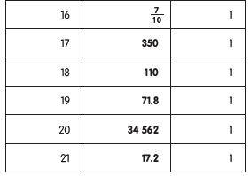
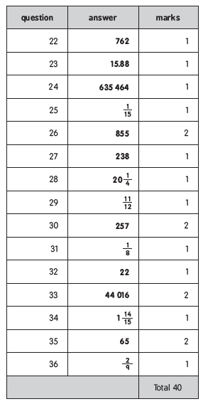
Arithmetic results Mark your work out of 40 – you may get two marks for some of your answers.

Slide 13
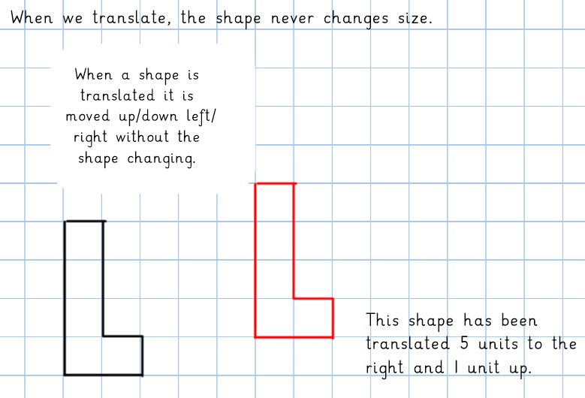
Day 2 - Translation

Slide 15
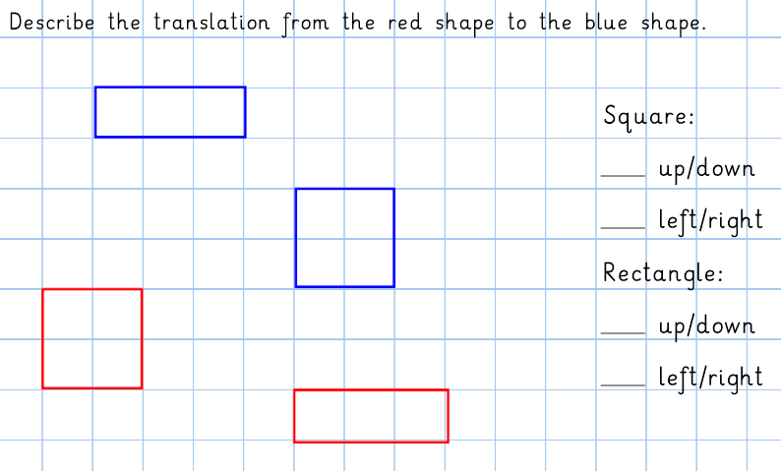

Slide 16
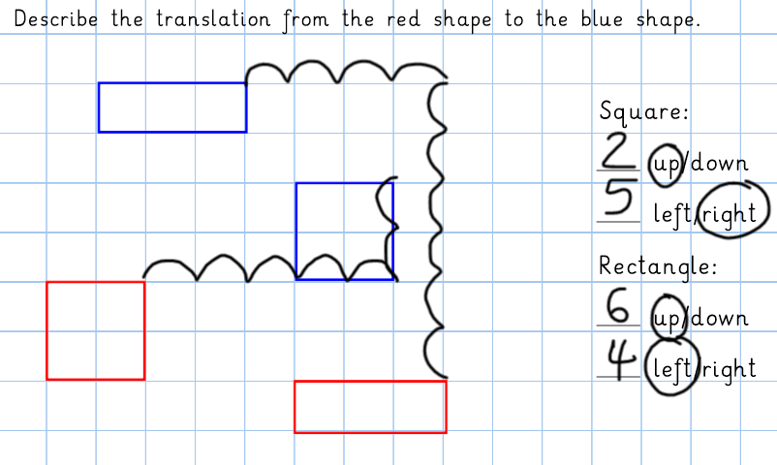

Slide 17
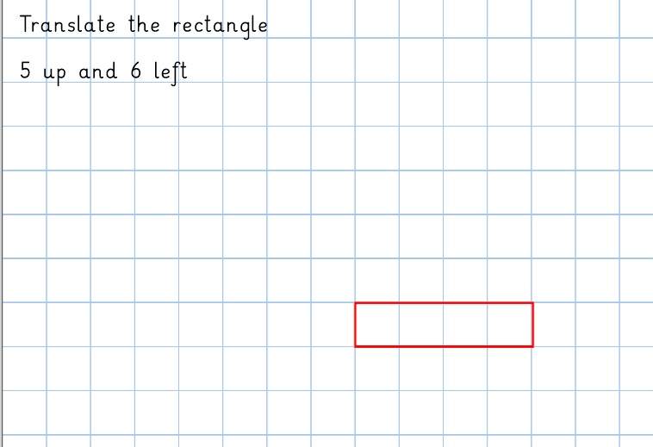

Slide 19
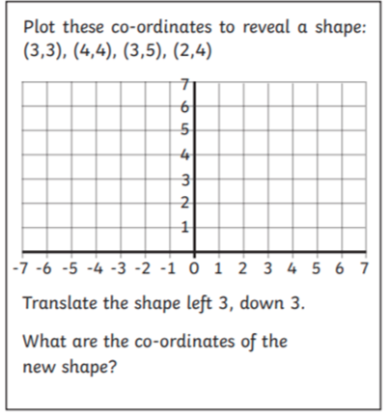

Slide 20
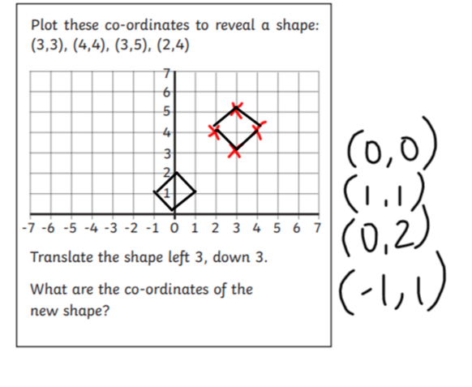

Slide 21
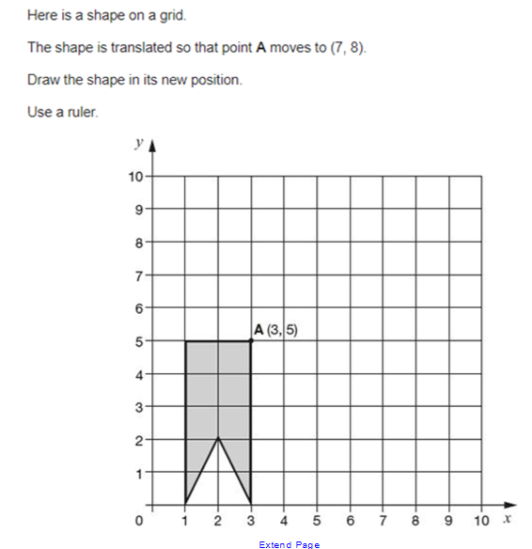

Slide 22
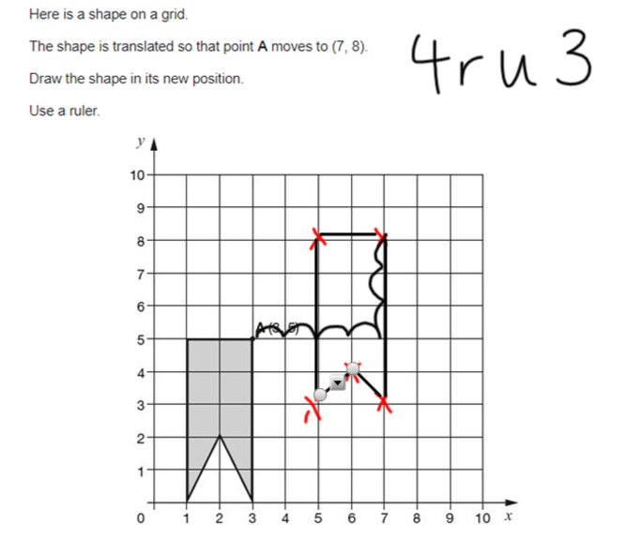

Slide 23
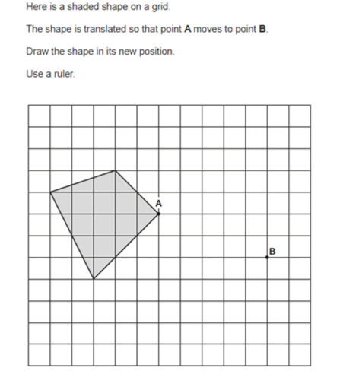

Slide 24
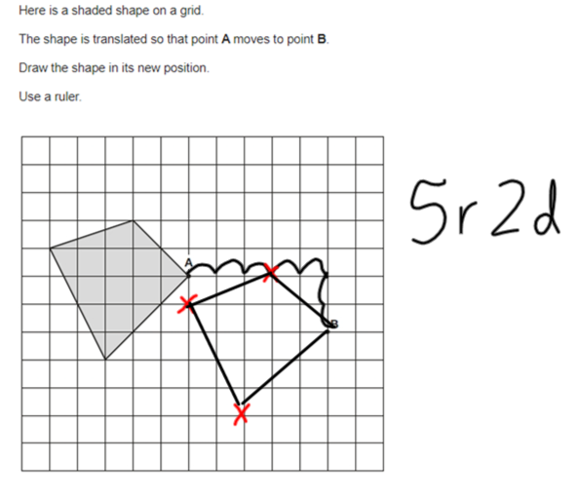

Slide 25
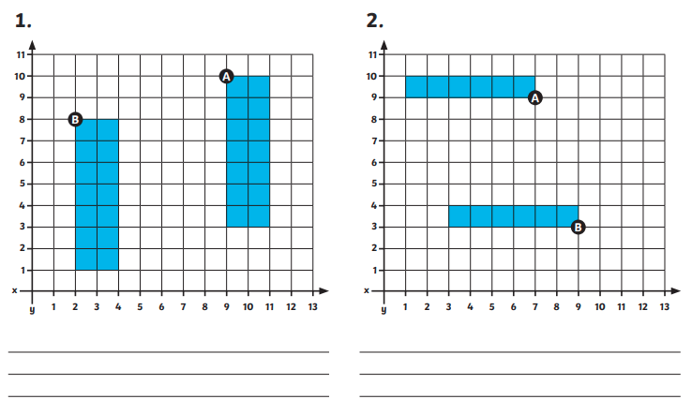
Activity – Write the translations from A to B

Slide 26
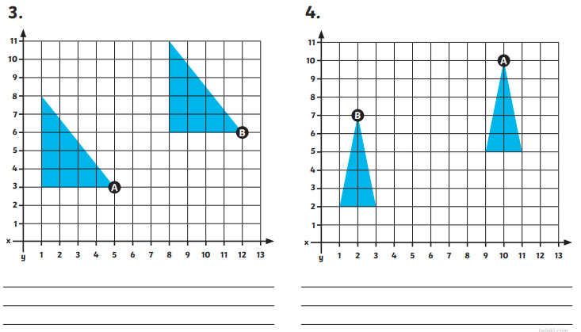

Slide 27
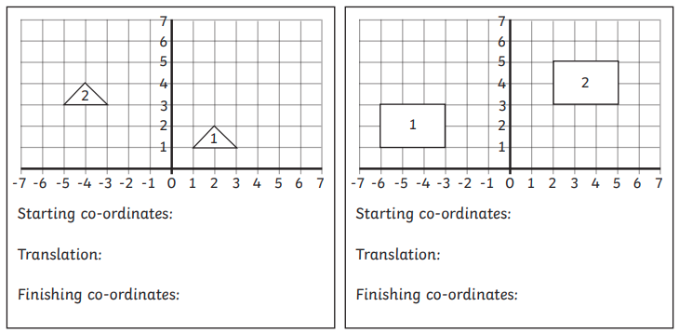

Slide 28
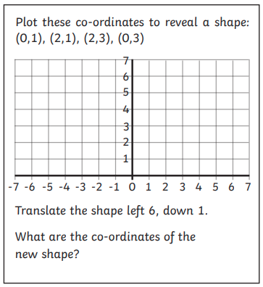
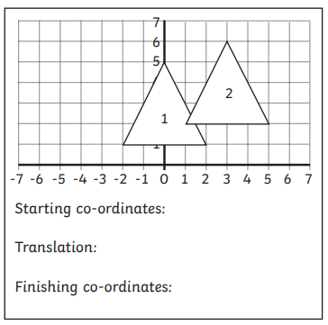

Slide 29
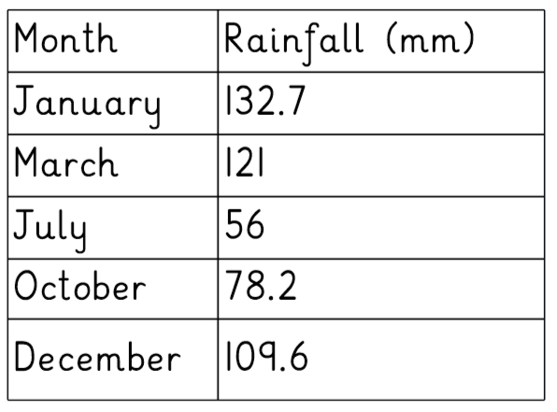
Day 3 – Reading and interpreting tables
A table helps us extract information and answer questions.
This table is informing us about the amount of rainfall in each month of the year. The rainfall is measured in millimetres (mm).
We can read the rows to work out how much rain there was in each month.
In July there was 56mm of rain.
The row telling us how much rainfall in July
This column is telling us the month
This column is telling us the rainfall

Slide 30
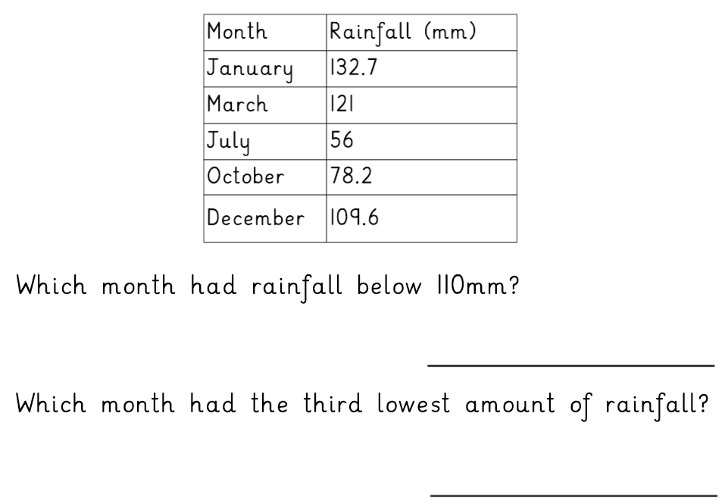

Slide 31
July, October and December
July

Slide 33
January is 132.7
July is 56
…so to find the difference I need to do 132.7 - 56
76.7
October is 78.2
December is 109.6
…to find how much larger I need to do 109.6 – 78.2
31.4

Slide 34
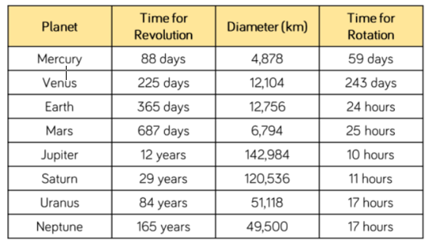
Read and interpret the table to answer the questions
1. How long does it take Mars to rotate?
2. Which planet has a diameter of 49,500km?
3. How many planets have a diameter greater than 50,000km?
4. How many planets take more than one day to rotate?
5. Which planets take more than one year to make one revolution?
6. Write the diameter of Jupiter in words.
7. What is the difference between the diameter of Mars and Earth?
8. What is the difference between the time for rotation between Mercury and Venus?
9. What is the total diameter of Mars and Earth?

Slide 35
Day 4 – Reading and interpreting line graphs
A line graph is plotted on a graph. It is similar to a table as it also shows data.

Slide 36
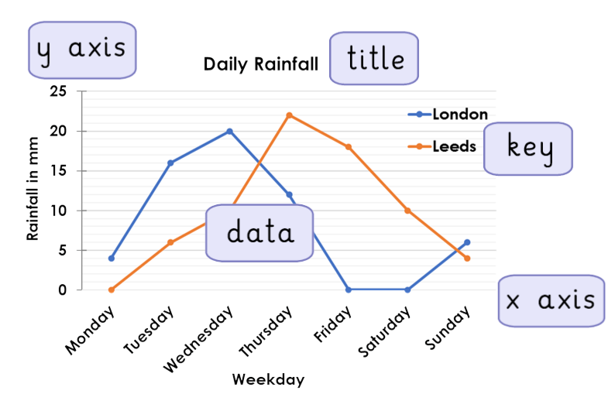
Here is some of the terminology you may need to know for line graphs.

Slide 37
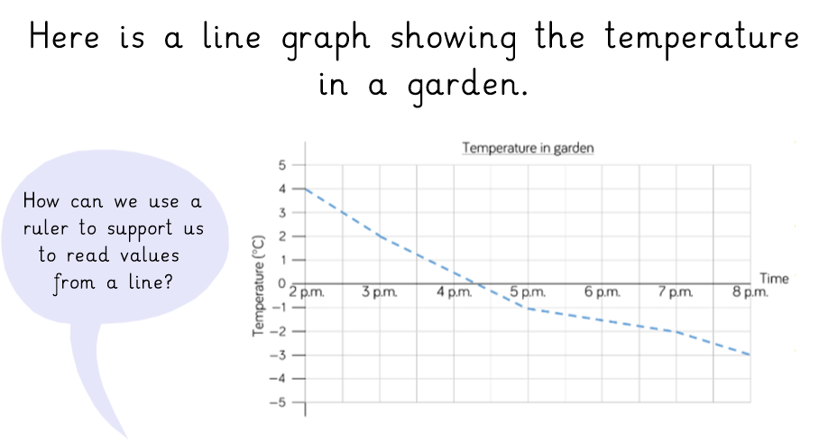
We can use a ruler to help us to find the answer to a question
What is the temperature at 5pm?
Used the straight edge of the rule to see the line is at -1 at this time.
So I know that the temperature is -1.

Slide 38
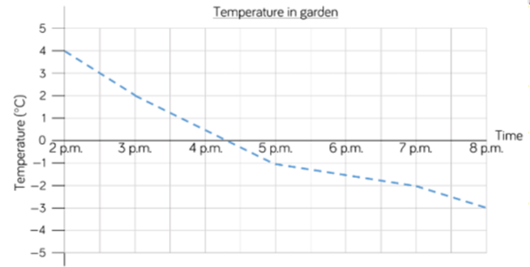
When was the temperature 4°C?
To answer this question I need to find 4°C and go down the line to see what time it was.
I can see it was 2pm.

Slide 39
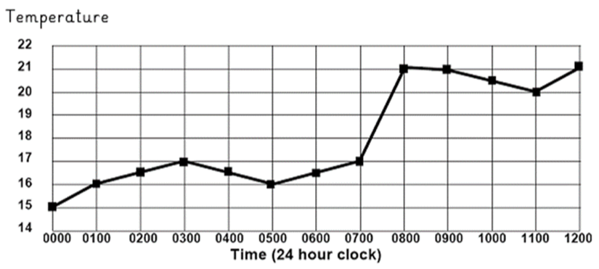
This graph shows the temperature in a room over a twelve hours. Answer the questions below.
What was the lowest temperature recorded on the chart.
What was the temperature at 3 o’clock am?
What was the temperature at 11.00?
Which hour shows the biggest rise in temperature?
For how long was the temperature between 16 and 17 degrees?
Can you estimate the temperature at 07.30?
Can you estimate the temperature at 10.00?

Slide 40
Day 5 – Drawing a line graphs
We may need to plot and draw our own line graph. We need to use the data to decide what intervals our axis need to go up in.
Watch this video clip explaining how to draw line graphs.
https://www.youtube.com/watch?v=n2YkbdNORp8

