Slide 1
English Home Learning
Week Beginning 28.9.20

Slide 2
This week…
Day 1 – Grammar – Using reported speech correctly
Day 2 – Introduce – Reading text and answer questions
Day 3 – Looking at a diary entry
Day 4 – Beginning to plan your own diary entry
Day 5 – Writing your diary entry on your own

Slide 3
Day 1 – Grammar – Using inverted commas correctly.
What is an inverted comma?
When do we use an inverted comma?
When you are writing, inverted commas or speech marks go before and after direct speech, surrounding what was said.
For example: "I'm hungry," she complained.
https://www.bbc.co.uk/bitesize/topics/zvwwxnb/articles/ztcp97h

Slide 4
Look at this example…

Slide 7
Change these sentences into reported speech.
Mrs Patankar shouted, “I want to have dinner!”
Lucy angrily said, “I’m late for school again!”
“I don’t like summer” mentioned Mr Tom.

Slide 8
Day 2 – Reading comprehension
To be able to understand a text
Complete task 1 and 2

Slide 9
Day 2 - Bug Club – Read text
Book title: Globe Challenge: Buried Treasure by Liz Miles. Use the link below to login to Bug Club then access through your library.
https://www.activelearnprimary.co.uk/

Slide 10
Day 2 - Task 1 Answer the questions below - Use pages 2 and 3 1. What did Reema receive? 2. Who did she receive the parcel from? 3. How did Reema feel about her parcel? 4. What did Reema want to find out about Britain?

Slide 11
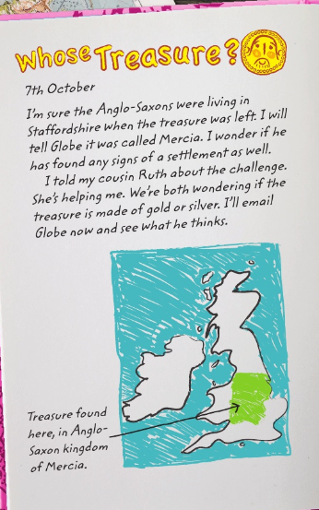
Day 3 - Look at the diary entry. What do you learn about Reema’s day?

Slide 12
Day 4 - Copy and complete the timetable below in your book. Make notes about a school day.
Morning (before school)
Morning (at school)
Lunch
After lunch
Hometime
Dinner
Bedtime

Slide 13
Day 5 – Task 1 – Write your own diary entry.
Remember :
Write your diary entry in your Home Learning book.
You should be writing in full sentences, starting with a capital letter and ending with a full stop.
You can start off your diary entry by writing:
Dear diary,
Today I have had the best day EVER!

