Slide 1
Year 5 Maths Home
Learning
Week Beginning 12.10.20

Slide 2
This week…
Day 1 – Horizontal and vertical lines
Day 2 – Parallel and perpendicular lines
Day 3 – Symmetry
Day 4 – Symmetry
Day 5 – Arithmetic lesson: Rounding

Slide 3
Day 1 – Horizontal and vertical lines

Slide 9
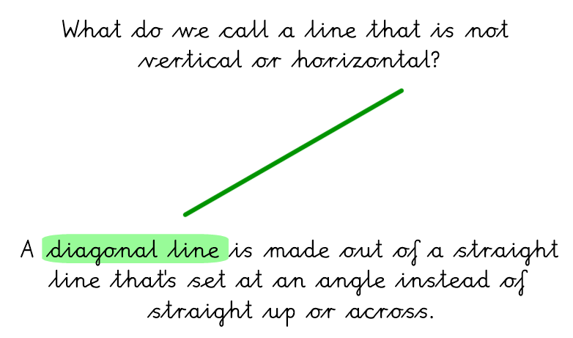

Slide 12
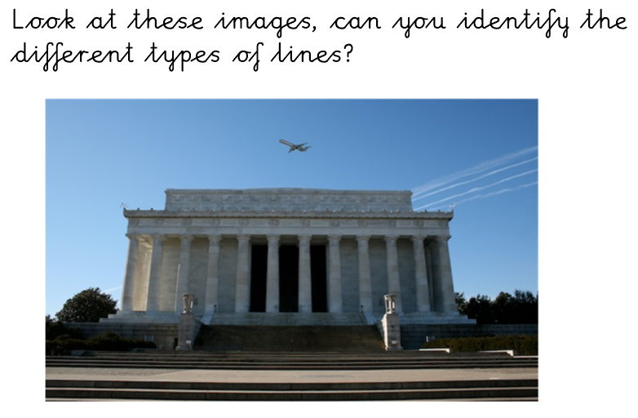

Slide 13
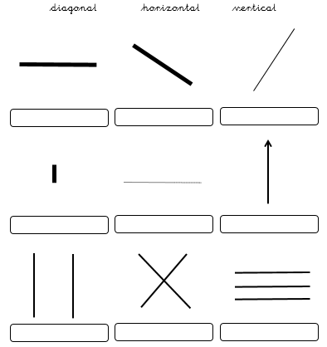

Slide 14
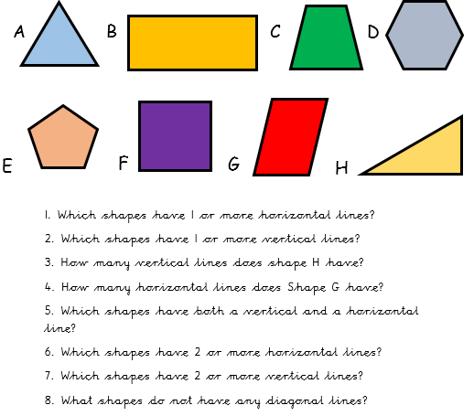

Slide 15
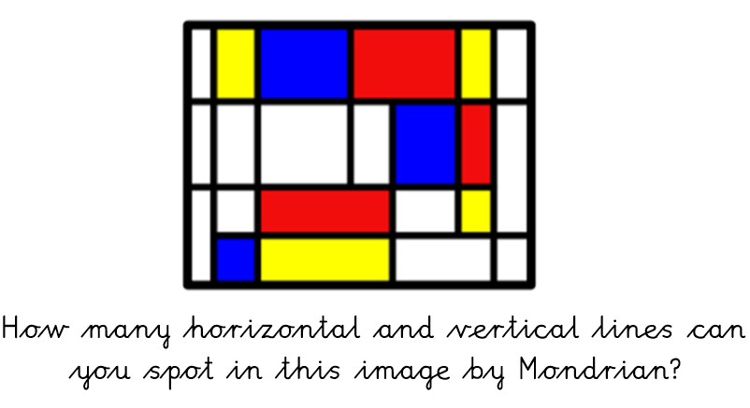

Slide 16
Day 2 – Parallel and perpendicular lines

Slide 18
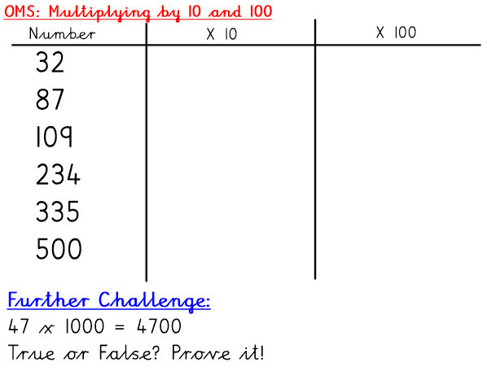

Slide 26
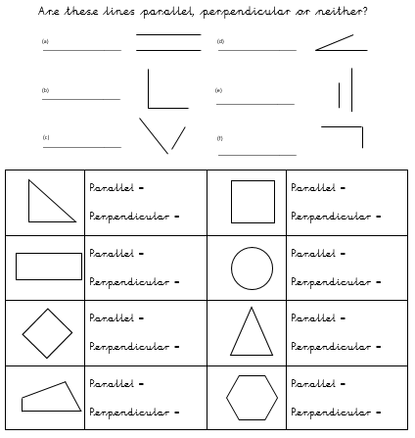

Slide 27
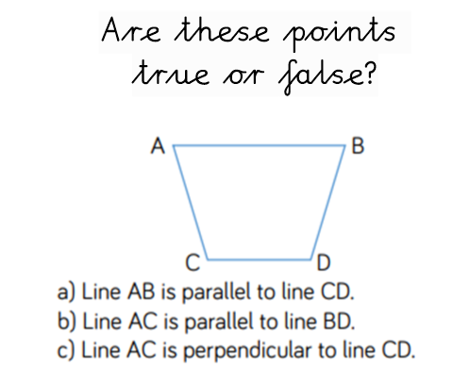

Slide 28
Day 3 – Symmetry

Slide 32
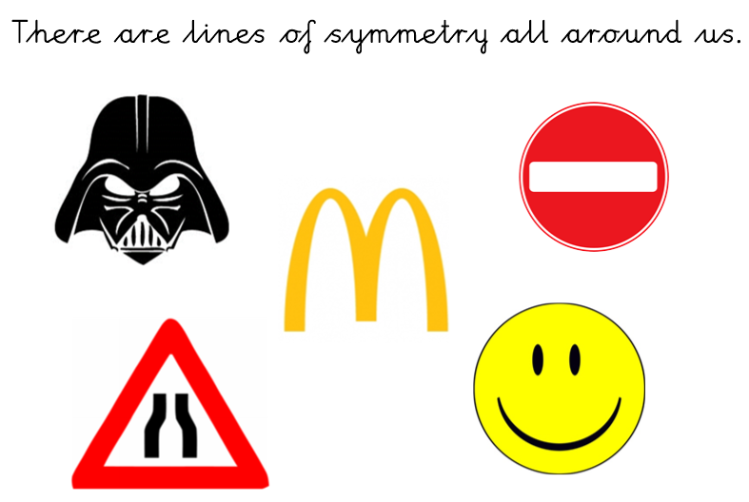

Slide 33
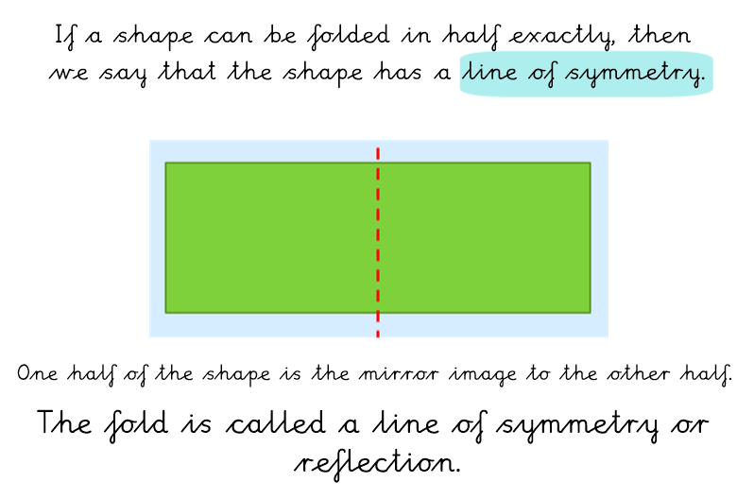

Slide 38
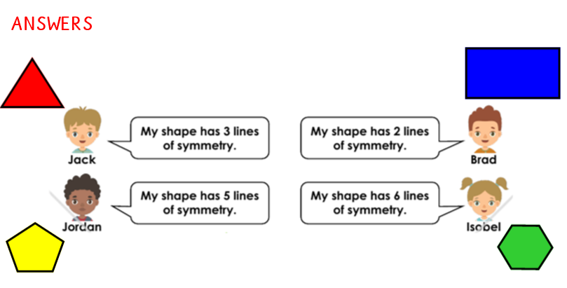

Slide 40
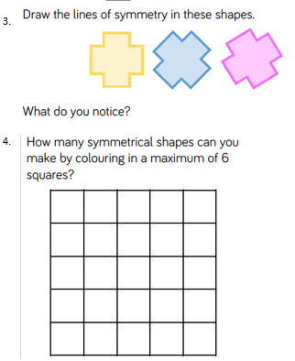
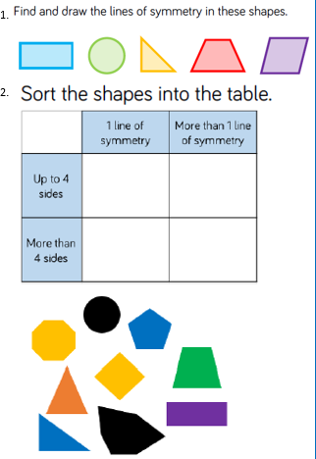

Slide 41
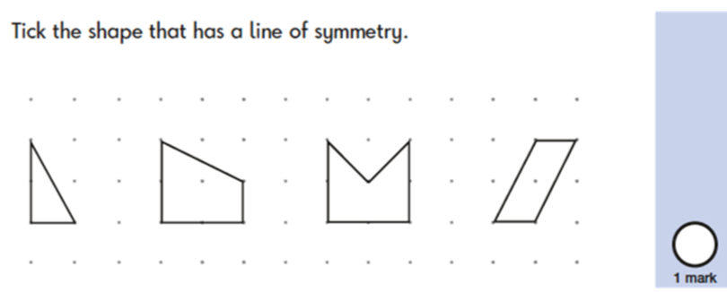
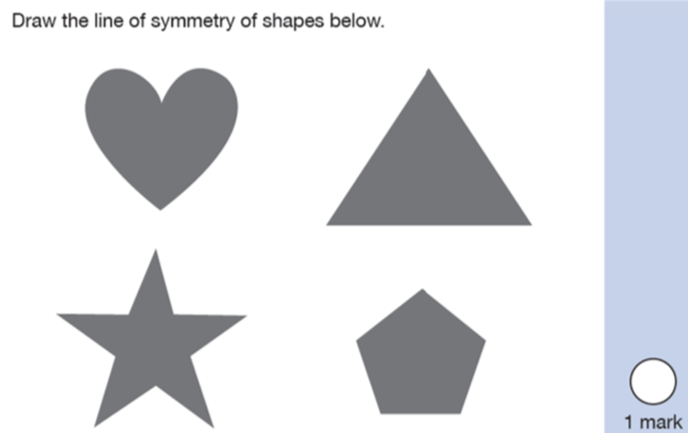

Slide 42
Day 4 – Symmetry

Slide 44
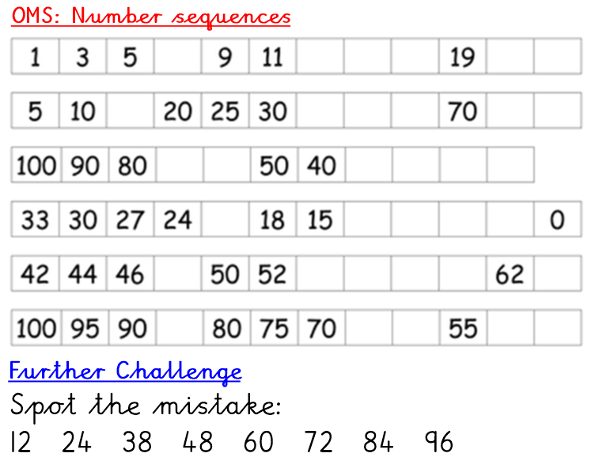

Slide 49
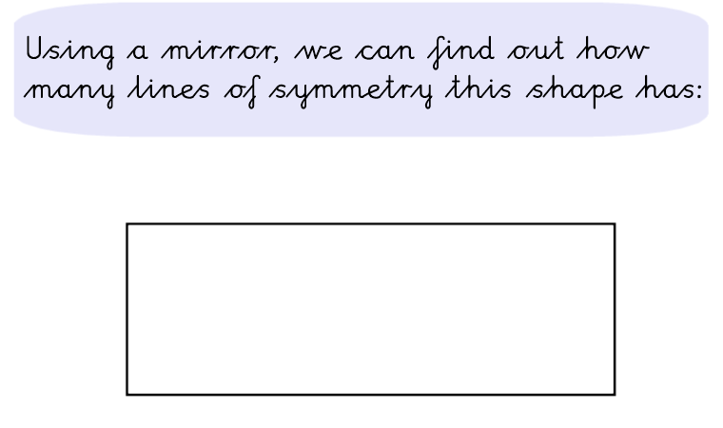

Slide 52
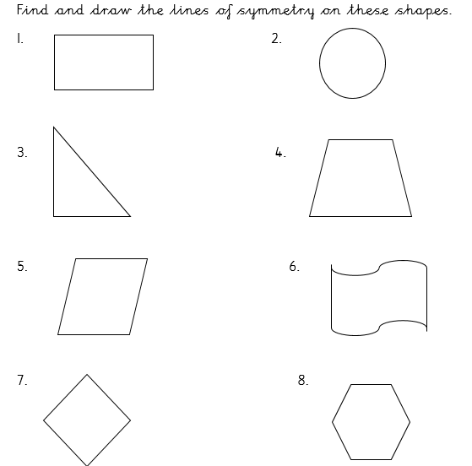

Slide 53
Day 5 – Rounding

Slide 55
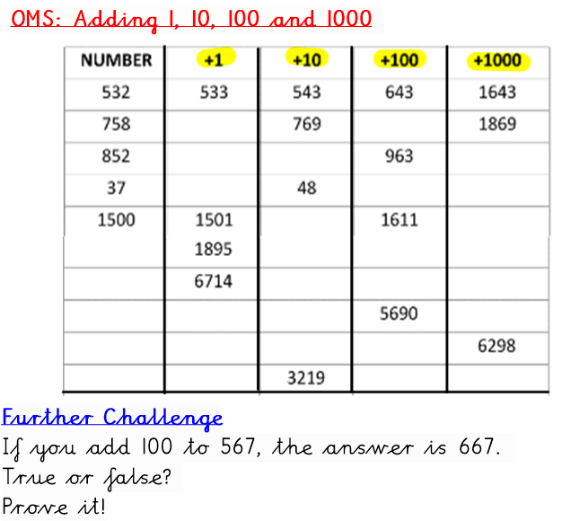

Slide 56
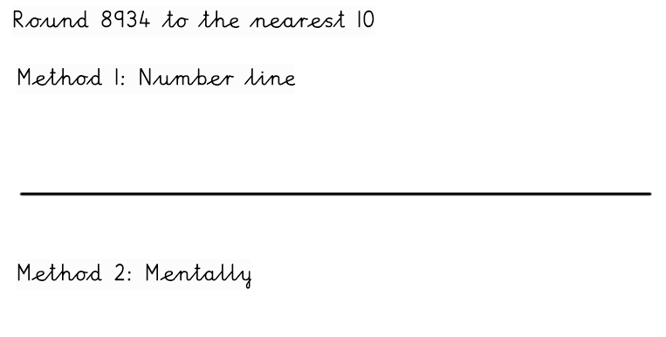

Slide 57
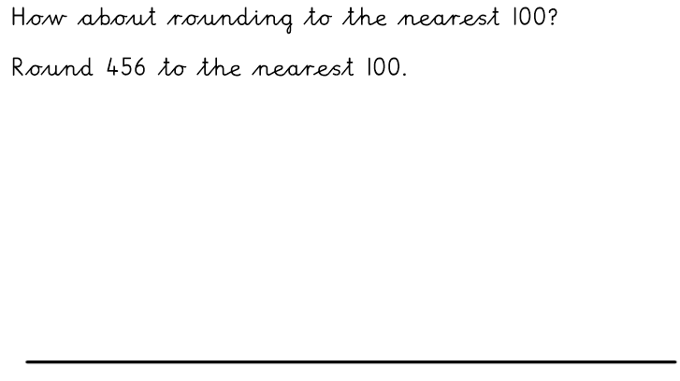

Slide 58
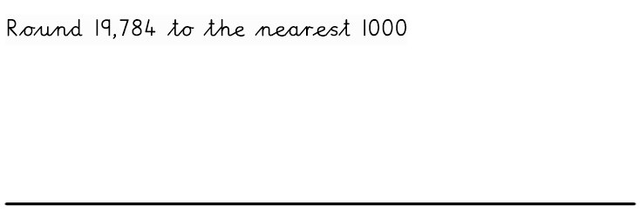

Slide 60
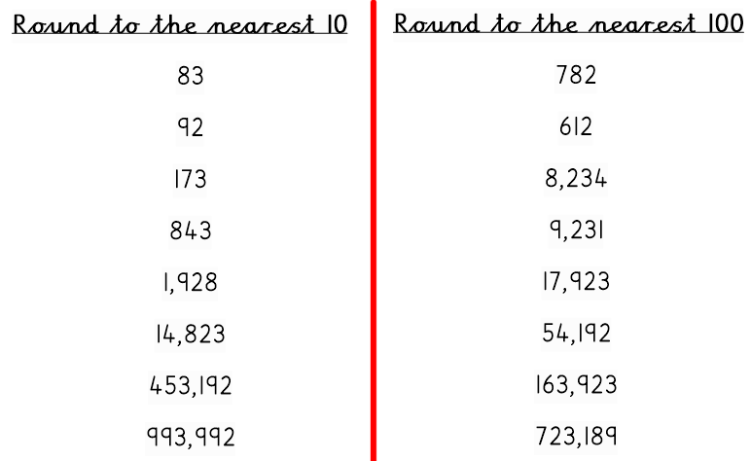

Slide 61
