Slide 1
Maths Home Learning
Week Beginning 19.10.2020

Slide 2
This week…
Day 1- Fractions of amounts- practical
Day 2 –Fractions of amounts
Day 3- Would you rather??
Day 4- Reasoning with fractions.
Day 5- 4 number operations

Slide 3
Arithmetic
Let’s learn our x 8 tables
Sing along!
https://www.youtube.com/watch?v=kN3RG5iLKpo

Slide 4
Day 1

Slide 5
Day 1

Slide 6
Day 1

Slide 7
I do

Slide 8
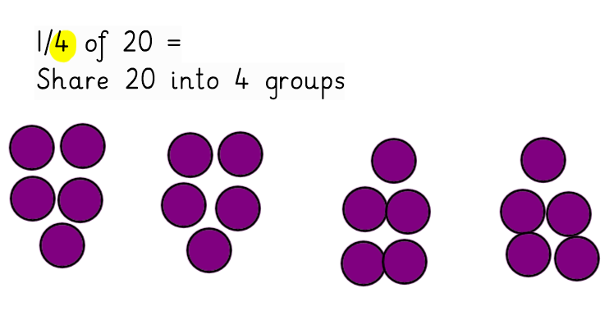
I do- Answers
There are 5 in each group.
So ¼ of 20= 5

Slide 9
We do

Slide 10
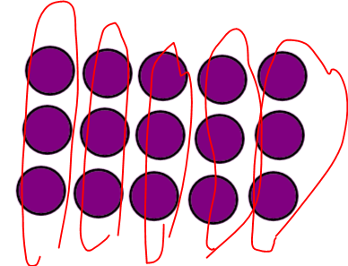
Answers
There are 3 in each group.

Slide 11
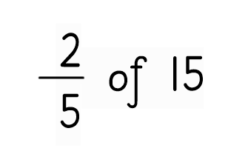
You Do…
Divide by the denominator
Multiply the answer by the numerator.
15 divided by 5=
Multiply the answer by 2…

Slide 12
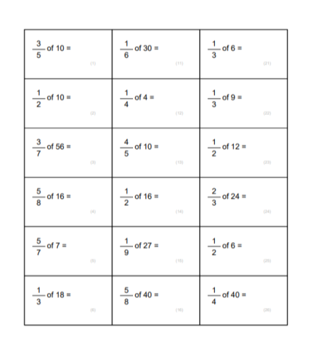
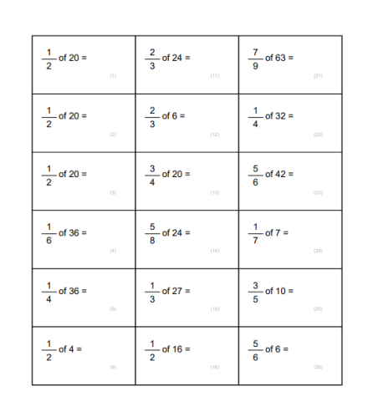
Main Task- Use practical equipment

Slide 13
Day 2
Fractions of amounts

Slide 14
Arithmetic
Let’s practise our x8 tables.
How quickly can you answer these questions. Time yourself
1 x 8=
2x 8 =
3 x 8=
4 x 8=
5 x 8=
6 x 8=
7 x 8=
8x 8=
9 x 8 =
10 x 8 =
11 x 8=
12 x 8 =
Check if you can beat your time the second time.

Slide 15
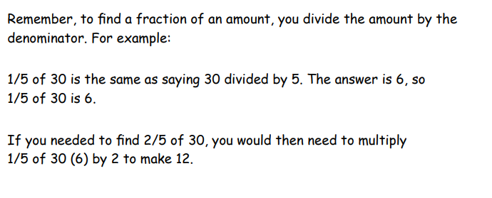
I do

Slide 16
We do
40 divided by 4 = 10
10 X 3 = 30

Slide 17
You do
4/7 of 28
What will you do first?

Slide 18
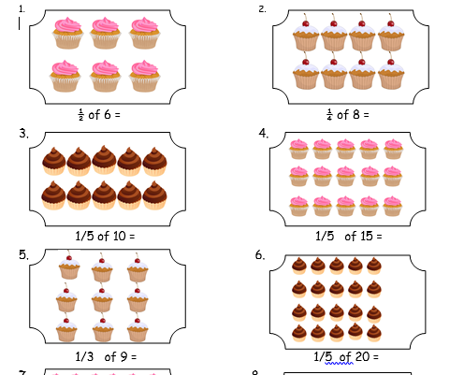
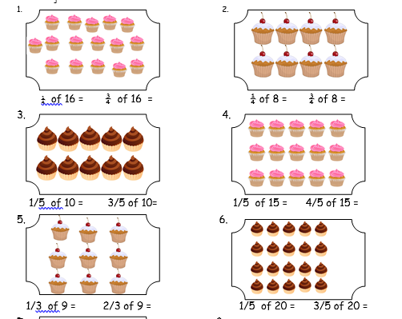
Day 2 Main Task

Slide 19
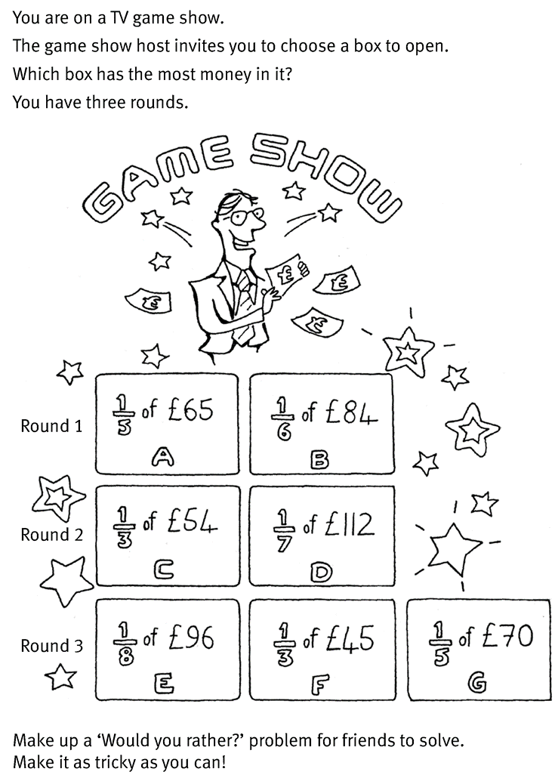
Day 2 Challenge

Slide 20
Day 3
Would you rather?

Slide 21
Arithmetic
Use the link below to play hit the button for your 8 times table practice.
https://www.topmarks.co.uk/maths-games/hit-the-button

Slide 23
I do

Slide 24
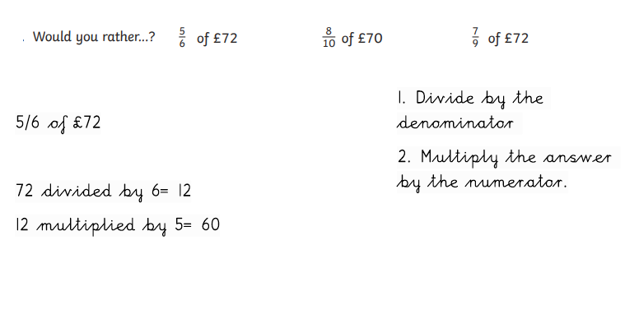
We do

Slide 25
We do- Answers

Slide 26
You do

Slide 27
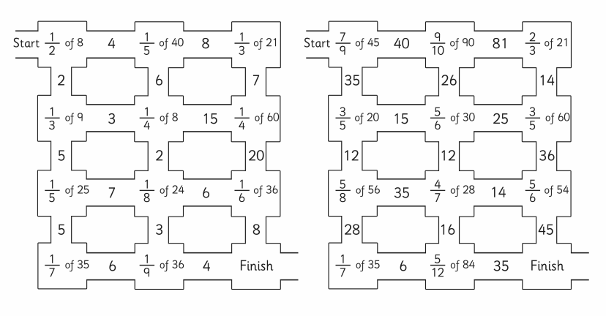
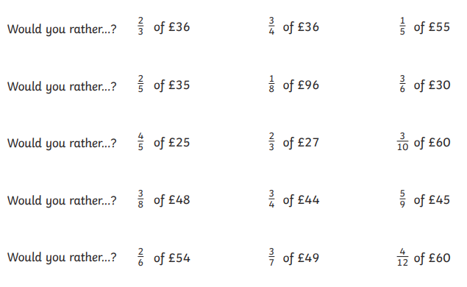
Day 3 Main Task

Slide 28
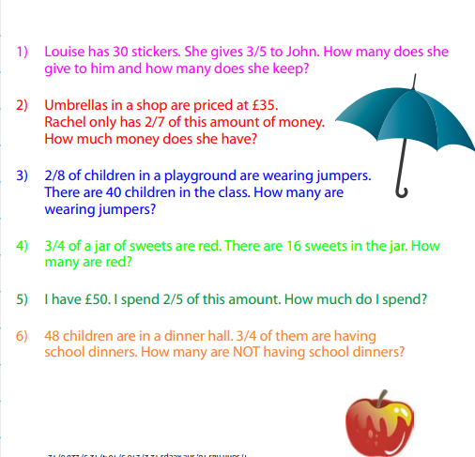
Day 3 Challenges

Slide 29
Day 4
Reasoning with fractions

Slide 30
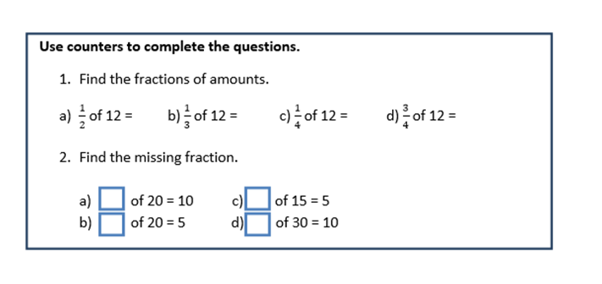
I do
½ of 12= 6
1/3 of 12= 4
¼ of 12= 3
¾ of 12= 9

Slide 31
I do- Answers
½ of 12= 6
1/3 of 12= 4
¼ of 12= 3
¾ of 12= 9
2. ½ of 20= 10
¼ of 20= 5
1/3 of 15= 5
1/3 of 30= 10

Slide 32
We do

Slide 33
We do- Answers
2/4 of 8= 4
½ of 8 = 4
Both fractions equal the same.
When shading there is more parts to shade.
They equal the same fraction when shaded.
¼ of 20= 4

Slide 34
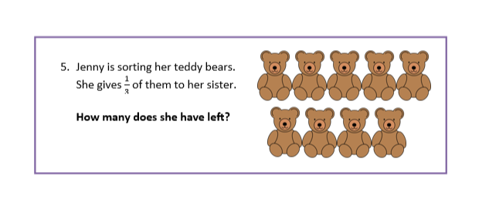
You do

Slide 35
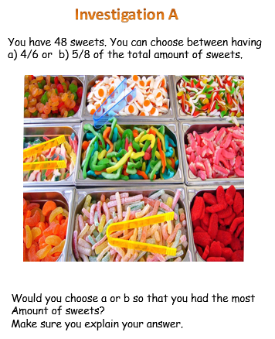
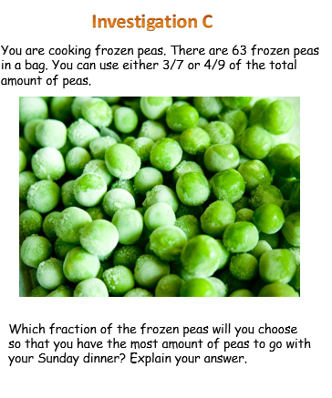
Day 4 - Main Task

Slide 36
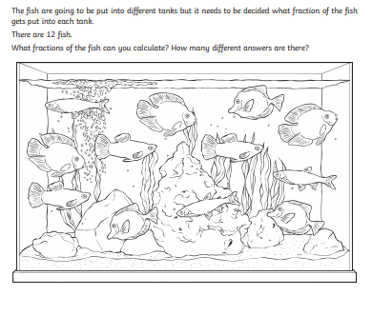
Day 4 – Challenge

Slide 37
Day 5
Column addition
Column Subtraction
Grid Multiplication/ Instant Recall

Slide 38
Arithmetic
Test yourself on your 8 times tables.
4 X 8=
6 X 8=
8 X 8=
1 X 8=
9 X 8=
2 X 8=
10 X 8=
4 X 8=

Slide 39
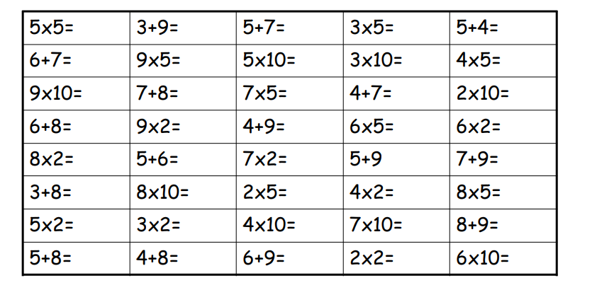
Time yourself on every slide

Slide 40
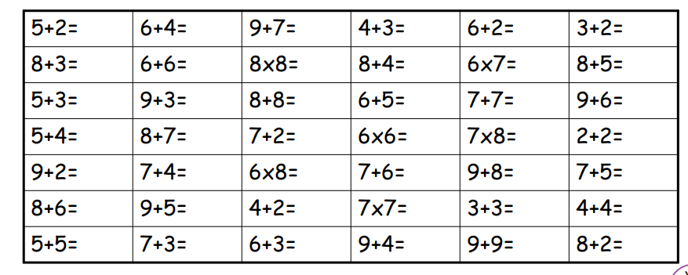
Time yourself on every slide

Slide 41
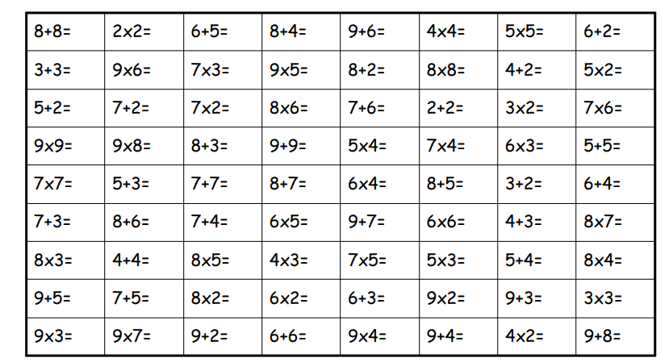
Time yourself on every slide

