Slide 1
Year 3 Home learning! English
Week Commencing: 12th October 2020

Slide 2
This week..
Day 1: Grammar- Conjunctions
Day 2: Reading comprehension
Day 3: Poetry performance practice
Day 4: Poetry performance
Day 5:

Slide 3
Day 1- Grammar
Lets warm up!
Can you play this adjective game and identify them correctly!
https://www.sheppardsoftware.com/grammar/adjectives.htm

Slide 4
Day 1- Grammar
Today we are going to be recapping all of our learning about conjunctions.
Have you got your grammar hat on?
What is a conjunction?
A word that is used to connect sentences together

Slide 5
Day 1- Grammar

Slide 6
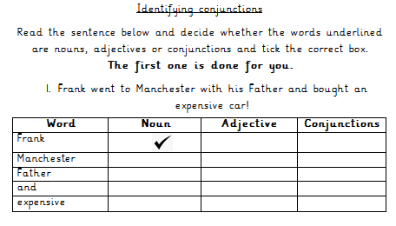
Day 1- Grammar
First Task!

Slide 7
Day 1- Grammar
Lets check our answers!

Slide 8
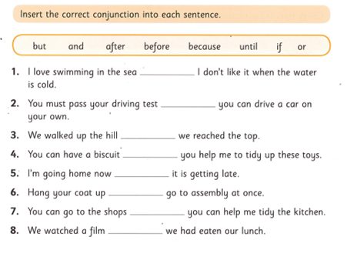
Day 1- Grammar
Second Task!

Slide 9
Day 1- Grammar
but
before
until
if
because
and
or
after

Slide 10
Day 2
Reading Comprehension!
Task 1- Read the book
Task 2- Answer the questions! Today you are going to read a book and answer questions about the text ‘All Gone!’
You can access the text via bugclub using your login details!
Click the image below to follow the link!

Slide 11
Day 2- Reading Comprehension- Task 1
CLICK ME FOR A REMINDER
I hope you enjoyed reading all about ‘All Gone!’
In your homework book, answer the questions below.
Is this book fiction or non-fiction? How do you know?
What did Kiki order at the café?
Where was Jason stood on Page 7?
Can you find any conjunctions in the text?
After you have finished your sentences, you can illustrate your work!

Slide 12
Day 3

Slide 13
Do you remember the poem we have been reading in class?

Slide 14
The Wicked Witches’ Song by Clare Bevan.
I’m making witch spells,
Give-you-all-an-itch spells,
Stir the steamy cauldron with a monster
Bone,
I’m making mean spells,
Slithery and green spells,
Turn you into a lizard on a slimy stone.
I’m making cat spells,
Dangle-like-a-bat spells,
Swish you on a broomstick through the
Inky sky,
I’m making shark spells,
Dangerous and dark spells,
Give you all a nightmare ‘til you scream
And cry.

Slide 15
Today you are going to practice reading the poem. How will you make it interesting? Will you add actions? Practice carefully because you are going to perform to your family tomorrow.

Slide 16
Day 4

Slide 17
Today you are going to perform the poem to an audience.
What do you need to remember when you are performing a poem? Remember to speak clearly, look at your audience and make it interesting.
You could even record yourself reading the poem on a phone or tablet.

Slide 18
The Wicked Witches’ Song by Clare Bevan. I’m making witch spells, Give-you-all-an-itch spells, Stir the steamy cauldron with a monster Bone, I’m making mean spells, Slithery and green spells, Turn you into a lizard on a slimy stone. I’m making cat spells, Dangle-like-a-bat spells, Swish you on a broomstick through the Inky sky, I’m making shark spells, Dangerous and dark spells, Give you all a nightmare ‘til you scream And cry.

Slide 19
Day 5

Slide 20
We are working towards writing our own poem but first you need to come up with your own potion?
What will you put in it?
What will the potion do?
Will it be disgusting or lovely?

Slide 21
Read through the witch’s brew recipe.
1 cat’s tail
3 frog’s eyes
1 giant bat
5 little boy’s noses
½ a snail
6 dirty tissues.

Slide 22
What could you put in your witch’s brew? Think of the most disgusting and strange things to put into a potion.
Think about the words to describe what you are adding to the potion and how you are adding them. How are you mixing your potion? What is happening to it?
Make a list of all the things you are going to add to the potion and words you can use to describe them.
Make a list in your homework book.

Slide 23
Now you need to draw everything you need for the witch’s brew on a piece of paper, remember to colour them in the correct colours. Do this in your homework book.

