Slide 1
English Home Learning
Week Beginning 28.9.20

Slide 2
This week…
Day 1 – Grammar – Using capital letters
Day 2 – Looking at letters
Day 3 – Writing a letter
Day 4 – Writing a letter
Day 5 – Guided Reading – Is Nan in?

Slide 3
Day 1 – Grammar – Capital letters recap
What is a capital letter?
When do we use one?
Let’s find out…

Slide 4
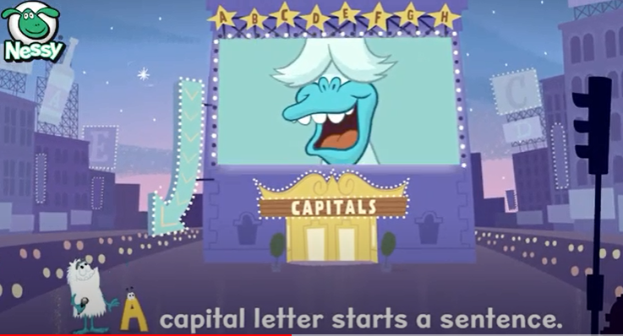

Slide 5
A capital letter is also used for a month. e.g. May, September, December

Slide 6
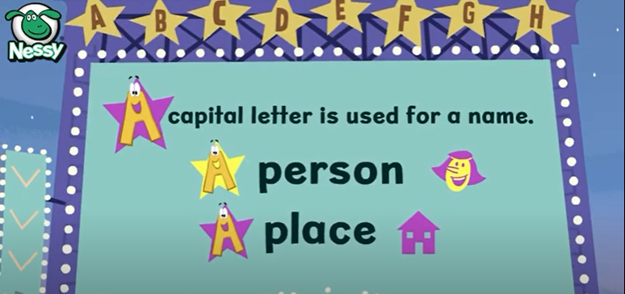

Slide 7
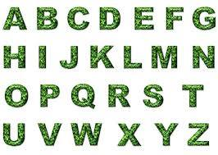
Day 1 – Grammar – Capital letters
A capital letter is also used when we write the word ‘I’.
e.g. Yesterday I went to the shop.
Can you try writing the capital letters
in your book?

Slide 8
Day 1- Can you add the capital letters to these sentences:
can i go to the shop?
i like mondays.
today zohaib sat next to me.
maryam went to school.
my auntie lives in sheffield.
my birthday is in may.
the cat is sat down.
Write these sentences in your book.

Slide 9
Day 2 - Looking at letters
Look carefully at this letter:
Dear Miss Dawson
At home I like to cook food for my family.
My favourite food to eat is chicken with potatoes.
Write back soon
From Miss Matthews
Dear… (who is the letter being sent to?)
Main body (what is the letter about?)
Closing sentence (to end your letter)
Signature/From… (who is the letter from?)

Slide 10
Day 2 - Writing a letter
Think about the letter we just looked at.
Can you write a letter to your friend at school to tell them about what you have been doing at home?
Use the template on the next page to help you…

Slide 11
Day 2 – Task
Dear _____________
At home I like to __________________________.
My favourite food to eat is _______________________.
Hope you are OK at school.
From ________________________

Slide 12
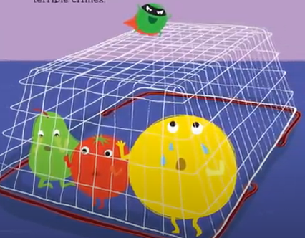
Day 3 – Writing a letter:
Look at what Evil Pea has done now:
Talk about:
-What can you see?
-What has Evil Pea done?
-How are the characters feeling?

Slide 13
Day 3 – Task – Write your own letter
Using the picture, write a letter to your class to explain what Evil Pea has done to the fruits and vegetables.
Remember :
Write your letter in your book.
What has Evil Pea done now? e.g. Evil Pea has trapped the characters. He has…
You should write in full sentences, starting with a capital letter and ending with a full stop.

Slide 14
Day 3 – Task
Dear _____________
Evil Pea has _____________________________________.
He has ________________________________________.
Hope you are enjoying reading the book.
From ________________________

Slide 15
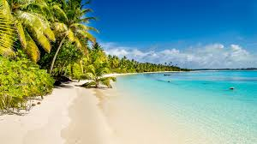
Day 4 – Writing a letter
Think carefully about what has just happened in our book:
BUT… There is a problem!
Supertato has gone on holiday!

Slide 16
Day 4 – Task – Write a letter
We need Supertato’s help to save the day!
You need to write a letter to Supertato to tell him to come back:
Write your description in your book.
You should try to write in full sentences, starting with a capital letter and ending with a full stop.
Use the frame on the next page to help you write your letter.

Slide 17
Day 4 – Task – Write a letter
Dear Supertato
Evil Pea has __________________________________.
We need your help to ____________________________________.
Come back soon!
From ___________________

Slide 18
Day 5 – Guided Reading

Slide 20
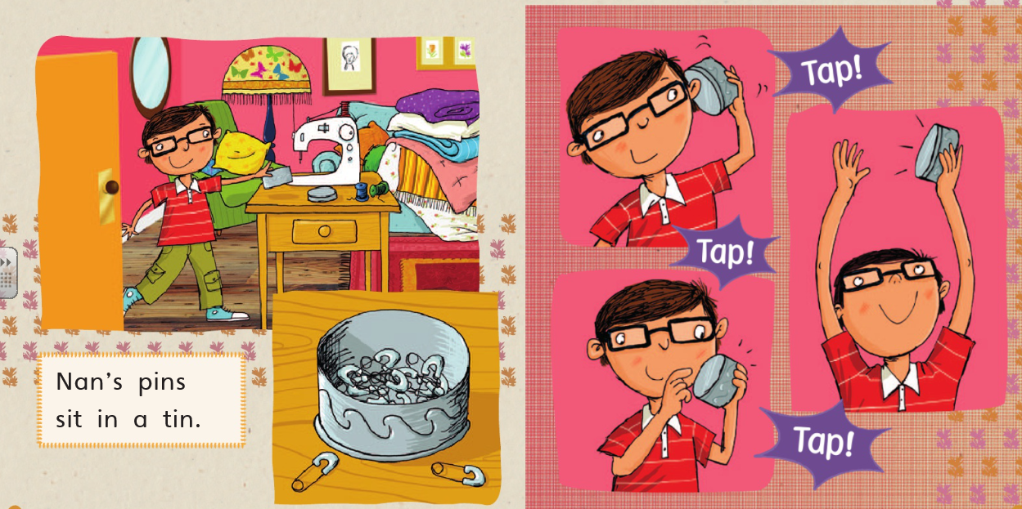

Slide 21
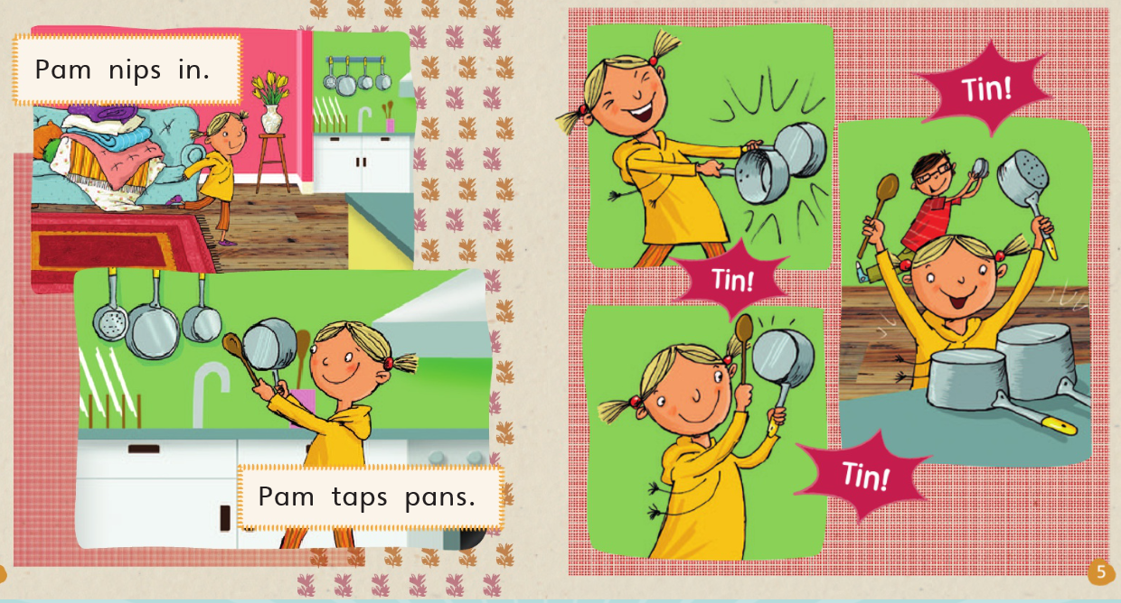

Slide 22
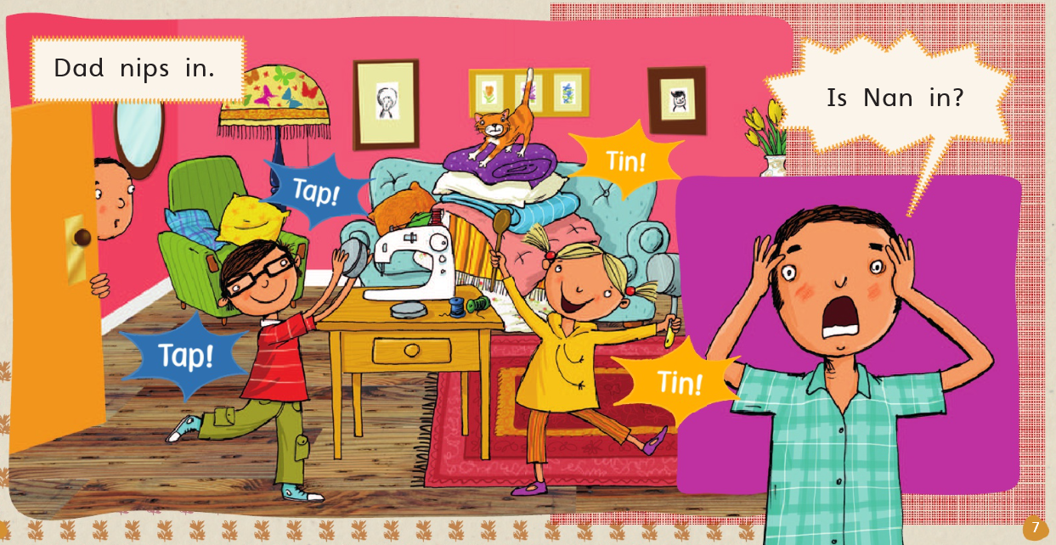

Slide 23
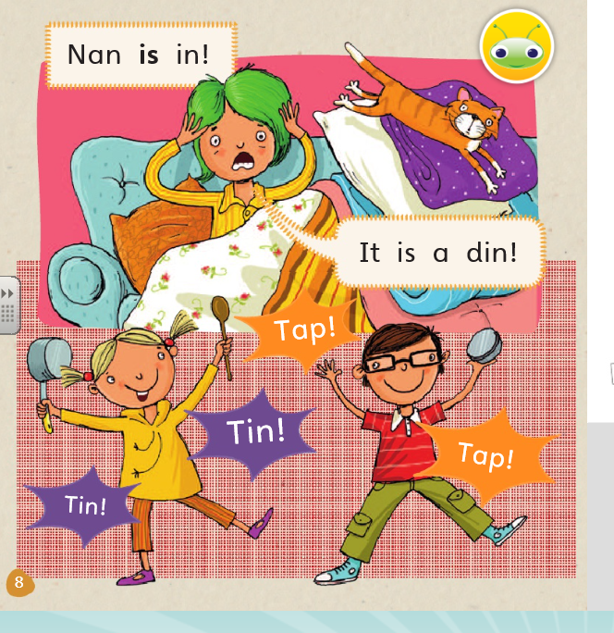
Questions to ask:
Who do you think is having a good time?
Who is not having such a good time?
Can you spot?
Look through the story, can you spot Nan’s cat?
Make it
Can you make an instrument? Use an empty box or tub and fill it with rice.

