Slide 1
English Home Learning
Week Beginning 5.10.20

Slide 2
This week…
Day 1 – Grammar - using the prefix -un
Day 2 – Introduce – reading text and answer questions
Day 3 – Non-fiction -research and making notes.
Day 4 – Practising writing sentences about a non-fiction topic.
Day 5 – Creating a factfile.

Slide 3
Day 1

Slide 4
Day 1 – Grammar – Using the prefix -un
What is a prefix?
A prefix is something that is added onto the beginning of a word to change the meaning of the word.
How do we use the prefix –un?
It means “not” or the opposite of something.
Example:
Happy Unhappy (Not happy).

Slide 5
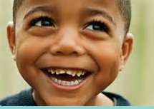
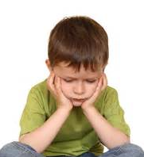
Look at this example in a sentence…
He was happy because he was at school.
He was unhappy because he was at school.
Look how the use of un makes the sentence the opposite.
It changes it completely.

Slide 6
Can you add un to the beginning of these words to make new ones? Write a sentence for each of the un word in your Homework book.
kind
able
fair
comfortable
true
healthy

Slide 7
Day 2

Slide 8
Day 2 – Reading comprehension
Today we are going to be reading this book on Bug Club.
It is a non-fiction book.
This means it has FACTS and information.
Please log in using the details your teacher has given you.
https://www.activelearnprimary.co.uk/login?c=0

Slide 9
Day 2 – Reading comprehension.
Book title: Epic Adventures.
Use the link below to login to Bug Club then access through your library.
https://www.activelearnprimary.co.uk/

Slide 10
Day 2 - Task 1 Answer these questions in your Home Learning book
What does a contents page tell us?
2. On which page will we find information of how did
they get there? Use your contents page to answer this question.
3. Where did Neil Armstrong want to fly to?
4. Which two people is the book about?
5. How long did it take them to get to where they were going?
6. What did they find when they got there?
7. Would you like to be an explorer? Why?

Slide 11
Day 3

Slide 12
Day 3 – Research and note writing.
Look at the non-fiction book you read yesterday.
Look at the questions and your answers.
One of the explorers travelled to Space. He was called Neil Armstrong.
Today we are going to learn more about him and his adventure. This
is called research.
At the end of the week you will be writing a factfile about him and
his adventure.

Slide 13
Day 3 – Research and note taking.
Write out this information in your homework books then read the information and put a line under anything you find interesting or think is important. This will help you to remember facts.
Example: You can still see their footprints on the Moon as there is no wind.
Who was Neil Armstrong?
Neil Armstrong was a famous American astronaut, and teacher.
He is most famous for being the first man to step foot on the moon.
He flew the Apollo 11 spacecraft to the Moon with with his friends Edward E “Buzz” Aldrin and Michael Collins.
He could fly a plane before he even learned how to drive a car.
Six hundred million people watched the astronauts make history in the Moon Landing on live television and several million more listened to it on the radio.

Slide 14
Day 4

Slide 15
Day 4 – Writing sentences about Neil Armstrong.
Look at the notes we made. We will write our own sentences about what we have found out. Try to put them in your own words and do not copy the full sentence.
Example:
Neil Armstrong left his footprints on the Moon.
I used a Capital letter at the beginning and a full stop at the end.

Slide 16
Day 4 – Writing sentences about Neil Armstrong. Now it is your turn to write sentences about Neil Armstrong. Use the information you found out to write 5 sentences in your homework book about Neil Armstrong and space. Remember to use: Capital letters Full stops Interesting adjectives Interesting verbs

Slide 17
Day 5

Slide 18
Day 5 – Create a factfile of information.
What is a factfile?
A factfile is an interesting way to tell facts.
First we need a title that matches what we want to write about.
Then we will add our sentences.
Next we add pictures or drawings about our subject.

Slide 19
Day 5 – Create a factfile of information.
Look at the work from yesterday what would be a good title for your factfile?
Example: Space Travel or Travel to Space.
Can you think of a different title?

Slide 20
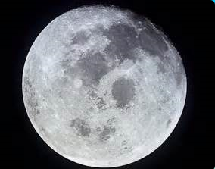
Day 5 – Create a factfile of information. My factfile might start like this:
Space Travel
Neil Armstrong travelled to the Moon.
He was an astronaut.

Slide 21
Day 5 – Create a factfile of information. Now it is your turn. In your homework books create your own factfile about Neil Armstrong.
Remember to include:
A title.
Sentences telling us facts.
Pictures or drawings.

