Slide 1
English Home Learning
Week Beginning 19.10.20

Slide 2
Day 1 - Reading
Sing this rhyme together. Encourage your child to repeat after you.
Incy Wincy Spider climbed up the water spout,
Down came the rain and washed the spider out.
Out came the sunshine and dried up all the rain,
So Incy Wincy Spider climbed up the spout again.
Do you think Incy Wincy Spider likes the rain? Why?

Slide 3
Day 2 Reading and Speaking
Show the picture on the next slide to your child and ask them:
Where do you think this is?
What can you see? How does it look?
Encourage your child to speak in full sentences. Talk to your child about pumpkins and how they are decorated for Halloween.

Slide 4
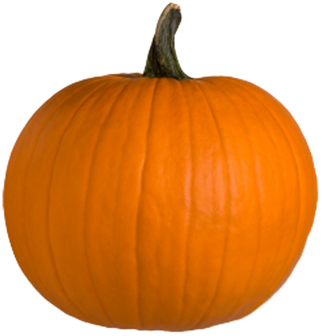
Day 2

Slide 5
Day 3 Speaking
Make some playdough together.
3 cups of plain flour
3 cups of water with added food colouring of your choice
1 ½ cups of salt
6 tablespoons of cooking oil
6 teaspoons of cream of tartar
Put all of the ingredients into a pan over a low heat, and continue to stir until it all comes together. Take out of the pan, let cool and enjoy! If kept in a tupperware tub the playdough should last a while.
Using playdough is really good for your child’s physical skills and encourages communication and imagination. If you already have some playdough you could use it to make Incy Wincy Spider.

Slide 6
Day 4 Phonics
Play a listening game.
Show your child the pictures on the next slide and discuss what kind of sound it might make. Make the sound of one of the pictures and ask your child to guess which sound you are making. Can your child make the sounds for you to guess?

Slide 7
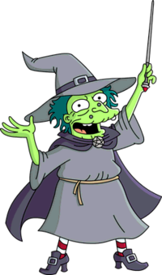
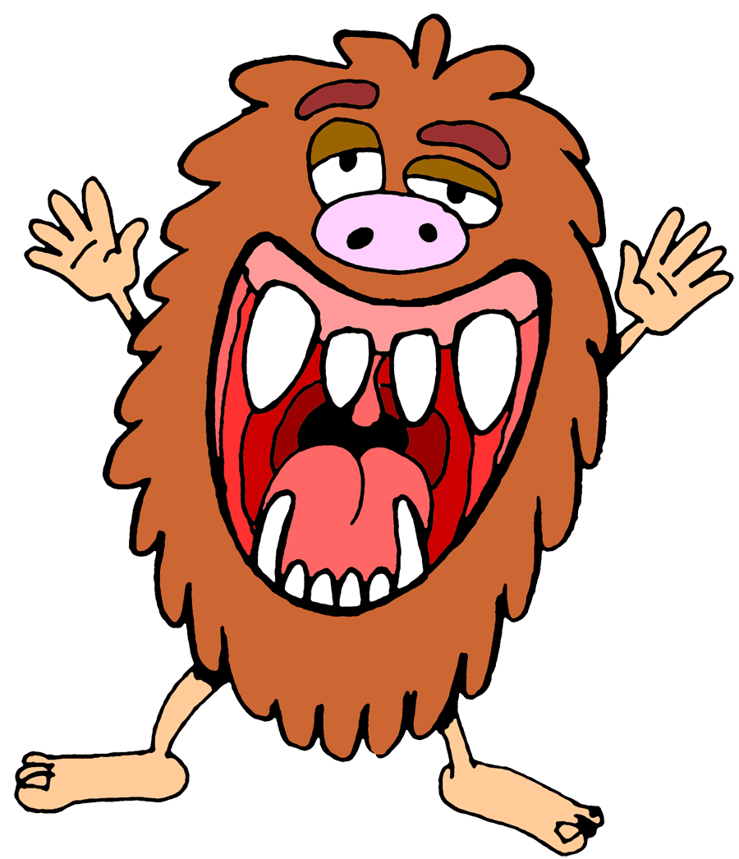
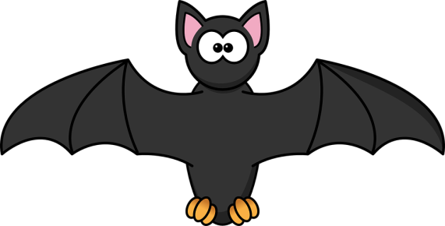
Day 4
Play a listening game.
Hee hee hee! Boo! Flap flap! Raaaa!

Slide 8
Day 5 Communicating
Teach your child the Makaton sign for ‘Please’. Hand moves side to side in waving movement.

