Slide 1
English Home Learning
Week Beginning 12.10.20

Slide 2
Day 1
Sing this rhyme together. Encourage your child to repeat after you.
I'm a little teapot, short and stout, Here is my handle, here is my spout.
When it comes to tea time,
Hear me shout, tip me over and pour me out
What is a teapot for? What do you think spout and stout mean?

Slide 3
Day 2
Show the picture on the next slide to your child and ask them:
Where do you think this is?
What can you see?
What do you think the people will order to eat?
Encourage your child to speak in full sentences. You could even make up your own story to tell together.

Slide 4
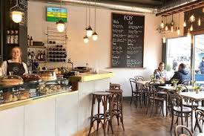
Day 2

Slide 5
Day 3
Make some playdough together.
3 cups of plain flour
3 cups of water with added food colouring of your choice
1 ½ cups of salt
6 tablespoons of cooking oil
6 teaspoons of cream of tartar
Put all of the ingredients into a pan over a low heat, and continue to stir until it all comes together. Take out of the pan, let cool and enjoy! If kept in a tupperware tub the playdough should last a while.
Using playdough is really good for your child’s physical skills and encourages communication and imagination. If you already have some playdough you could use it to make teapots and cups and act out the rhyme.

Slide 6
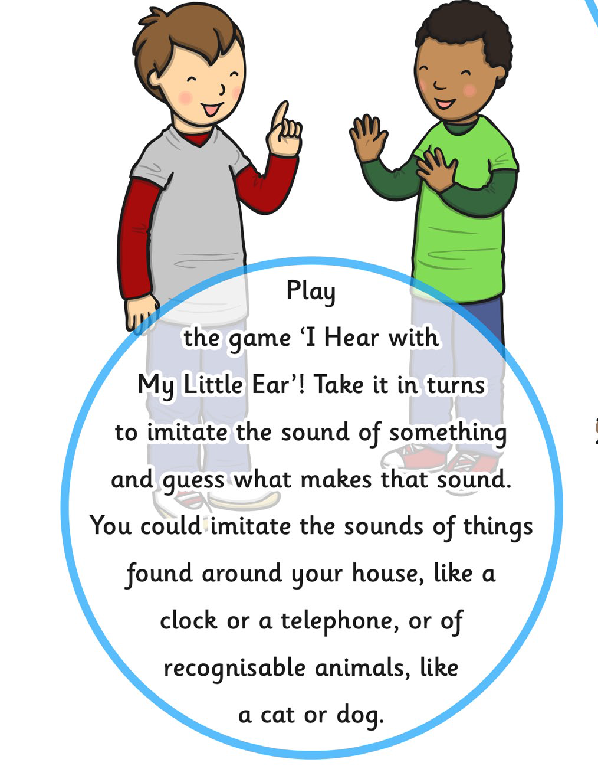
Day 4
Play a listening game.

Slide 7
Day 5
Teach your child the Makaton sign for ‘Thank you’. Hand moves side to side in waving movement.

