Slide 1
Curriculum
Week Commencing: 12.10.2020

Slide 2
This Week
Day 1: Science- Complete the life cycle of a flowering plant
Day 2: Science- Explain how seeds are dispersed
Day 3: Spanish- Learn how to say your nationality.
Day 4:Music- Creating a chant
Day 5: PE-Practise your dance movements

Slide 3
Day 1 and 2- Plants

Slide 4
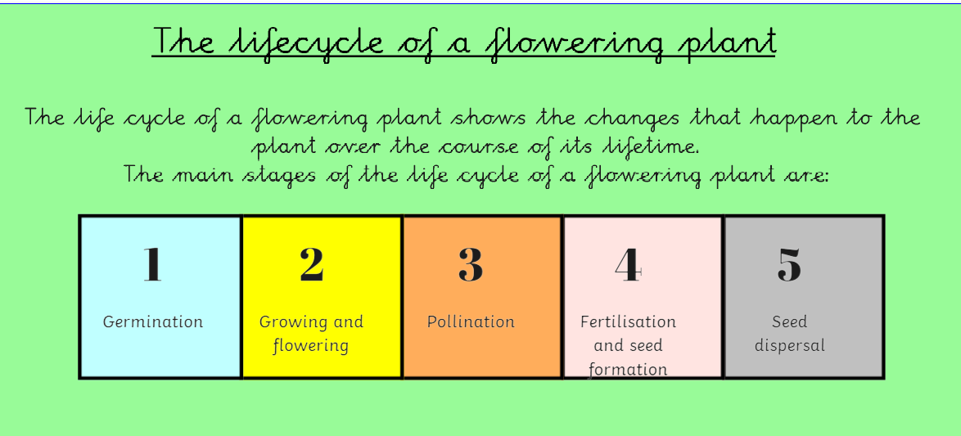
Watch this video to find out more
https://www.bbc.co.uk/bitesize/clips/z3wsbk7

Slide 5
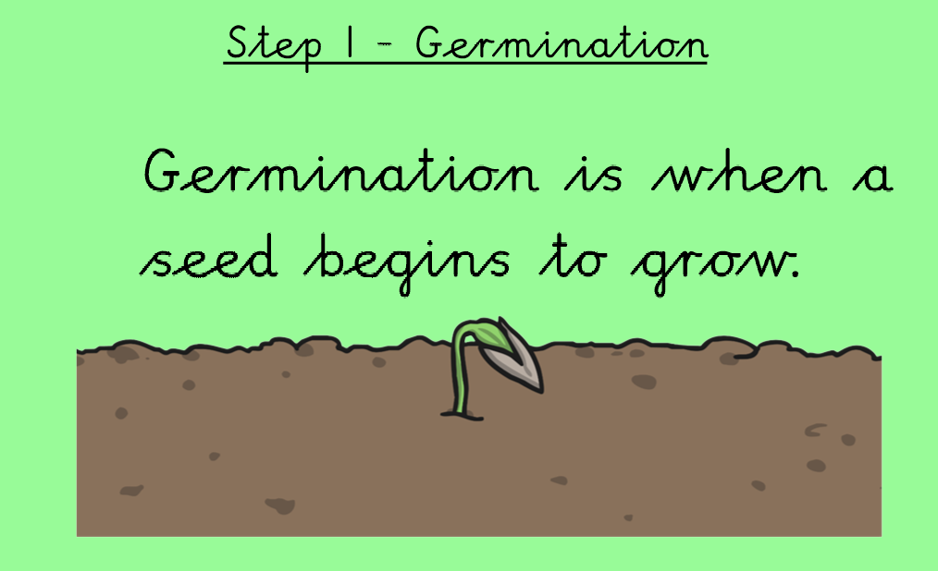
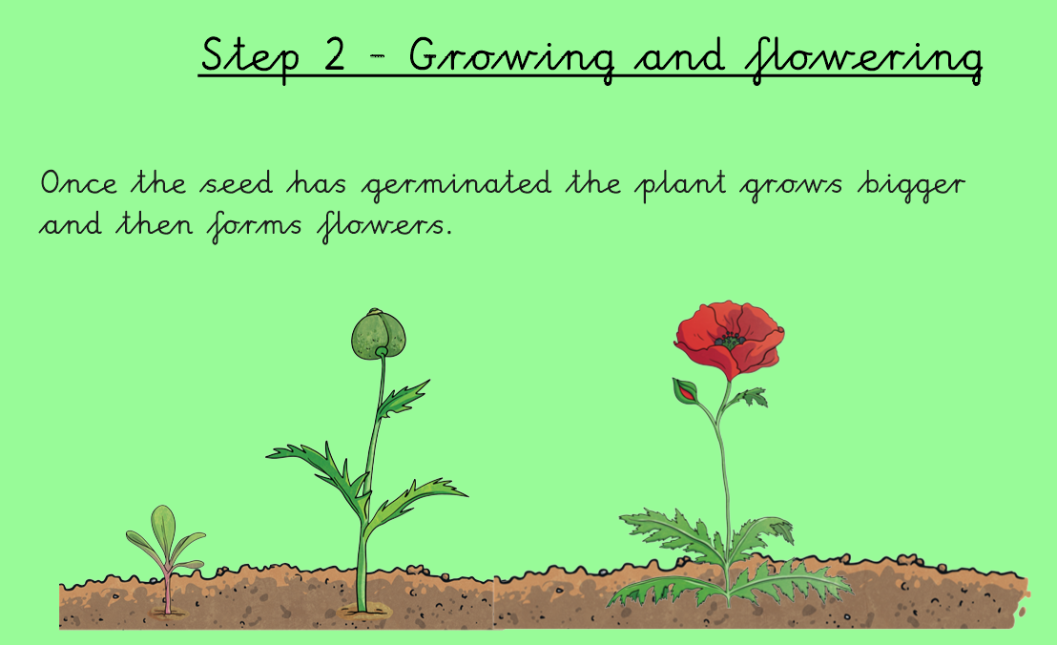

Slide 7
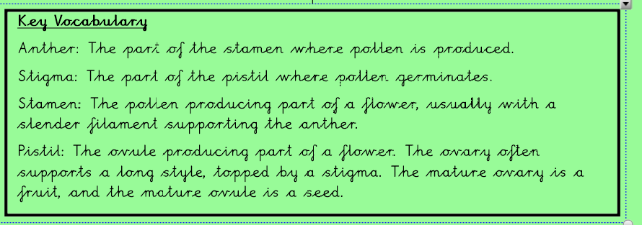
https://www.bbc.co.uk/teach/class-clips-video/science-ks1-ks2-ivys-plant-workshop-what-is-pollination-and-how-does-it-work/zv4df4j

Slide 8
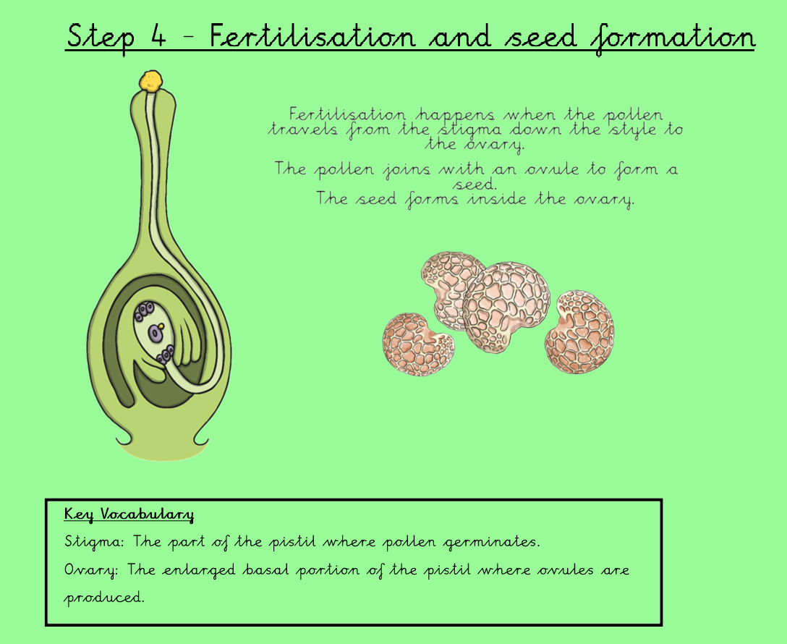
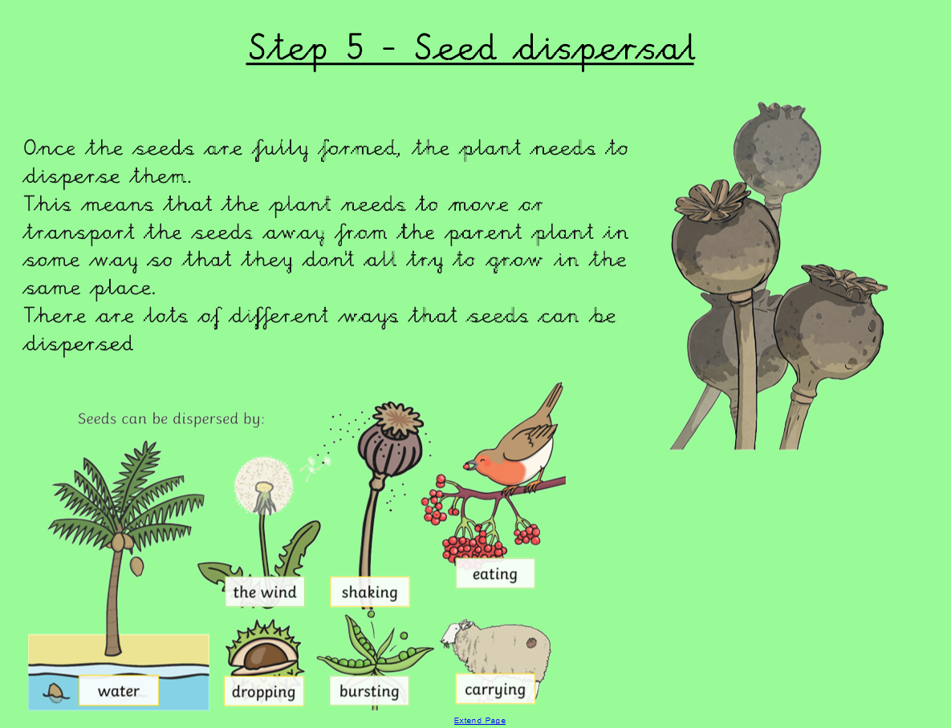

Slide 10
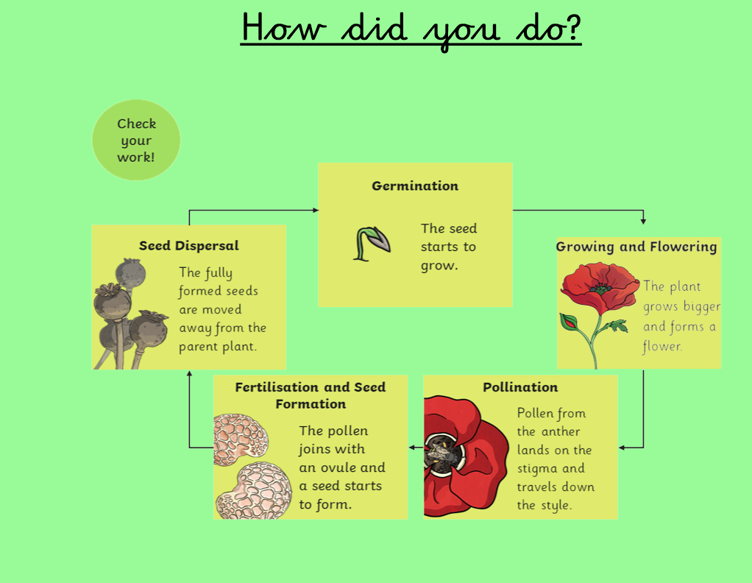

Slide 11
Day 3- Spanish
Starter-
https://rockalingua.com/games/colors

Slide 12
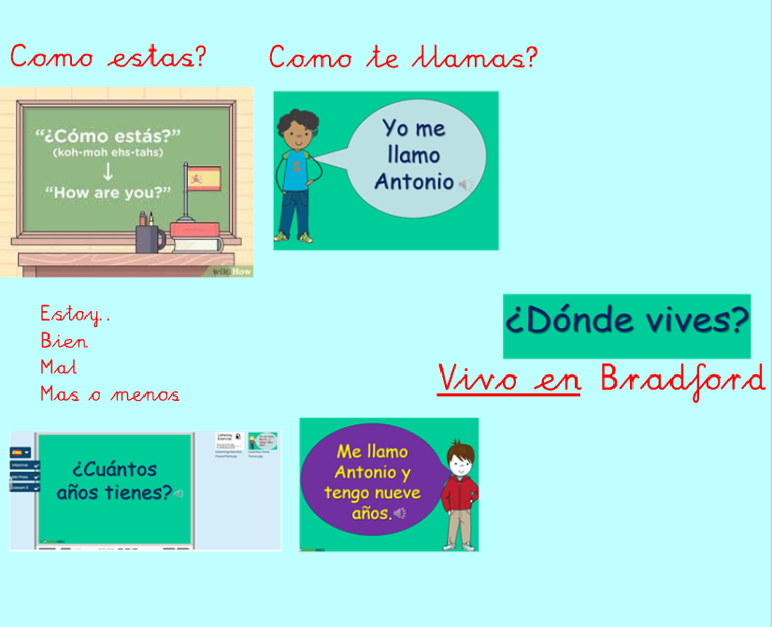
Day 3- Spanish

Slide 13
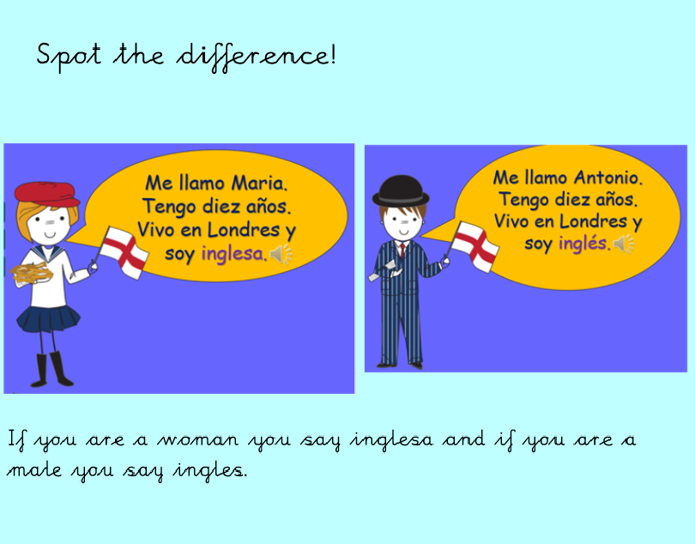
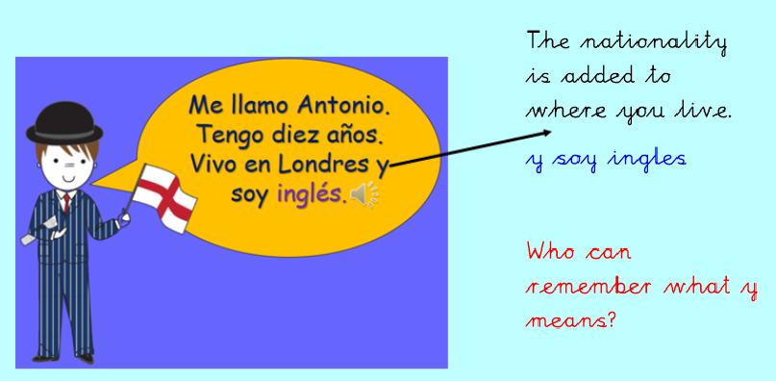
Day 3- Spanish

Slide 14
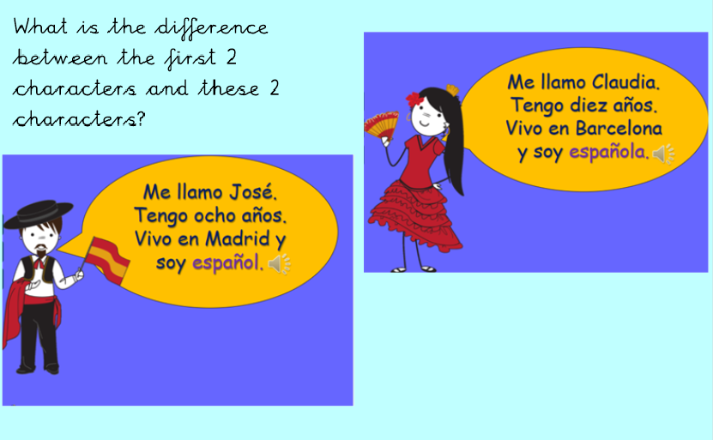
Day 3- Spanish

Slide 15
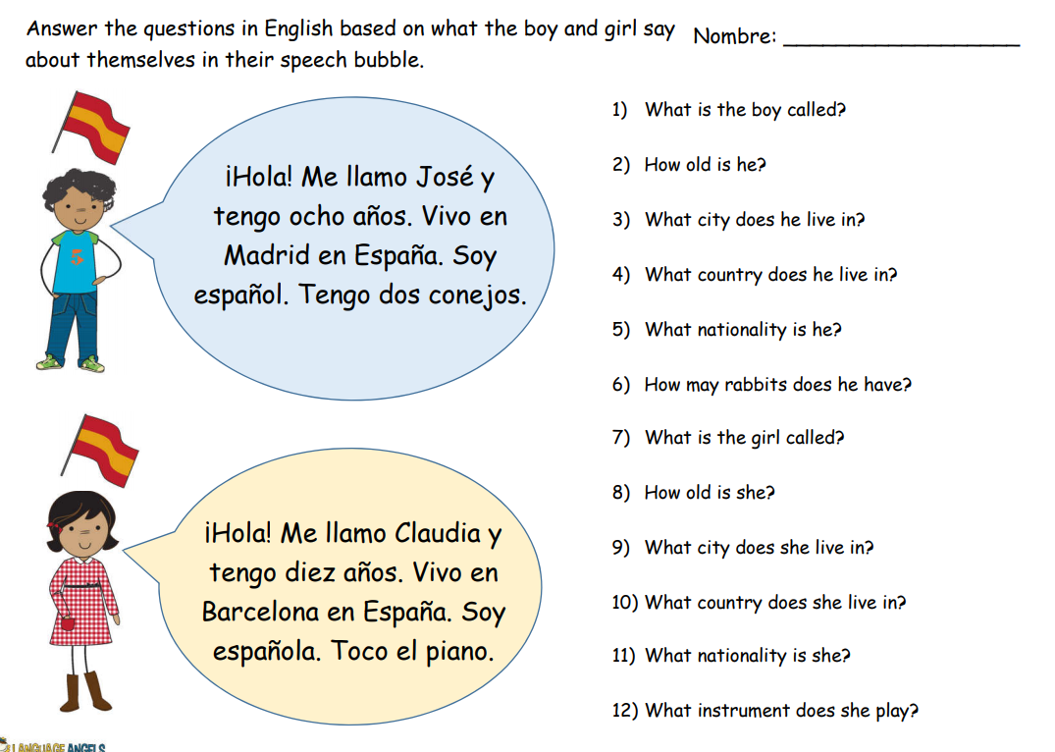
Day 3- Spanish

Slide 16
Today we will create our own class chant
Day 4- Music

Slide 17
What is a chant?
A chant is a repeated rhythmic phrase, typically one shouted or sung in unison by a crowd.
Near enough every football team has their own football chant. Fans usually sing this before, during and after the game (all the time).
Where else may people use a chant?

Slide 18
Chant Examples
https://www.youtube.com/watch?v=uchOo5HU95s
Here is an example of a chant for the best football team in the world! (Watch the clip above).
What did you notice about the chant?
Rhymes
Has a chorus
Short sentences
Rhythm

Slide 19
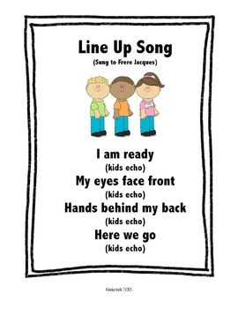
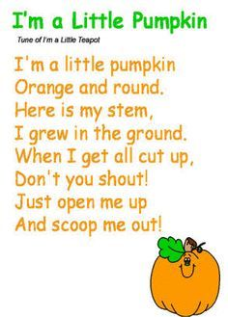
Here are some more chants – You can create a chant for more or less anything

Slide 20
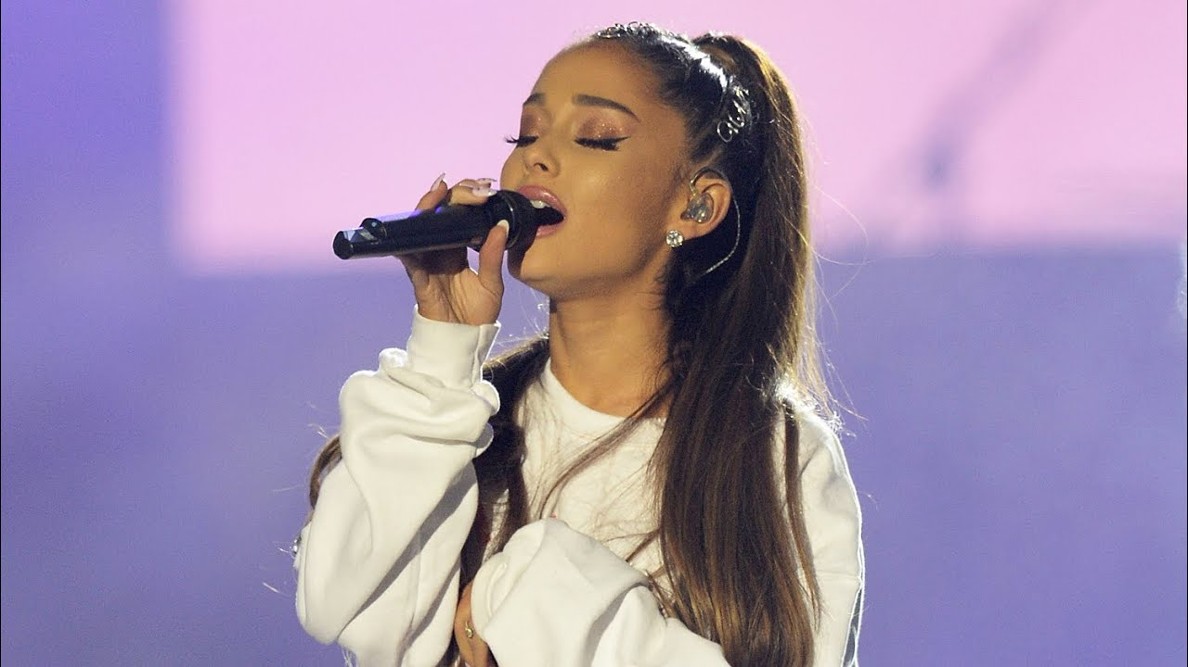
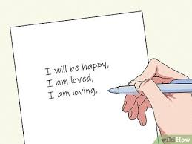
Today you will create your own class chant
https://www.youtube.com/channel/UCKWqFz3H_NK1Z9Ii43VB7iA
This could be the background music to your chant or some of you could clap as you sing a long.
Have a look at the Year 4 chant on the next slide!

Slide 21
Year 4 Chant! Created by Ms. McCallion Co produced by Mr. Mahmood
We’re year 4,
Learning everyday,
Finding every possible way.
Challenges, what?
We don’t say not!
Watch us get hot,
We’ll learn a lot!
We’re year 4,
Learning everyday,
Finding every possible way.

Slide 22
Challenge
Add some claps and stomps.
Add some actions
Add some similes.
https://www.youtube.com/watch?v=gavT_q9CLME

Slide 23
Day 5 – PE
Dance
Watch the video using the link below to remind you of the Waka Waka dance
https://www.youtube.com/watch?v=E9ohdRq1Ovs

Slide 24
‘WAKA WAKA’ Dance
https://www.youtube.com/watch?v=E9ohdRq1
WATCH this video to remind yourself of the ‘Waka Waka’ dance
Watch the ‘Waka Waka’ video and substitute your own movements to create your own dance sequence
Pick out each level from the video: low, medium or high. Then find 3 movements for each level. Once you have the three movements, think about the appropriate transition to link the movements.
On the other hand, if you want to just copy the dance you can watch the clips and have a go!
LETS DANCE!!

