Slide 1
English Home Learning
Week Beginning 28.9.20

Slide 2
This week…
Day 1 – Grammar – Using inverted commas correctly
Day 2 – Introduce – Reading text and answer questions
Day 3 – Looking at character description
Day 4 – Beginning to plan your character description
Day 5 – Writing your description on your own

Slide 3
Day 1 – Grammar – Using inverted commas correctly.
What is an inverted comma?
When do we use an inverted comma?
When you are writing, inverted commas or speech marks go before and after direct speech, surrounding what was said.
For example: "I'm hungry," she complained.
https://www.bbc.co.uk/bitesize/topics/zvwwxnb/articles/ztcp97h

Slide 4
Look at this example…

Slide 5
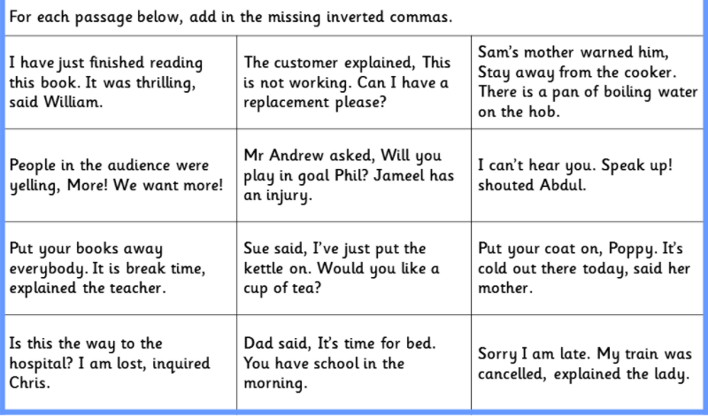
Check whether the sentences are correct or not and write these into your book.

Slide 6
Create some sentences that include the correct use of inverted commas.
Create 3 sentences in your book.
For example: Mrs Patankar shouted, “I want to have dinner!”

Slide 7
Day 2 – Reading comprehension
To be able to understand a text
Complete task 1 and 2

Slide 8
Day 2 - Bug Club – Read text
Book title: Rat Island by Stu Duval. Use the link below to login to Bug Club then access through your library.
https://www.activelearnprimary.co.uk/

Slide 9
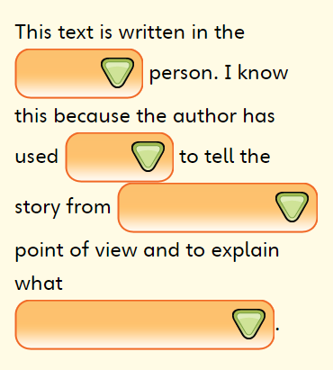
Day 2 - Task 1 Use the words at the bottom of the page to fill in the gaps- use pages 6 and 7
Tam Spratley’s
I
First
Tam thinks and feels

Slide 10
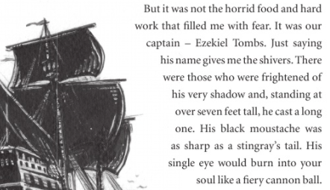
Day 2 -Task 2 Use the description of the captain to draw a picture in your book.

Slide 11
Day 3 - Look at the character description. What do you learn about her personality.

Slide 12
Day 4 - Create your own character description. Copy and complete the table below in your books.
Eyes | Ears | Mouth | Body | Nose
Size Colour Glasses? | Size Colour | Size Shape | Height Arms Legs Hair? Neck? Weight? | Size Shape

Slide 13
Day 5 – Task 1 – Write your own character description.
Remember :
Write your description in your Home Learning book.
You should be writing in full sentences, starting with a capital letter and ending with a full stop.
Our grammar focus is inverted commas. Make sure that you use this skill and include some in your description. If you have forgotten what they are then look at Day 1 on this PowerPoint.

