Slide 1
Year 1 Maths Home Learning
Week Beginning 21.9.2020

Slide 2
This Week………
Day 1: Slides 3-5: Maths Pictorial Counting to 20
Day 2: Slides 6-7: Maths Practical Missing Numbers
Day 3: Slides 8-10: Maths Abstract Missing Numbers
Day 4: Slide 11: Maths Pictorial One More Than
Day 5: Slides 12-14: Maths Abstract One More Than

Slide 3
Maths Pictorial Lesson
Let's count to twenty together!
https://www.youtube.com/watch?v=D0Ajq682yrA

Slide 4
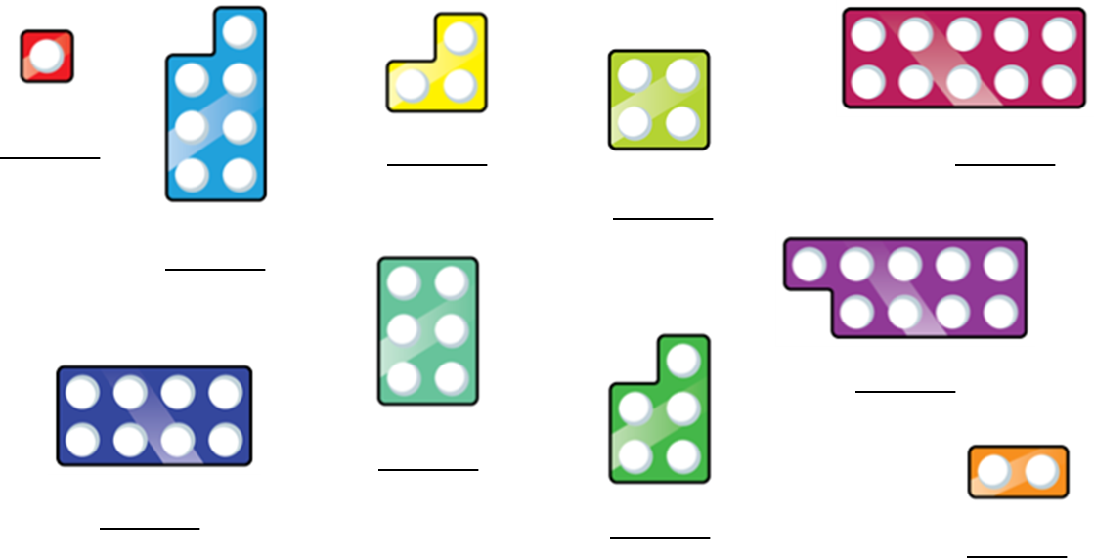
Maths Pictorial Lesson
Count how many each is worth.

Slide 5
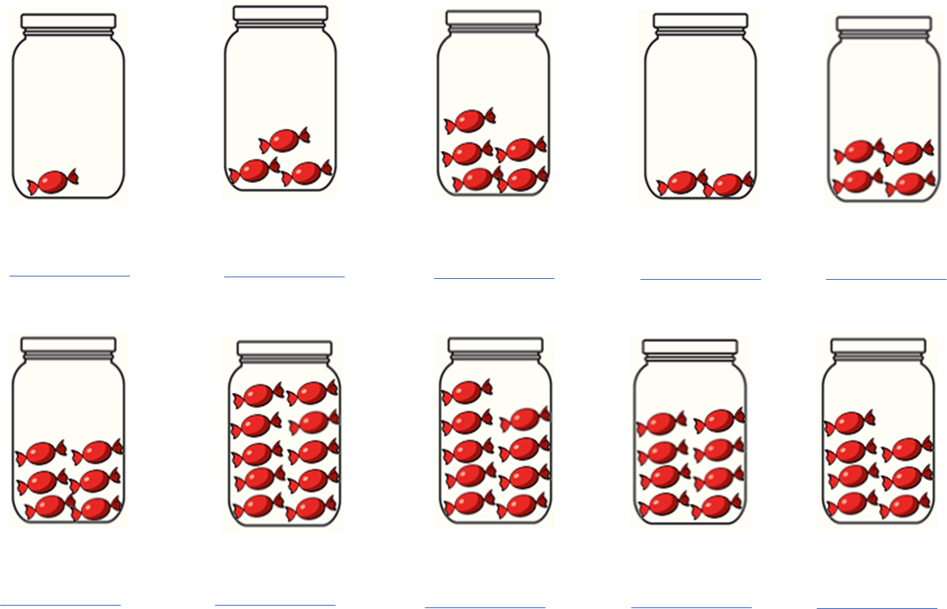
Maths Pictorial Lesson
Count how many each is worth.

Slide 6
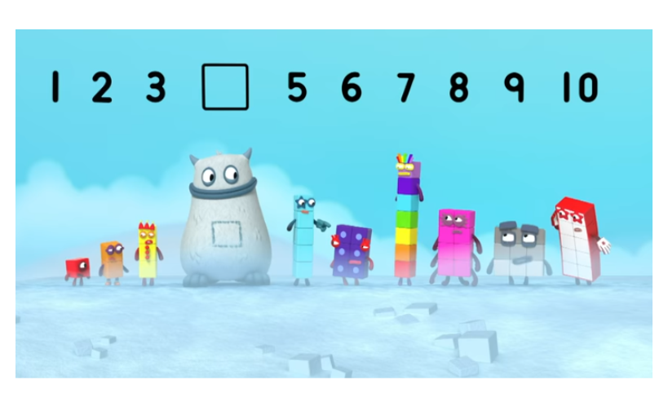
Maths practical lesson
Today we are learning about missing numbers in a sequence up to 20.
Let’s start by watching a quick video!
https://www.youtube.com/watch?v=dBKyiYq5k98

Slide 7
Maths practical lesson
Now practise drawing the numbers and writing the words.

Slide 8
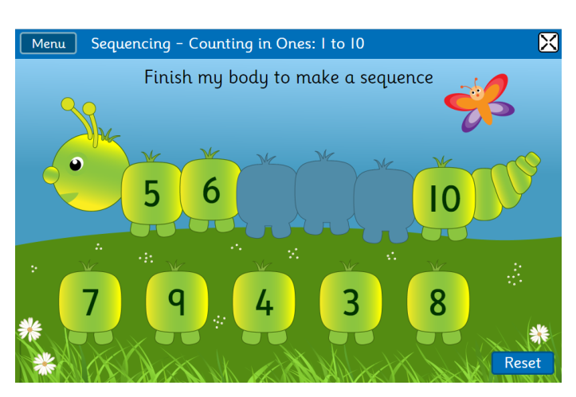
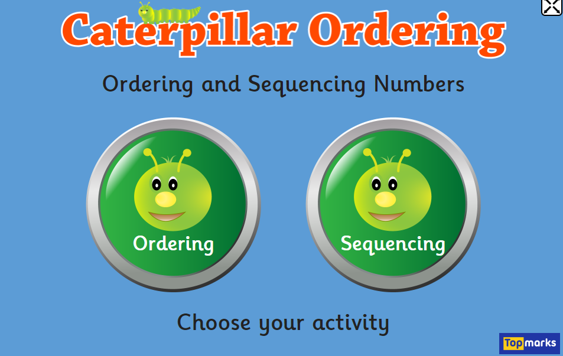
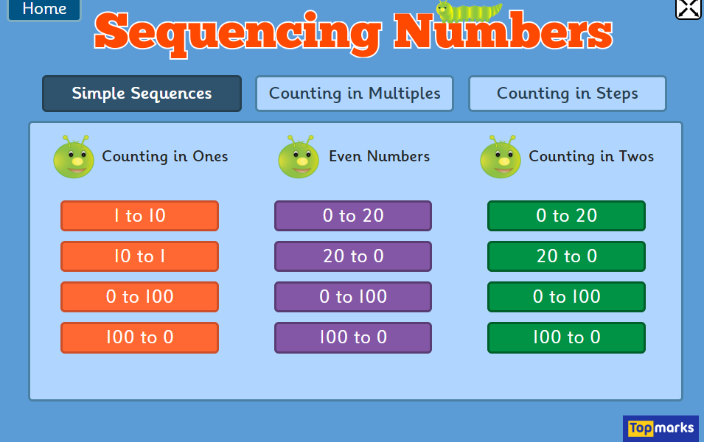
Maths Abstract lesson
https://www.topmarks.co.uk/ordering-and-sequencing/caterpillar-ordering
Sequencing
1 to 10
Further Challenge: Do the task for 0-100

Slide 9
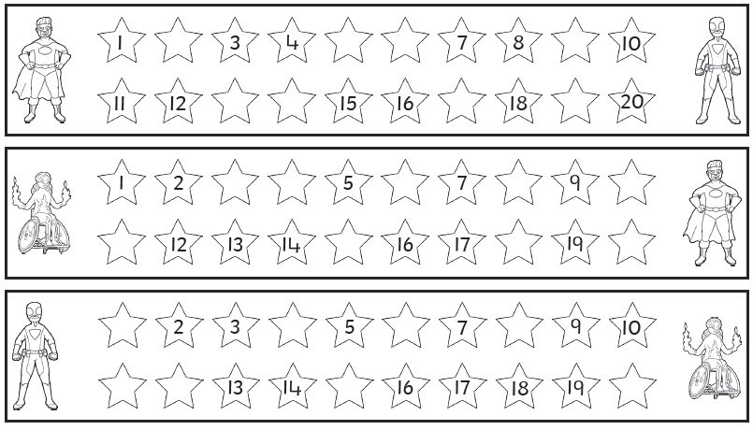
Maths Abstract task
We are learning to count in ones to find missing numbers.
Can you count in ones to find the missing numbers?

Slide 10
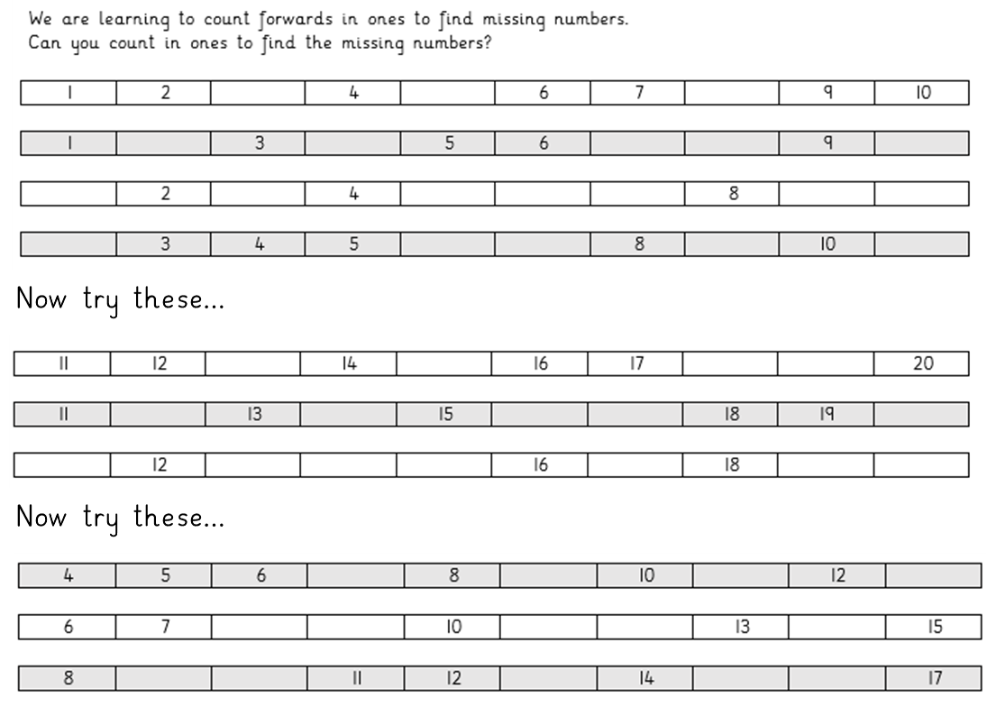

Slide 11
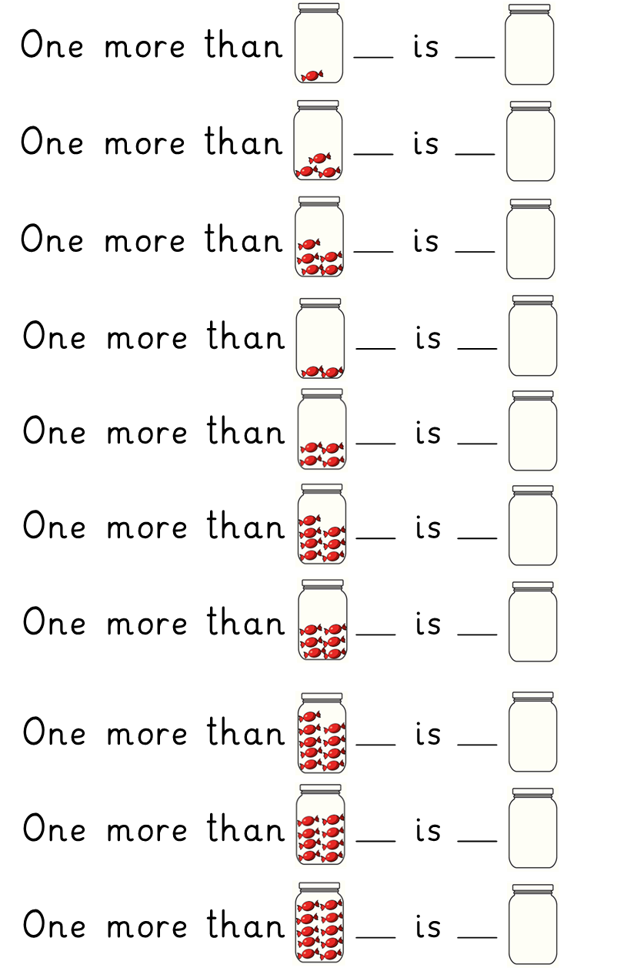
Maths Pictorial Lesson
Count the sweets in the jar and write the number next to it.
What is one more than this number?
You could draw one more sweet and count them again if you want.
Write this new number down.
Draw the correct number of sweets for the new number.

Slide 12
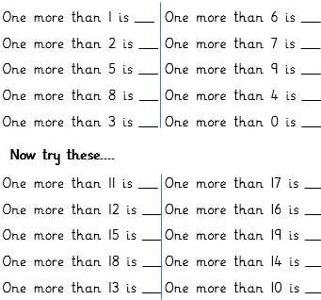
Maths Abstract task
What is one more than each of these numbers?
Try putting the number in your head and counting on one, or find the next number on the number track below to help.

Slide 13
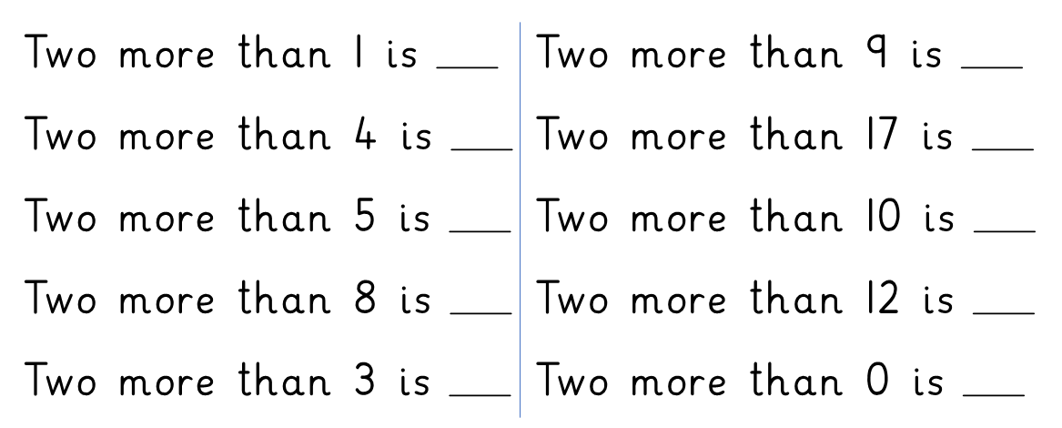
Maths Abstract task
Further Challenge
What is TWO more than each of these numbers?
Try putting the number in your head and counting on TWO, or use the number track below.

Slide 14
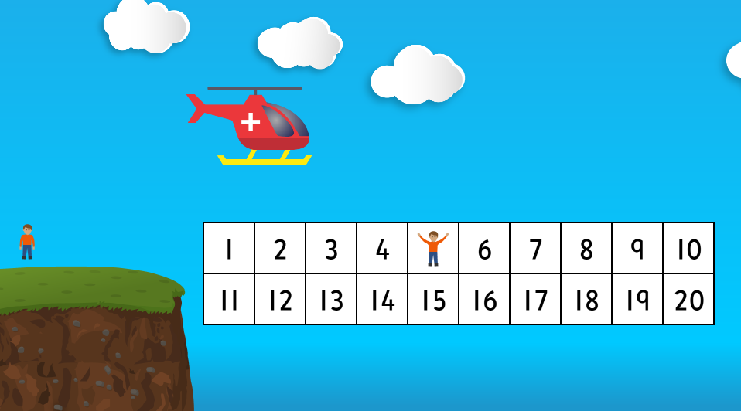
Maths Abstract lesson
https://www.topmarks.co.uk/learning-to-count/chopper-squad

