Slide 1
Maths Home Learning
Week Beginning 21.9.20

Slide 2
Day 1 - numbers
Sing this number rhyme together:
1,2,3,4,5.
Once I caught a fish alive.
6,7,8,9,10.
Then I let it go again.
Why did you let it go?
Because it bit my finger so.
Which finger did it bite?
This little finger on my right.
Encourage your child to use their fingers to count. You could even make some paper fish to count!

Slide 3
Day 2 - counting and colours
Go on a treasure hunt around the house. Can you find 5 things that are red/blue/green?

Slide 4
Day 3 - Counting
Use the play dough you made (see English) to make 5 pretend cakes. Count them to check you have enough.

Slide 5
Day 4 - Counting
Count some actions.
Can you clap 5 times?
Can you jump 5 times?
Can you nod your head 5 times?
Can you think of your own action?

Slide 6
Day 5 - Counting
Look at the picture on the next slide and count the sheep together.

Slide 7
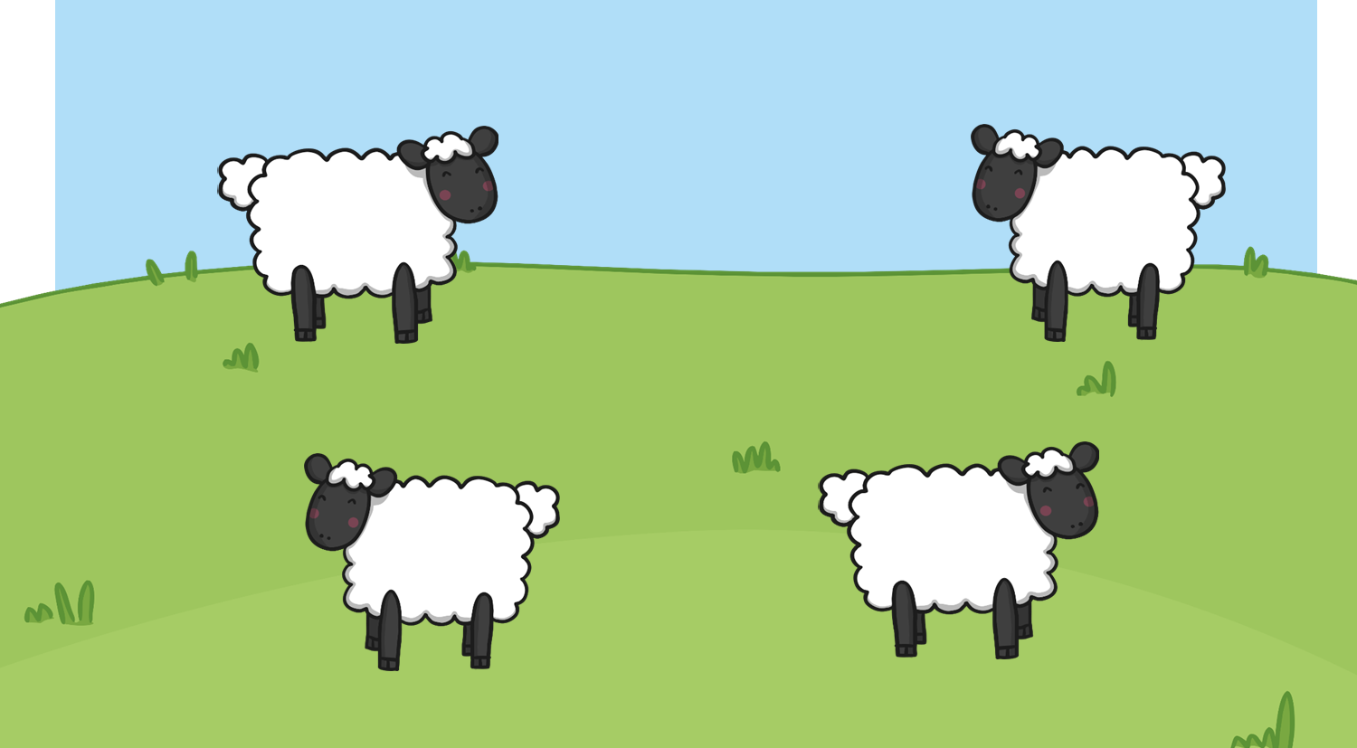
How many sheep in the field?

