Slide 1
Year 3 Home learning! English
Week Commencing: 28th September 2020

Slide 2
This week..
Day 1: Grammar- Conjunctions
Day 2: Reading comprehension
Day 3: Diary entries
Day 4: Key feature of a diary entry
Day 5: Write your own diary entry

Slide 3
Day 1- Grammar

Slide 4
Day 1- Grammar
Today we are going to be learning all about conjunctions.
What is a conjunction?
A word that is used to connect sentences together
Can you think of any?

Slide 5
Day 1- Grammar
Examples of conjunctions!
and because if but or so
Lets find out more!
Click me

Slide 6
Day 1- Grammar
Can you find them in the sentences below?
1. Rapunzel enjoyed going to watch exciting films at the cinema and going to the park with her friends.
2. Mr Smith had fun walking for miles all over England but he disliked it when it rained.
3. On Wednesday we bring our homework book in so we can stick new homework in for the week.
4. Maths if my favourite lesson because it’s lots of fun!

Slide 7
Day 1- Grammar
Lets see if you were right!
Rapunzel enjoyed going to watch exciting films at the cinema and going to the park with her friends.
2. Mr Smith had fun walking for miles all over England but he disliked it when it rained.
3. On Wednesday we bring our homework book in so we can stick new homework in for the week.
4. Maths if my favourite lesson because it’s lots of fun!

Slide 8
Now it’s your turn to write some sentences!
Here is a list of conjunctions! Can you write some sentences including a conjunction. REMEMBER to use capital letters and full stops and see if you can include some adjectives as well!
and
because
or
so
but
if

Slide 9
Day 2
Reading Comprehension!
Task 1- Read the book
Task 2- Answer the questions! Today you are going to read a book and answer questions about the text ‘Escape in Egypt’
You can access the text via bugclub using your login details!
Click the image below to follow the link!

Slide 10
Day 2- Reading Comprehension!
CLICK ME FOR A REMINDER
I hope you enjoyed reading all about ‘Escape to Egypt’
In your homework book, answer the questions below.
Who is the author of the book?
Which adjective was used to describe the pyramids on page 4?
On page 5 it say’s “I had a book about a mummy”. Was it talking about their mum or something different?
Who is Samir?
After you have finished your sentences, you can illustrate your work!

Slide 11
Day 3

Slide 12
Today we are going to look at different diary entries.

Slide 13
These are the key features of a diary entry.
Start with the date. Write in the past tense. Write in the first person - I, my, we, our Write as if you were there. Write in the order the events happened. Describe my feelings. Use time linking words - next, first, then, finally. Talk about where the events happened.

Slide 14
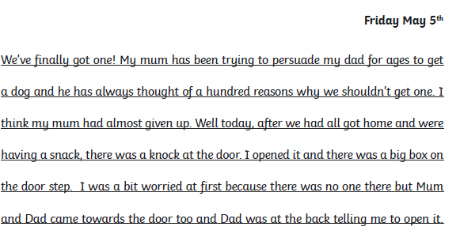
Look at this diary entry, which key features can you find? Make a list in your book.

Slide 15
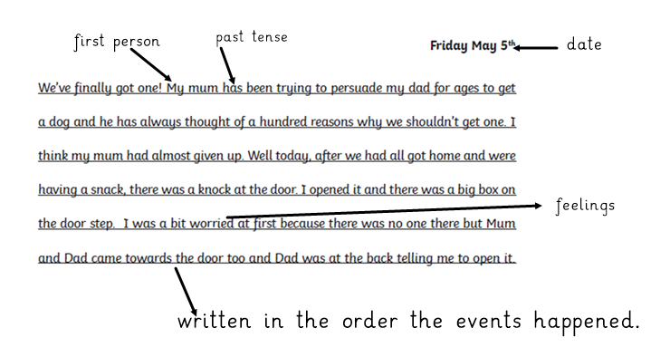
These are some of the key features I found, did you find any others?

Slide 16
Day 4

Slide 17
Today we are going to think about the features of a diary entry. Can you remember what they are?

Slide 18
Start with the date. Write in the past tense. Write in the first person - I, my, we, our Write as if you were there. Write in the order the events happened. Describe my feelings. Use time linking words - next, first, then, finally. Talk about where the events happened.

Slide 19
Read this diary entry.
Tuesday 23rd September.
I woke up very early in the morning so it was still dark and gloomy outside. I felt extremely tired. First I jumped out of my cosy bed and brushed my teeth carefully. After that I washed my face. My mum started calling me so I rushed downstairs and ate my delicious breakfast. I knew that I was going to have a busy day so I made sure I had two slices of toast.
Soon it was time to go to school. I managed to get as far as our gate when I realised that I had forgotten my book bag, I needed that so I could hand in my homework. The rest of the day passed by so quickly and very soon it was time for home. When I got home I had time to read my book and watch some TV but all too soon it was time for me to go back to my cosy bed. The end of another fun packed, exciting day!

Slide 20
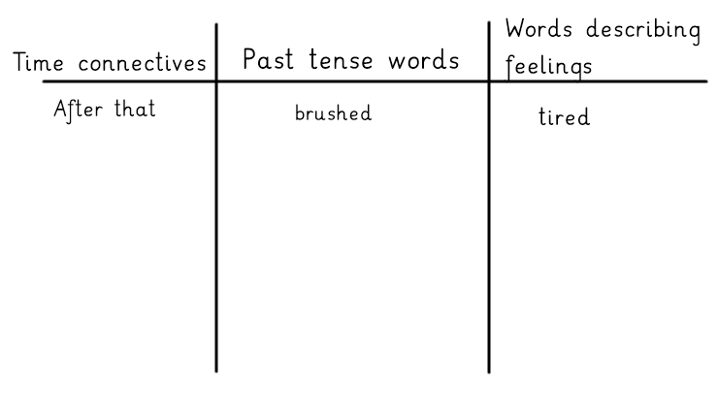
Draw this table in your book and then look back at the diary entry. Write all the key features you can find in the correct column. I have done one for you.

Slide 21
Day 5

Slide 22
Today you are going to write your own diary entry. Remember to look back at the slides for days 3 and 4, especially the key features of a diary entry.
You can choose to write about any day, but it must be a day that has already happened. Remember to make it interesting and only write about the most exciting things that happen to you. You don’t have to include every thing you do.
Make sure you have used all the key features as well as capital letters and full stops in the correct places, adjectives (describing words) and conjunctions (and, but, so, because.)

