Slide 1
Describe, name and sort 3-D shapes.
How many edges, vertices and faces does this cube have?
That’s 9 edges …plus the 3 that we can’t see, makes 12.
12 edges
8 vertices
6 faces
Notes:
Hold up a cube. Point to the faces, edges and vertices on the cube.

Slide 2
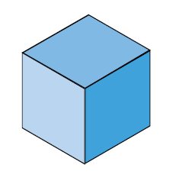
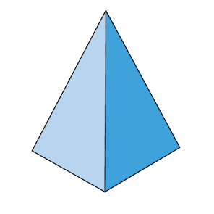
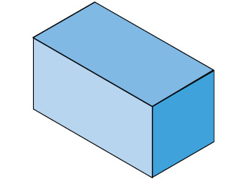
Describe, name and sort 3-D shapes.
A polyhedron is a solid shape with all flat faces. It doesn’t have any curved faces.
Notes:
Look at a selection of 3-D shapes.

Slide 3
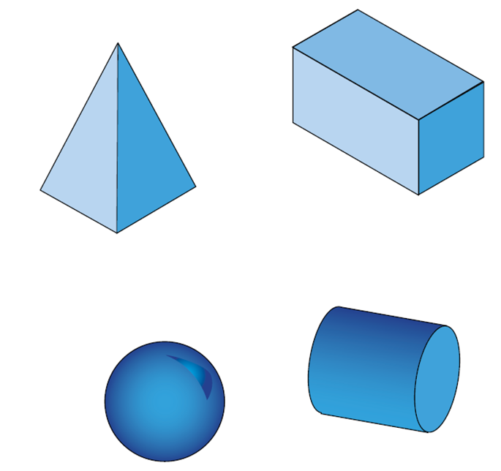
Describe, name and sort 3-D shapes.
Which of these shapes are not polyhedrons?

Slide 4
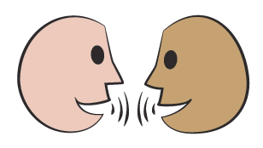
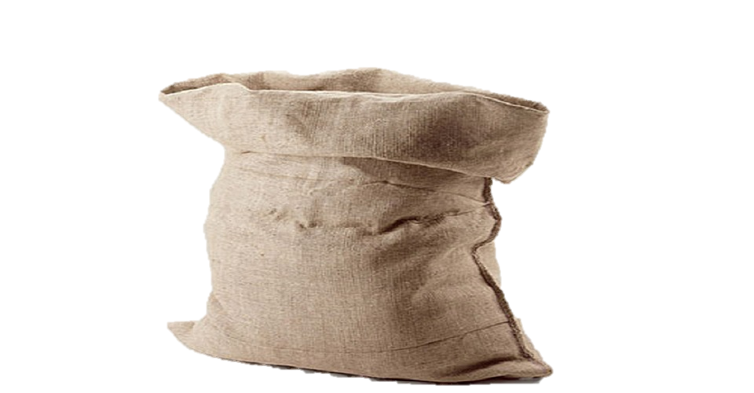
There is a 3-D shape in this bag. Read each clue… What do you think it might be? What can’t it be?
Describe, name and sort 3-D shapes.
It is not a polyhedron.
It has 3 faces, no vertices, and 2 edges.
2 faces are circles.

Slide 5
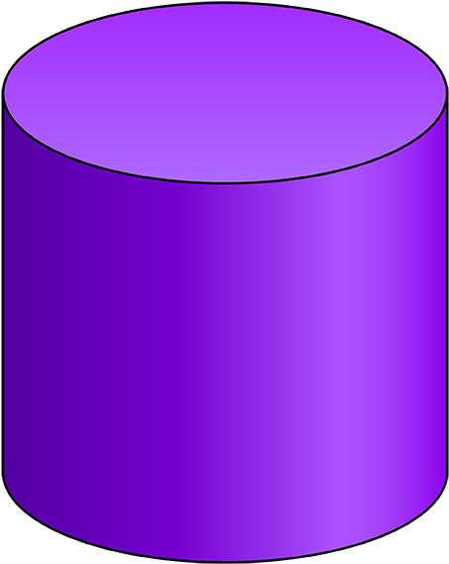
Describe, name and sort 3-D shapes.
It is a cylinder!

Slide 6
There is a 3-D shape in this bag. What do you think it might be? What can’t it be?
Describe, name and sort 3-D shapes.
It is a polyhedron.
It has 6 faces, 8 vertices, and 12 edges.
4 faces are not squares.

Slide 7
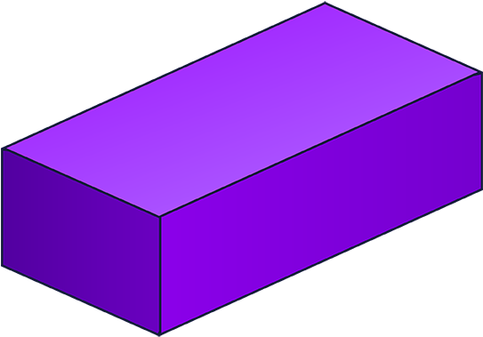
Describe, name and sort 3-D shapes.
It is a cuboid!

Slide 8
There is a 3-D shape in this bag. What do you think it might be? What can’t it be?
Describe, name and sort 3-D shapes.
It is a polyhedron.
It has 5 faces, 6 vertices, and 9 edges.
3 faces are rectangles and 2 faces are triangles.

Slide 9
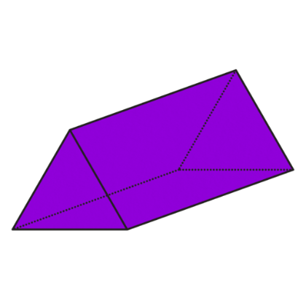
Describe, name and sort 3-D shapes.
It is a
triangular prism!
You might not have known the name of this shape, but could you imagine what it looked like?

